Slide 1
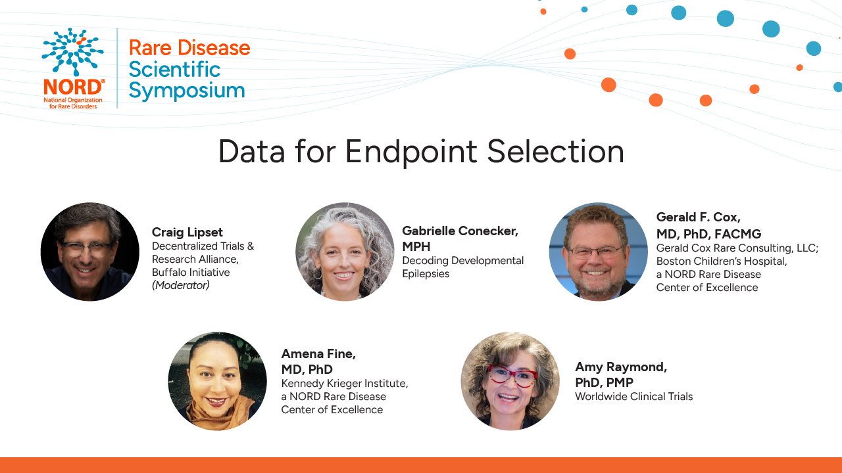

Slide 2
Data for Endpoint Selection
Gerald F. Cox, Md, PhD

Slide 3

The Art and Science of Selecting Endpoints
in Rare Disease Clinical Trials
Gerald F. Cox, MD, PhD, FACMG
Staff Physician in Genetics, Part-time
Boston Children’s Hospital

Slide 4
Endpoint Objectives
Target Engagement
Pharmacodynamics
Clinical Benefit
Is the drug active?
Proximal biomarker tied to MoA of drug
Is there a biological effect?
Downstream biomarkers from MoA of drug
Is the drug effective?
Feels, functions, or survives
MoA, mechanism of action

Slide 5
PathMap for Gaucher disease type 1
Level | Gene | Protein | Biochemical | Cell | Organ | Early Clinical | Late Clinical
Feature | Biallelic GBA mutations | GCase deficiency | Increased GL-1, and lysoGL-1 substrates | Accumulation of substrate leads to lysosomal expansion and dysfunction, transforming macrophages into Gaucher cells | Infiltration of liver, spleen and bone marrow by Gaucher cells | Hepatomegaly Splenomegaly Hypersplenism Anemia Thrombocytopenia Low BMD Delayed growth and puberty | Splenic rupture Bleeding Blood & platelet transfusions Skeletal pain, infarcts, and fractures Fatigue Low QoL Disability
Assay | DNA sequence | Activity assay | Plasma LC-MS/MS | Lysosomal volume (IFM) and substrate (LC-MS/MS) in PBMCs | Tissue levels of Gaucher cells (IFM) and substrates (LC-MS/MS) Chitotriosidase CCL-18 | Liver& spleen volume (MRI) Hemoglobin Platelets BMD (DXA) BMB (MRI) AGV/Tanner Stage Gaucher DSS | # transfusions # fractures Pain, fatigue scores SF-36, EQ-5D ADL score Ht, Wt Z-scores Gaucher DSS
AGV, annualized growth velocity; BMB, bone marrow burden; BMD, bone mineral density; DSS, disease severity score; IFM, immuno-fluorescence microscopy; LC-MS/MS, liquid chromatography-tandem mass spectrometry;
PBMC, peripheral blood mononuclear cells

Slide 6
Endpoint Development
Concept of Interest (COI)
Clinical Outcome Assessment (COA)
Context of Use (COU)
What domain is being measured?
What is the desired outcome?
How is it being measured?
Is it subjective or objective?
What is clinically meaningful?
Why, where, when, and in whom is it being measured?
Intended claim?
Geography, language, culture, clinical practice SoC?
Central reader?
Frequency?
Patient subset?

Slide 7
Endpoint Alignment with Disease Stage and Drug Effect
Disease course
  Rapid vs slow progression
  Frequency of events vs continuous change
  Responders vs non-responders
  Single vs co-primary vs composite vs multi-domain endpoints
Drug effect – dictates disease stage and trial designs
  Improvement vs stabilization
  Prevention vs reversal
  Transient effect – cross-over, N-of-1
  Durable effect – parallel group

Slide 8
Endpoint Attributes – Validation
Validation Element | What It Answers | Type | When Established
Face | Does it look appropriate? | Qualitative | Early
Content | Does it cover the domain? | Qualitative | Early–mid
Sensitivity | Can it distinguish groups? | Quantitative | Mid
Analytical | Is it technically reliable? | Quantitative | Mid
Change | Can it detect within-person change over time? | Quantitative | Late

Slide 9
Endpoint Attributes – Feasibility
For the Subject & Family
Study burden fatigue
  Duration of assessment
  Frequency of assessment
  Travel to clinic for assessment
  Invasiveness of assessment
  Risks of assessment
For the Sponsor
Logistical complexity and cost
  Ensure availability at all clinical sites
  Validate translation of questionnaires
  Assay development and validation
  Disease-specific assessment development and validation
  Training of assessors
  Standardization of assessments
  Central labs and readers

Slide 10
Endpoint Attributes – Effect Size
Intended treatment effect must be statistically significant and clinically meaningful
Effect size (mean change/SD change) is inversely proportional to sample size
Sample size is determined by power (80-90%), statistical significance (p< 0.5), and effect size
SES | N per Group
1.5 | 7
1 | 16
0.8 | 26
0.5 | 63
0.25 | 251
Sample size calculations based on 80% power and P <0.05 (two-tailed)
Cox GF, Am J Med Genet A. 2018;176:759-772

Slide 11
Endpoint Attributes – Interpretation
Clinically meaningful change is recognized by the patient and/or clinician as providing clinical benefit
Clinical benefit can be interpreted in complementary ways:
  Minimum (clinically) important difference (MCID or MID) – mean change
  Cohen’s effect size (Cohen’s d) – 0.2 (small); 0.5 (medium); 0.8 (large)
  Responders – % of subjects who achieve MCID/MID
  Number needed to treat – number of subjects required to produce one responder
  Statistical rationale – change exceeds assay variability (e.g., 3 SD)

Slide 12
Endpoint Attributes – Natural history
Characterizing potential endpoints for a clinical trial (desired outcome)
  How many patients have abnormal values? (higher prevalence)
  How abnormal are the values? (moderate to severe)
  How fast does the disease change? (faster rate of progression)
  How often do events occur? (higher frequency)
  How predictable is the change over time? (lower standard deviation)
  How homogeneous are the patients? (responsive sub-population)
  Are there known disease modifiers? (stratify or exclude sub-populations)
Understanding these characteristics aids in endpoint selection and sample size determination

Slide 13
Thank You

Slide 14
Data for Endpoint Selection
Amena Smith Fine, MD PhD
Assistant Professor Neurology
Kennedy Krieger Institute

Slide 15
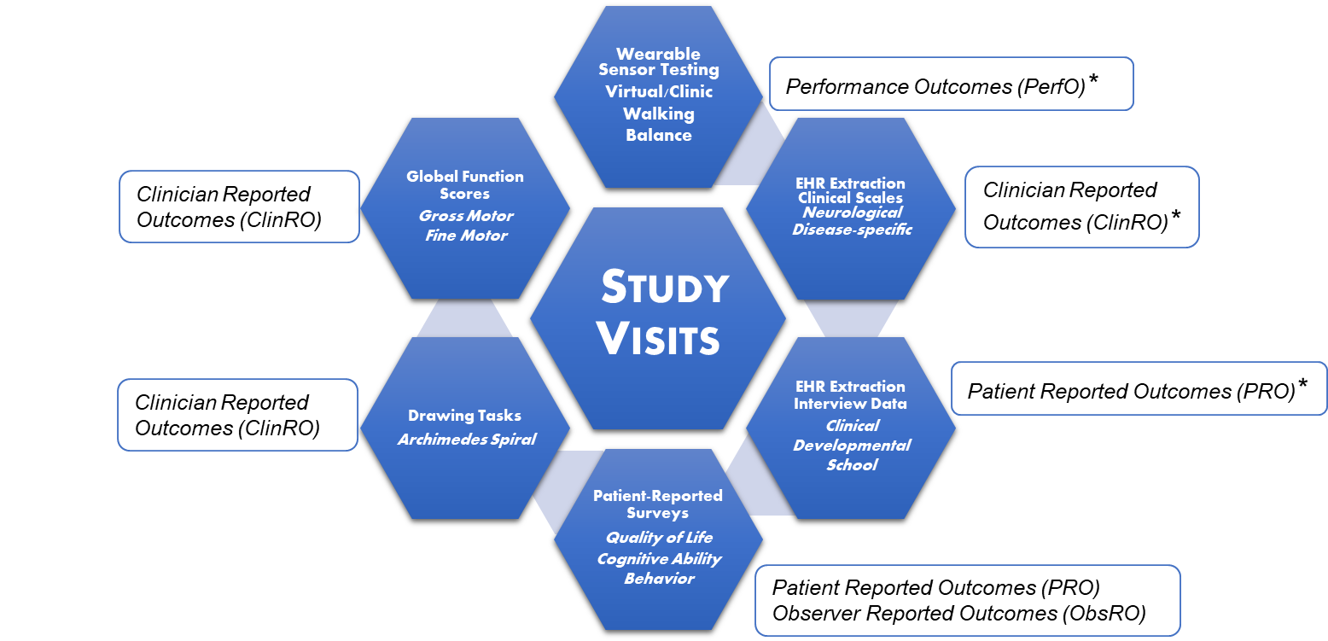
Clinical Outcome Assessments for Endpoint Selection
Notes:
COAs are tools or measures of data collection used to describe/reflect how a patient feels, functions or survives (as defined by the FDA).
COAs collected during NH studies are used, often in combination, to select endpoints that are valid, reliable and clinically meaningful to patients.
It's important to recognize the different types of COAs and incorporate a variety of them, ideally during NH study design, if not, as early as possible
(to better understand RD phenotypes, progression and to facilitate trial readiness)
As an example, this diagram shows the COAs my LD consortium (GLIA-CTN) site regularly collects during in-person or virtual NH visits
We measure standardized walking and balance tests using wearable accelerometers (defined as PERFOs)
Perform automated E.H.R. data extraction and dedicated diseases-specific clinical scales (CLINROs)
E.H.R. data and direct interviews are used to collect PROs about health status/symptoms, development, function in school/work/community
Surveys on QOL, cognitive and adaptive function and behavior are also completed by patients (PRO) or caregivers (OBSRO)
Drawing tasks assessing FM skills/tremor are scored as CLINROs
Global gross and fine motor function scores are also obtained as CLINROs
Today I'll emphasize automated E.H.R. data extraction and wearable technology approaches we can leverage to improve the quality and meaningfulness of our clinical endpoints

Slide 16
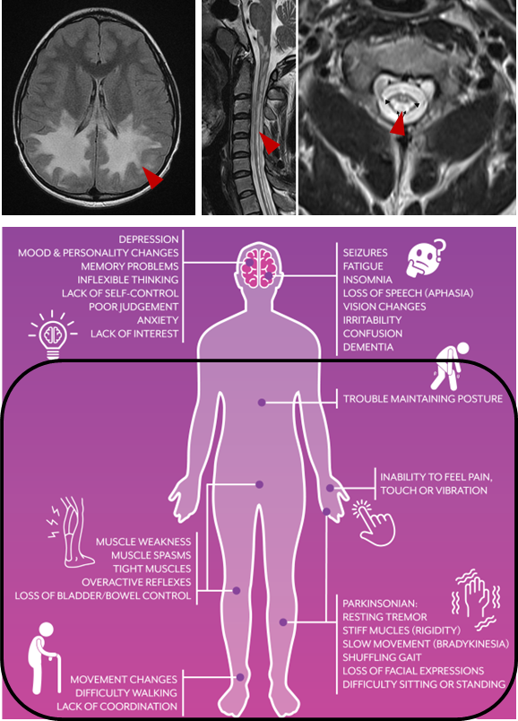
Endpoint Selection Approaches in Leukodystrophies
Diverse group of rare genetic disorders that affect CNS myelination (1:7,000)
Broad spectrum of neurologic and medical problems
  Motor dysfunction, impaired feeding, orthopedic complications, respiratory failure, seizures, cognitive and/or developmental delays
  Present across the entire lifespan
How do we determine clinically meaningful endpoints across a large, heterogeneous group of conditions?
Notes:
To briefly provide some context:
Leukodystrophies are a collectively large, diverse group of rare, genetic disorders that disrupt central myelination
Over 80 distinct forms
Although separately rare, the overall combined incidence is 1:7k
The LDs present on broad spectrum of neurological severity, with common complications of motor dysfunction..
These complications cumulatively have a large impact on QOL
LDs can present at any time across the lifespan
How do we determine CMEs across this large, heterogeneous group of conditions?

Slide 17

EHR Data Extraction to Determine Endpoints in LDs
2025 LD consortium cohort study of >1000 patients (42 LDs)
Automated EHR extraction queries of structured and unstructured data
Motor severity was the most important driver of complications
  Mortality was highest in patients with lowest motor milestone attainment
  Many lose walking ability and require extensive physical assistance and adaptive equipment
  Wide range of physical disabilities, high healthcare costs and patient/caregiver burden
Potential generalizability of clinical management, monitoring and treatment strategies across LDs
Kotes E, Smith Fine A, Vanderver A, et al. ACNS 2025
Notes:
One approach to tackle big data across as many RD clinical centers as possible is Automated E.H.R. data extraction
A recent LD Consortium cohort study of >1,000 LD patients in the US (42 LDs represented) used this method to query both structured and
unstructured data types..(procedures, lab reports, progress notes, radiology reports, etc)
We found that among many factors, motor severity was the most important driver of complications.
More specifically, mortality was highest in individuals with the lowest attainment of motor milestones.
If they attain it, many lose walking ability and require..
There was a wide range of physical disabilities, sometimes associated w high healthcare costs, and significant burden on patients and families
Importantly, these findings represent an opportunity to generalize strategies for clinical management, monitoring and treatment across LDs
Clinically Important Endpoints in Individuals With Leukodystrophy: A Multisite Study - Kotes - 2025 - Annals of the Child Neurology Society - Wiley Online Library

Slide 18
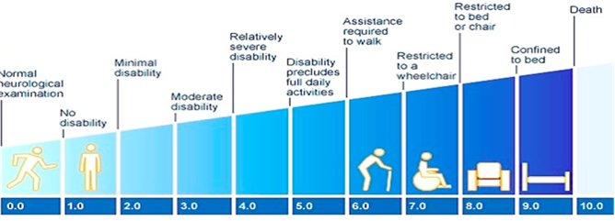
Approaches to Monitor Motor Disease Progression
Importance of monitoring disease severity and progression
  Patient perspective
  Pharmaceutical trials perspective
Challenge of variable progression
  Clinical Scales
    e.g. EDSS (Expanded Disability Status Scale)
    Validated
    Commonly used
    Not susceptible to small changes
Need for sensitive, accessible outcomes
  Quantify brain and spinal cord neurodegeneration
    Balance and gait disturbance
van Ballegoij WJC, Engelen M, et al. Front Physiol, 2020
Yan C, Smith Fine A, Pierpont R, et al. ACTN, 2026
Notes:
Monitoring the motor disease progression is important from multiple perspectives
In my clinic, people want to know: When will my symptoms get worse? Is it time to start using a walking aid/chair? Is there anything I can do (diet, medications, therapy/exercise) to slow the symptoms down?
From a trials/sponsor perspective, what markers or outcomes can be measured in this disease that change in a short period of time?
Again, progression is variable, so some of our well-known clinical scales are good at measuring severity or disability in LDs at 1 point in time (e.g. EDSS), but they aren’t sensitive to small changes on repeat assessments. (this means patients must be studied for many years or hundreds must be enrolled to capture change)
So, there’s a need for more sensitive..that can quantify brain and spinal cord degeneration, which manifests as balance and gait disturbance

Slide 19
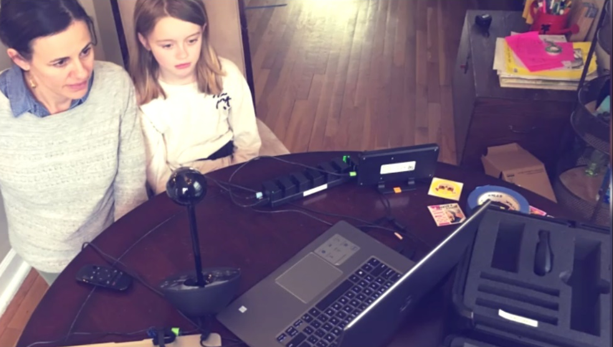
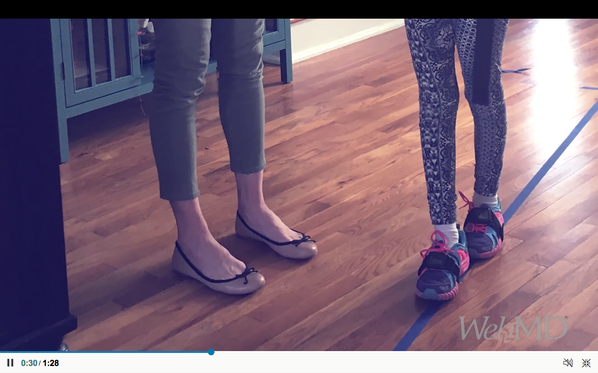
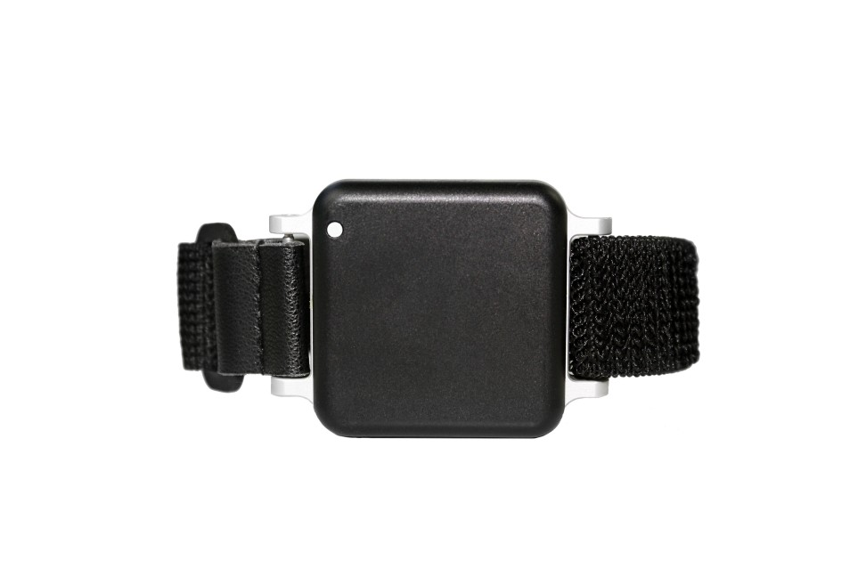
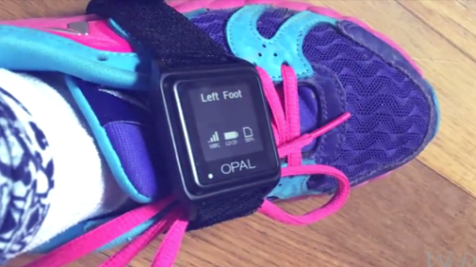
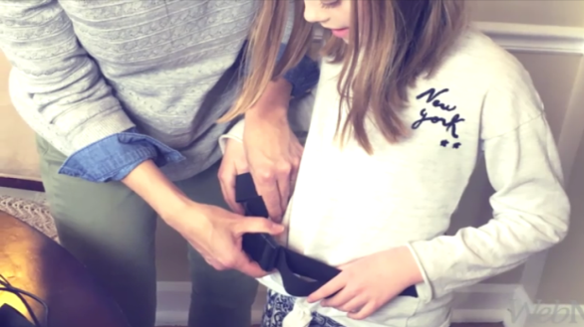
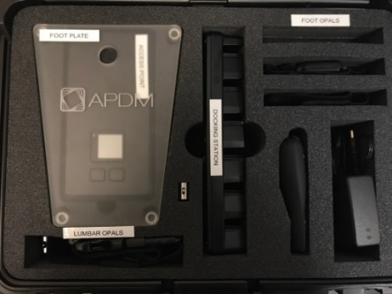



Wearable Sensors: In Person or Remote Data Collection
Wearable triaxial accelerometers
  Collect data on physical activity using non-invasive sensors
  Watch sized battery-based accelerometers
  Validity established in comparison with motion lab equipment
  Placed on waist, feet, +/- chest, wrists for a series of tests
    Pre-defined tasks (e.g. walk and balance tests) vs. dynamic movement vs. general activity tracking or step counts
Advantages of a wearable system
  Sensors can be used in-person or at home during virtual visits
  User friendly for the participant and new staff
  Allows more frequent collection of data points
  Tests are directly supervised in real-time by research staff
Horak FL, et al. J Bioeng Biomed Sci 2014
Dewey DC, et al. J Neurol Sci 2017
Zesiewicz TA, et al. Gait and Posture 2017
Smith Fine A, et al. ACTN 2022
Yska H, et al. JIMD 2024
Notes:
Wearable accelerometers: what are they?
Collect detailed information on physical activity using non-invasive sensors
Detect changes in speed of body segments over time(linear acceleration/deceleration)
Capture movement frequency, duration, intensity andpatterns
Validity established in comparison with gold standard equipm ent in the motion lab...Such as the force plate and 3D infrared motion capture systems
They’ve been used in more common and ataxic disorders
Assess pre-defined tasks vs. Dynamic movement or general activity tracking/step counts
To summarize the advantages:
Sensors can be used in the clinic, lab or shipped to home for remote collection, allow flexibility. Removes participation barriers, helps w attrition
Very user friendly for the minimal setup required of the participant. Also easy to teach new staff how to operate the equipment.
Tests are still directly supervised and conducted in real-time by research staff during a 1 hour scheduled web-based research visit, we share screen and do remote screen takeover
For the remote visits, we mail a sensor kit webcam, laptop, device manual and other small essential equipment to measure and mark the walkway.

Slide 20
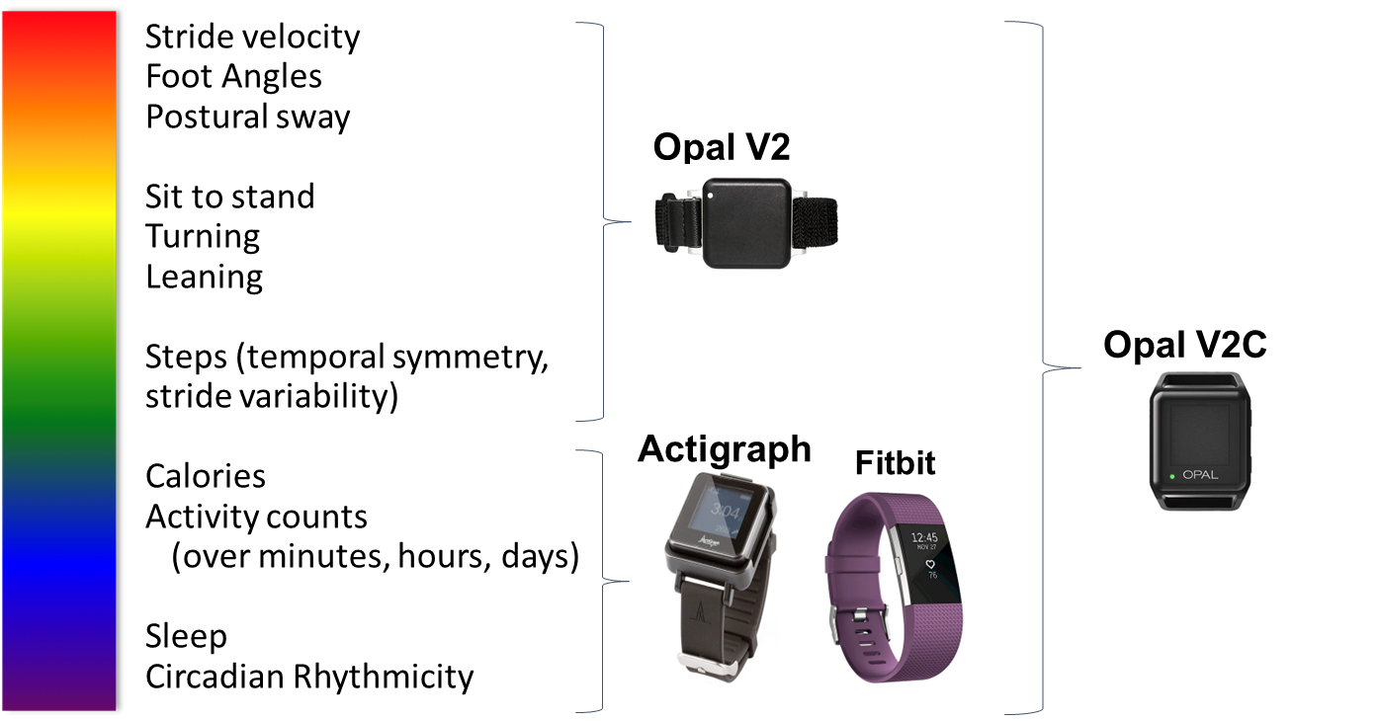
Wearable Devices for Sensorimotor and Activity Assessment
Notes:
This slide highlights a few of the wearable devices available for SM assessment and the TYPES of information each can gather
Opal – detailed, test-specific information about gait and postural sway, e.g…SV, FA during 6MWT or SA during 30-sec standing test
It can also give information such as the # of seconds to complete a TUG, including sit-to-stand and stand-to-sit time, turning duration/angle (waist), lean angle (chest).
Also can tell you about symmetry and variability in the stride pattern between left and right foot.
Actigraph – activity counts over minutes to hours to days – a research grade device. Can also detect sleep periods/ideally validating with journaling.
Fitbit – a popular fitness tracker, step counter, can detect general activity trends and intensity, including periods consistent with rest/sleep. Consumer grade but used in research
Opal V2C is a newer version that can capture most of this spectrum of variables
Choice of device depends on the aspects of mobility/activity you want to measure
For instance, applied to mitochondrial disease, or some NM disorders, you might be interested studying waxing/waning activity patterns, periods of fatiguing, or being able to calculate energy expenditure using data like HR and activity counts together
Also important is the ability of your patient population to follow simple instructions or not, due to age, cognitive ability or auditory/visual disability. If developmental age is ~<5yrs, better to focus on a device that can capture continuous, unrestricted movement rather than movement during discrete instructed tasks.

Slide 21
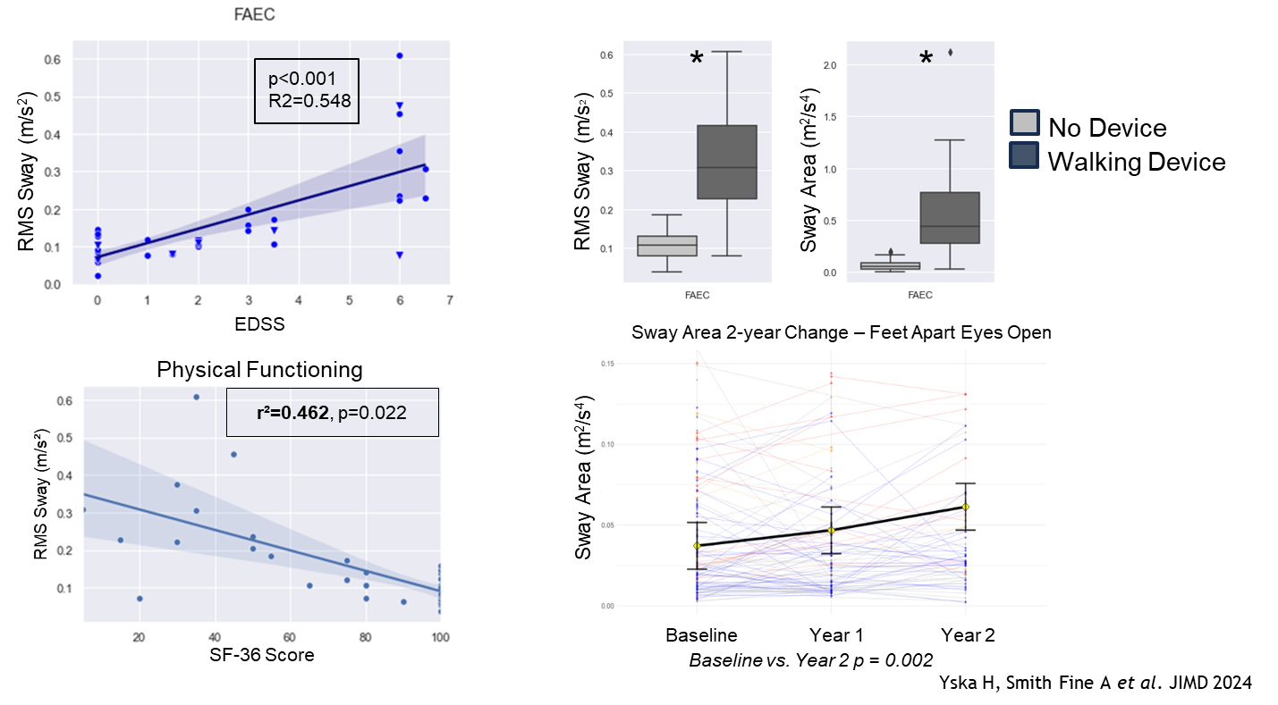
Clinically Meaningful Outcomes Identified in X-ALD - Sway
*p<0.01
Yska H, Smith Fine A et al. JIMD 2024
Notes:
In the last 2 slides I'll highlight some examples of how PERFOs collected using wearables can be paired with other rich clinician or patient-reported information to determine endpoint variables that are clinically meaningful.
This work was done using the Opals sensors in adults with X-ALD, a slowly progressive myeloneuropathy with gait and balance impairment (sensory ataxia)
Postural sway testing involves standing as still as possible for 30 secs, with feet apart and eyes open, and with eyes closed to challenge proprioception
It was found that sway amplitude is strongly correlated with the EDSS clinical disability scale
Sway (FAEC) differentiates use of a walking device - individuals who use a walking device sway significantly more than those who don’t use a device
Greater sway amplitude is also correlated with lower scores in physical function on the patient-reported SF-36 survey
Finally, the Sway Area significantly increases between baseline and Year 2 of measurement.
This is a time-period acceptable for most interventional trials.

Slide 22
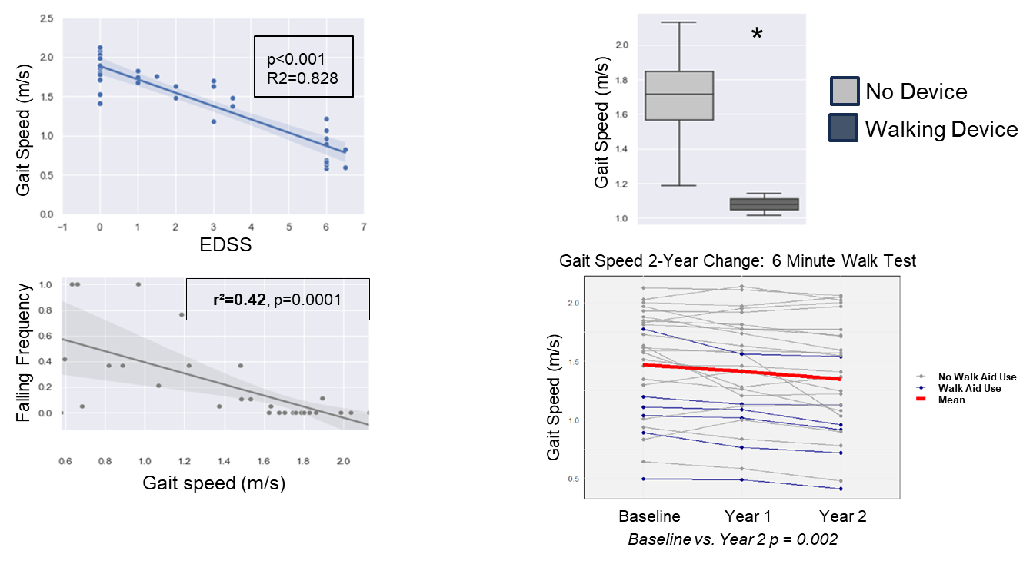
Clinically Meaningful Outcomes Identified in X-ALD - Gait
*p<0.01
Yska H, Smith Fine A et al. JIMD 2024
Notes:
We also evaluated walking in adults with X-ALD, known to experience progressive loss of independent walking due to SC degeneration.
Gait testing in this case was the 6MWT, a fast as possible walk challenge.
The 6MWT GS is strongly correlated with the EDSS clinical disability scale
Gait speed also differentiates use of a walking device – those who use a walking device walk much slower than those who don’t use a device
Slower gait speed is also associated with much more frequent falls over ~1year (patient-reported)
Finally, the Gait Speed significantly increases between baseline and Year 2 of measurement.
So this measure is also sensitive to change over a period used during most trials.
I’ve shared from the clinician scientist perspective how to develop meaningful COAs for trial endpoint selection, now moving to the patient advocate view on how we can best capture these measures..

Slide 23
Thank You
Amena Smith Fine, MD PhD
Assistant Professor of Neurology
Kennedy Krieger Institute
finea@kennedykrieger.org

Slide 24
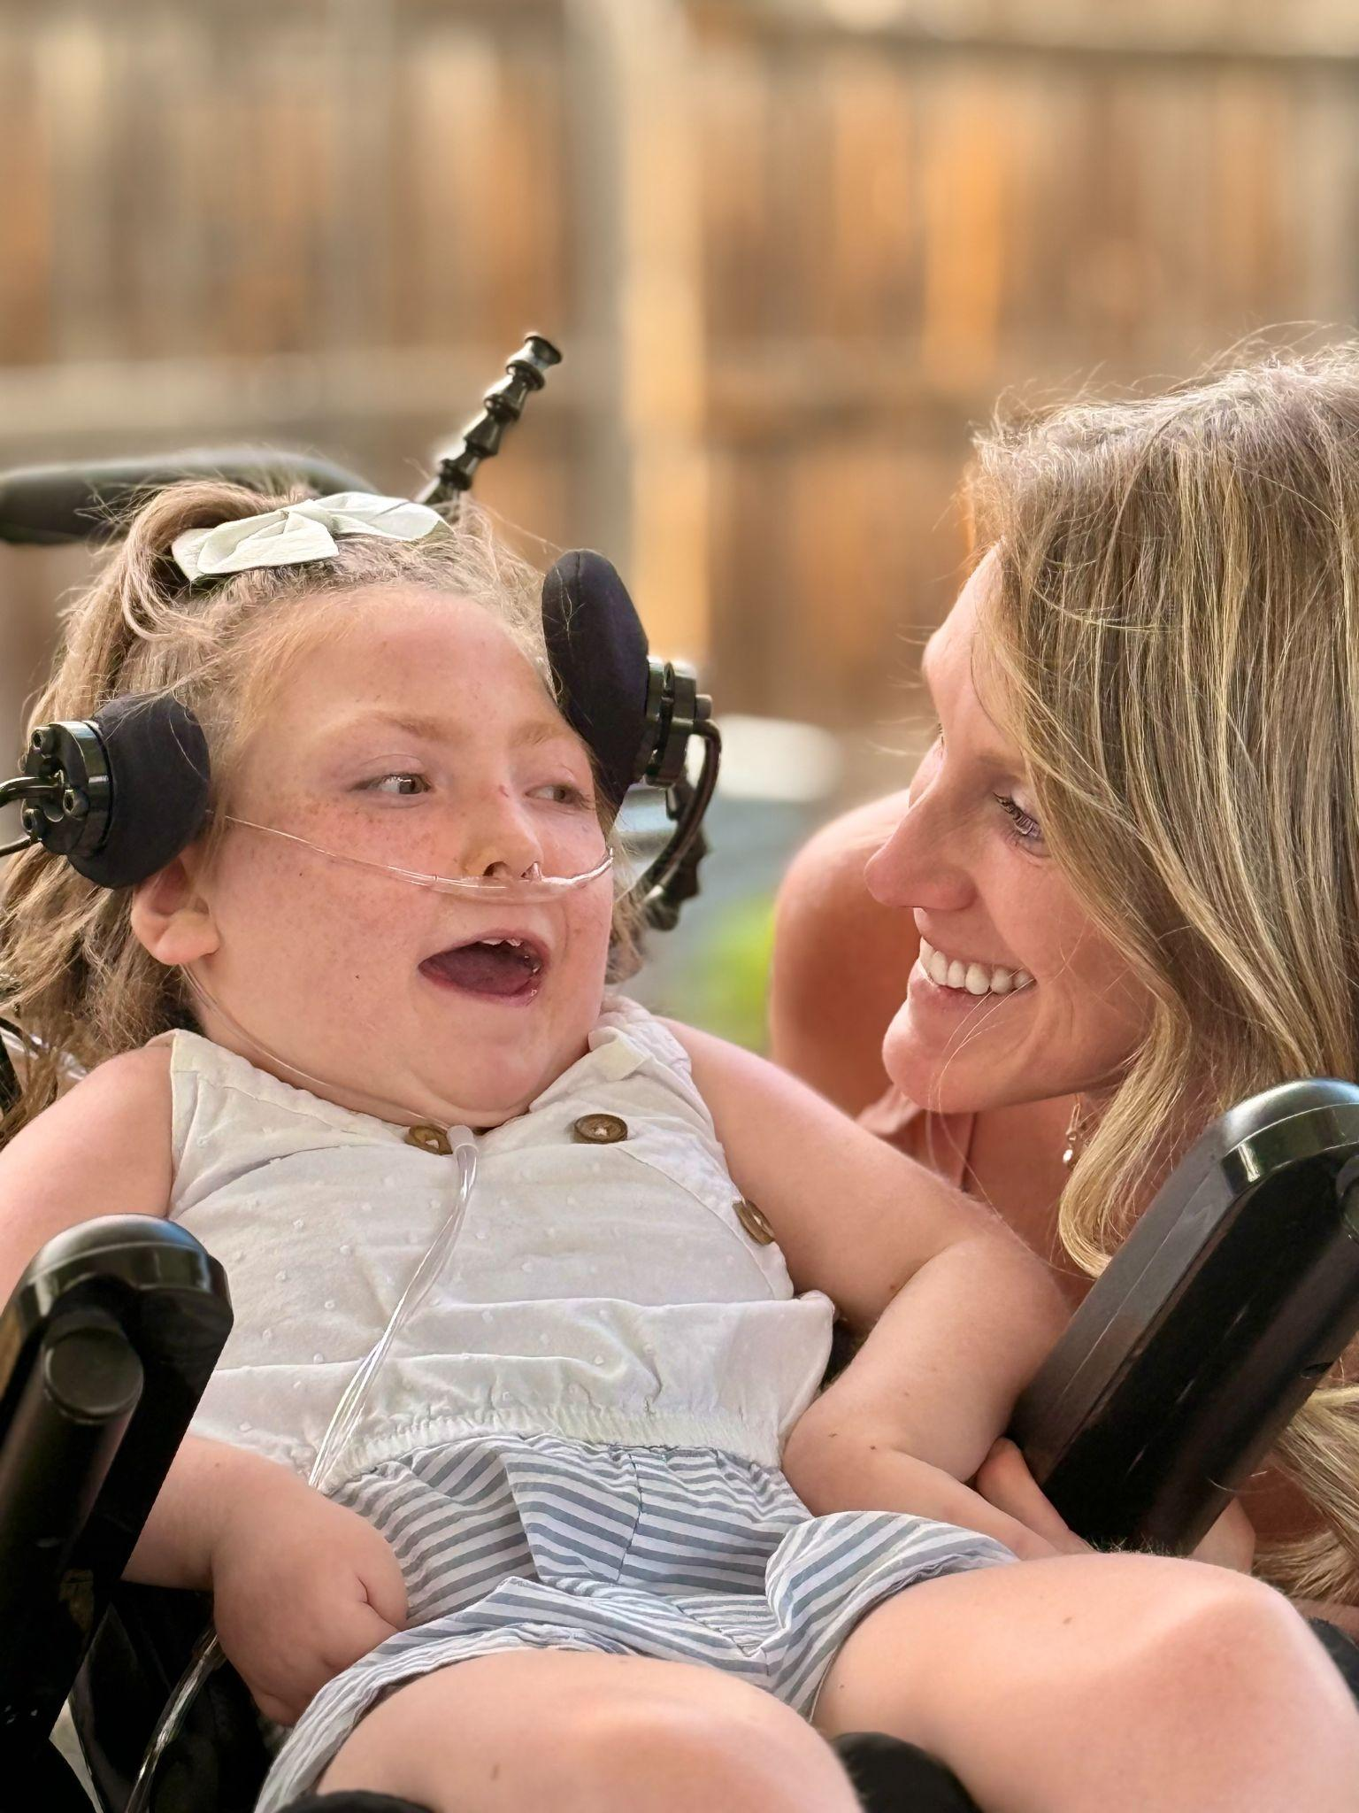
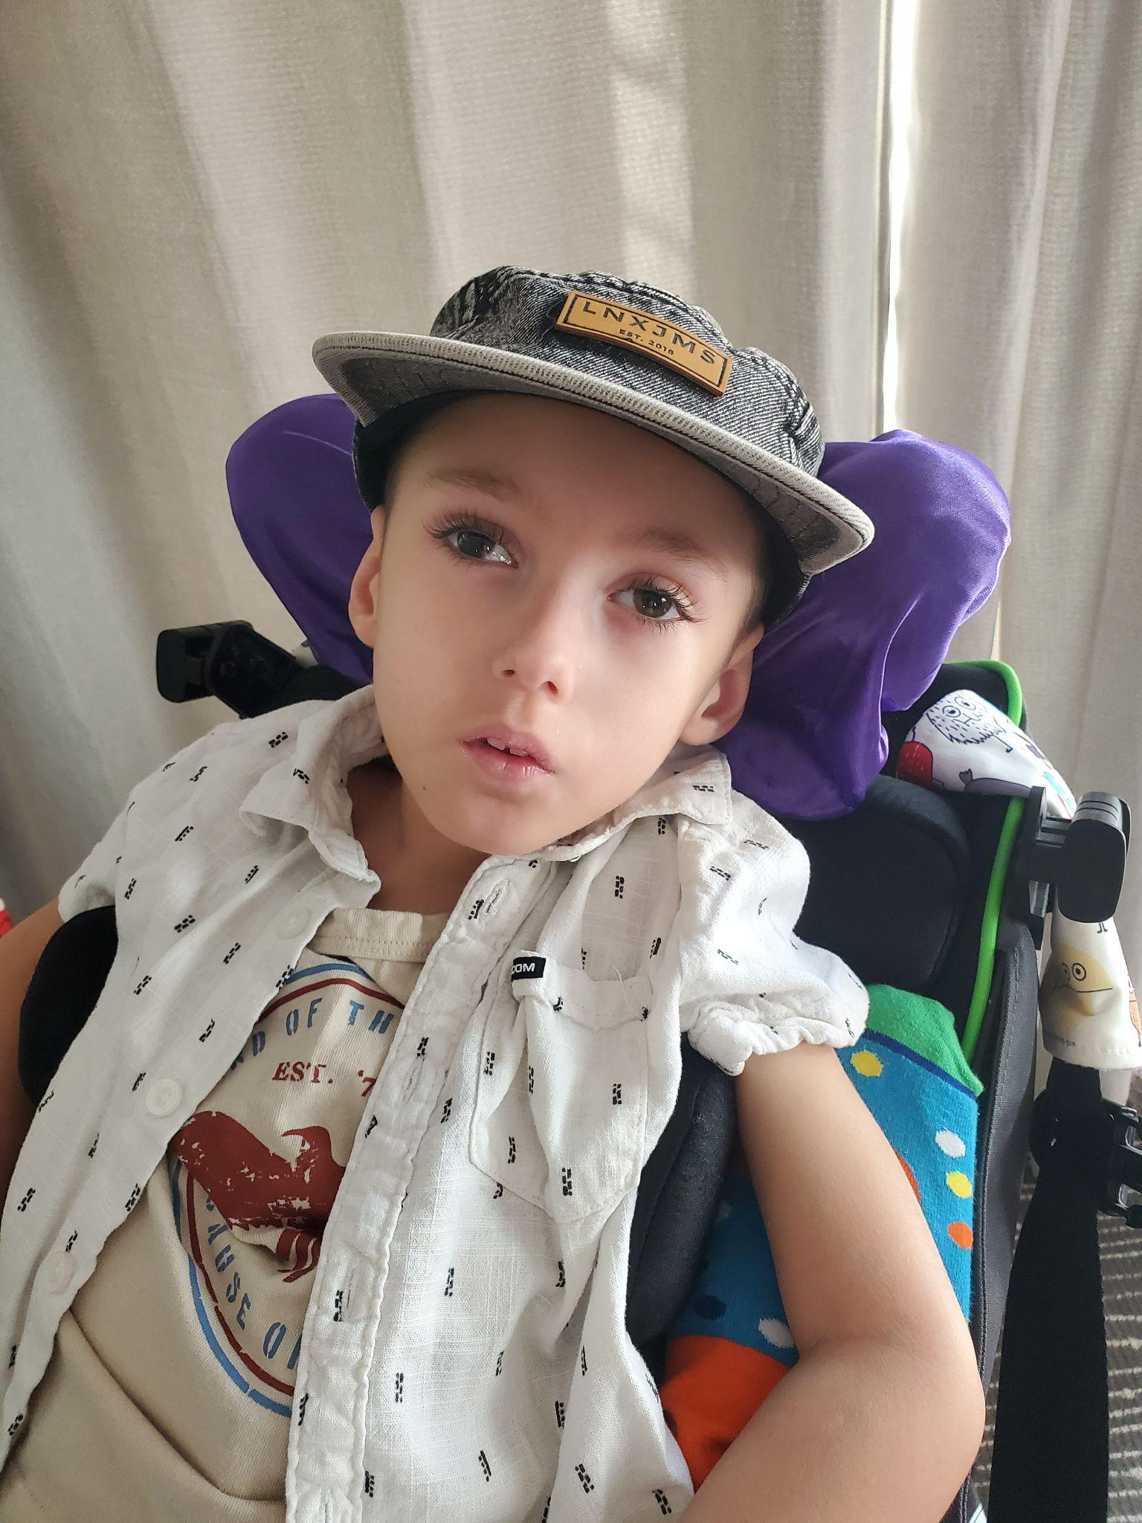


Data for Endpoint Selection:
Caregiver-Led Efforts to Measure All
Gabi Conecker, MPH
Decoding Developmental Epilepsies

Slide 25
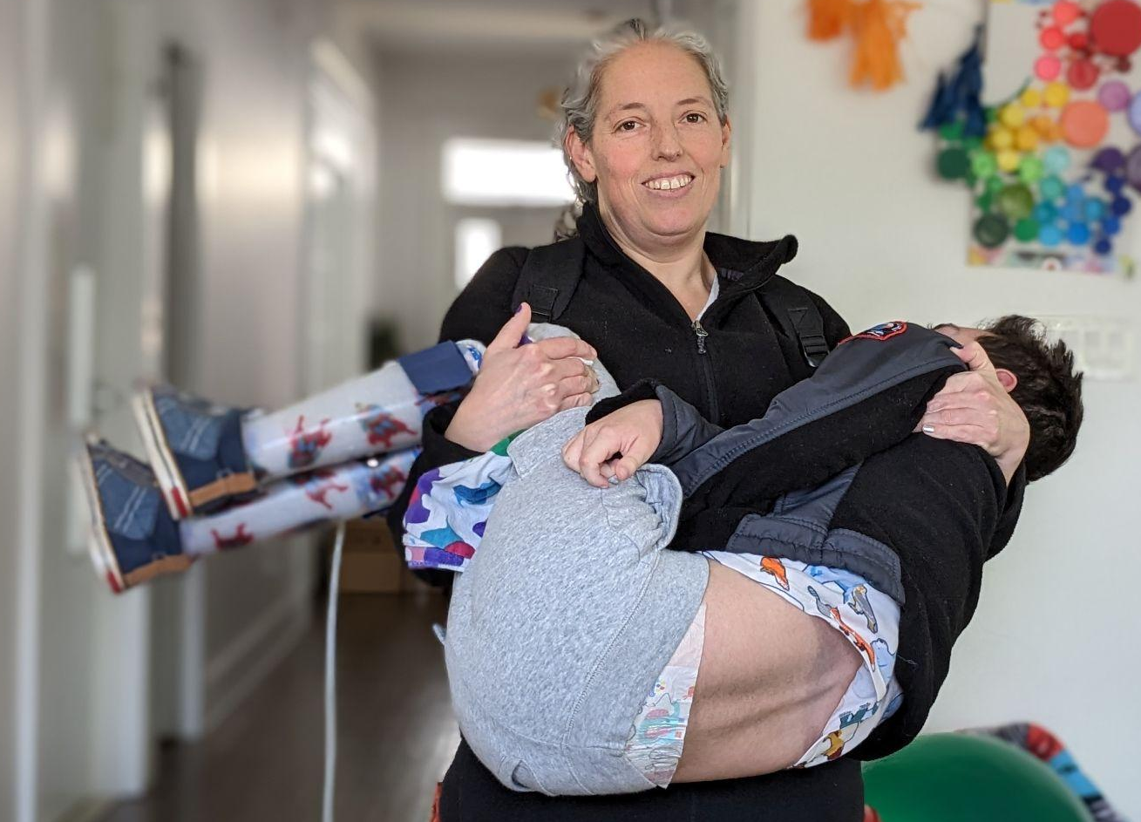
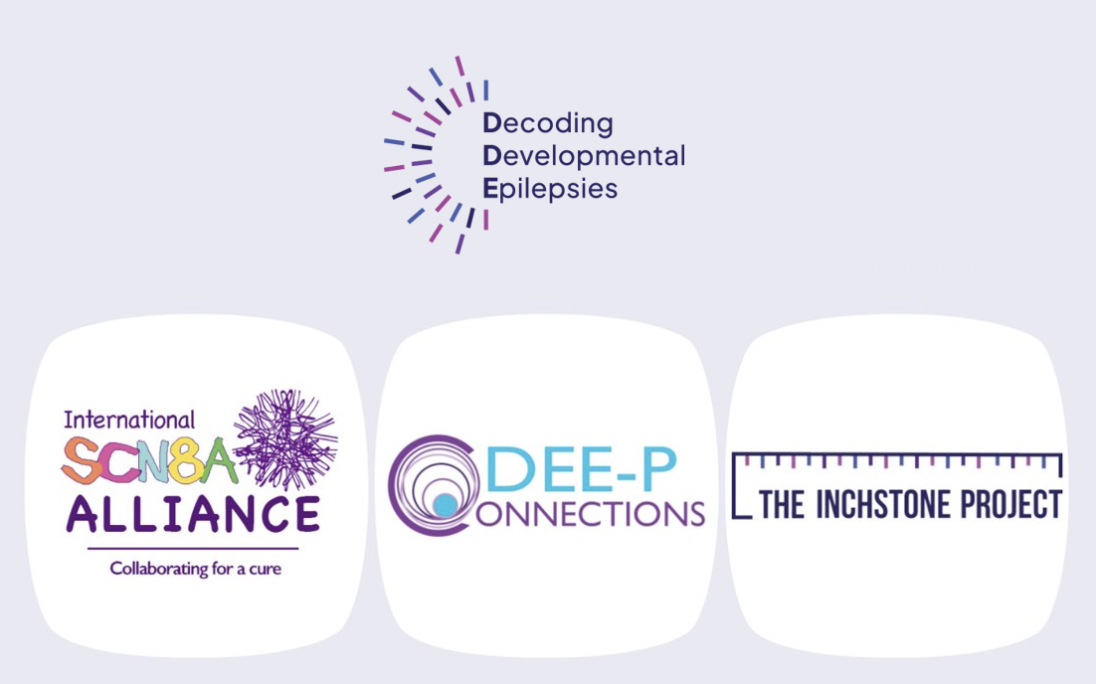


About Me
Background in Global Public Health
13 year old son with a severe pediatric-onset genetic epilepsy disorder - SCN8A-DEE
Isolated caregiver with no information on best care and treatments on a newly discovered disorder
Notes:
Seizures - always on watch. Rescue medications, he’s passed out
A cold = intubated in the ICU and potentially on life support
CVI - cannot see my face
Poor motor - cannot hug me grasp toy
Communication - cannot tell me what hurts, what he wants, Needs, Likes. he cannot tell me he loves me (or hates me for everything I have to do to him!)
Hypotonia - Head control, ability to hold something and entertain himself stronger and less time in the hospital, hours a day on regular urinary/bowel and GI manegement, isolation to avoid colds

Slide 26
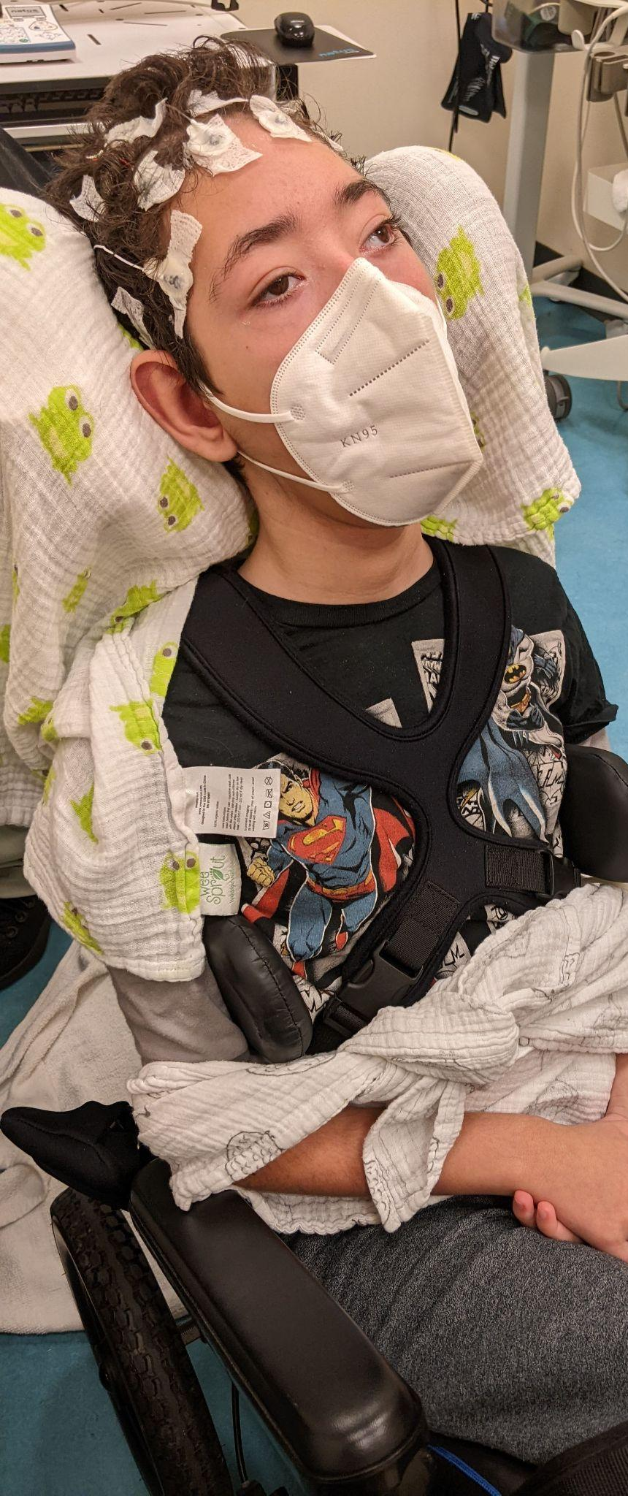
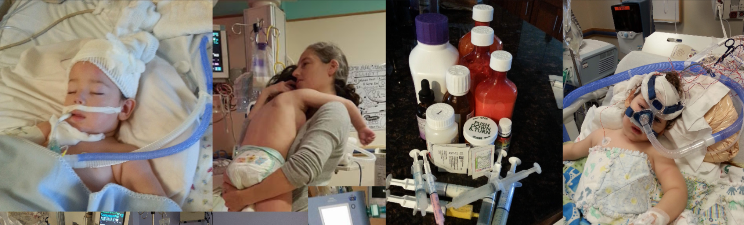
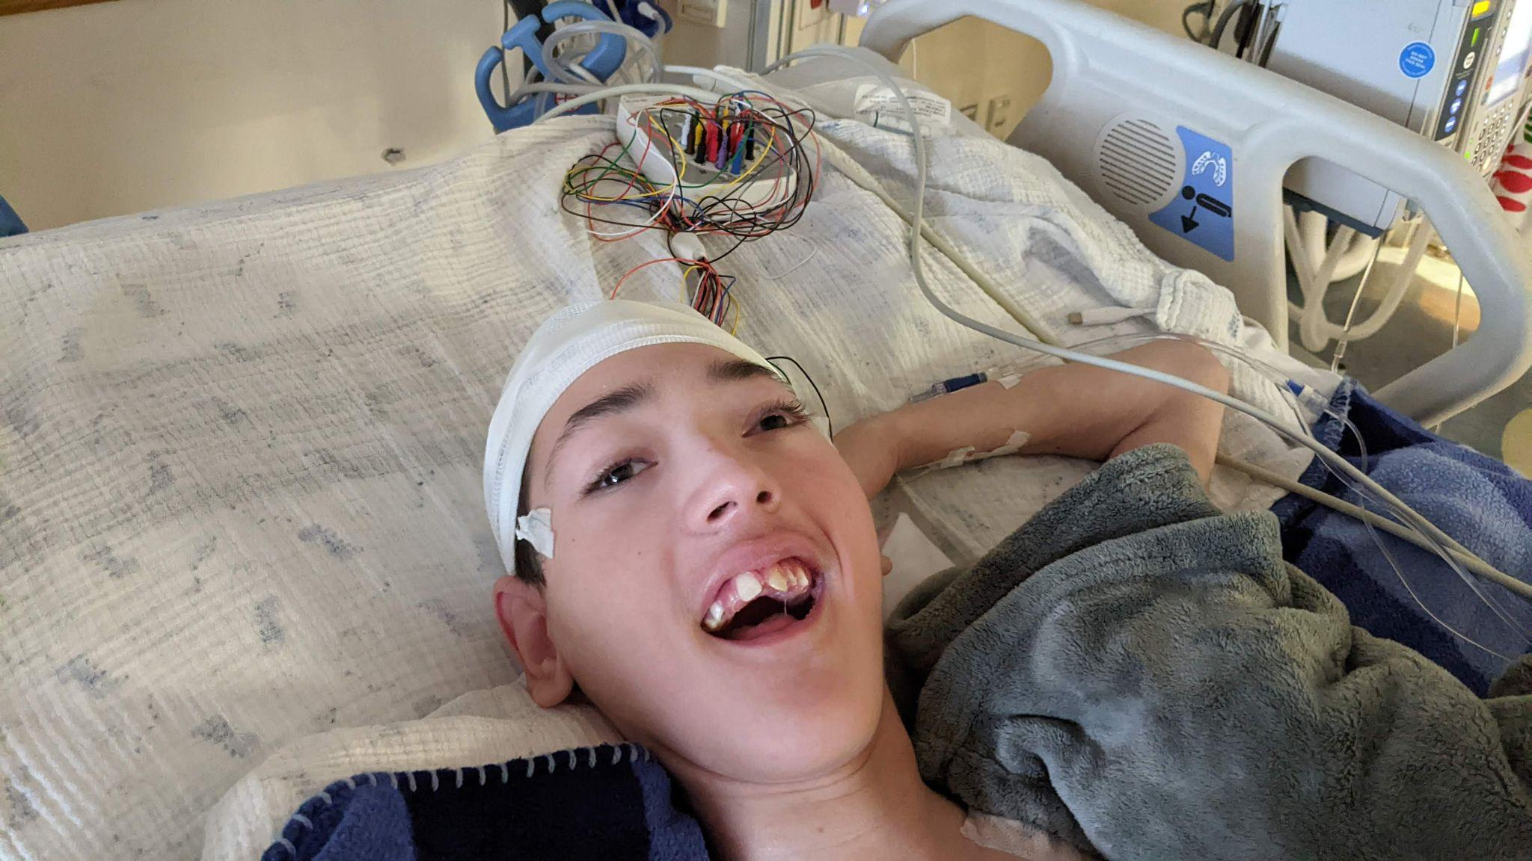
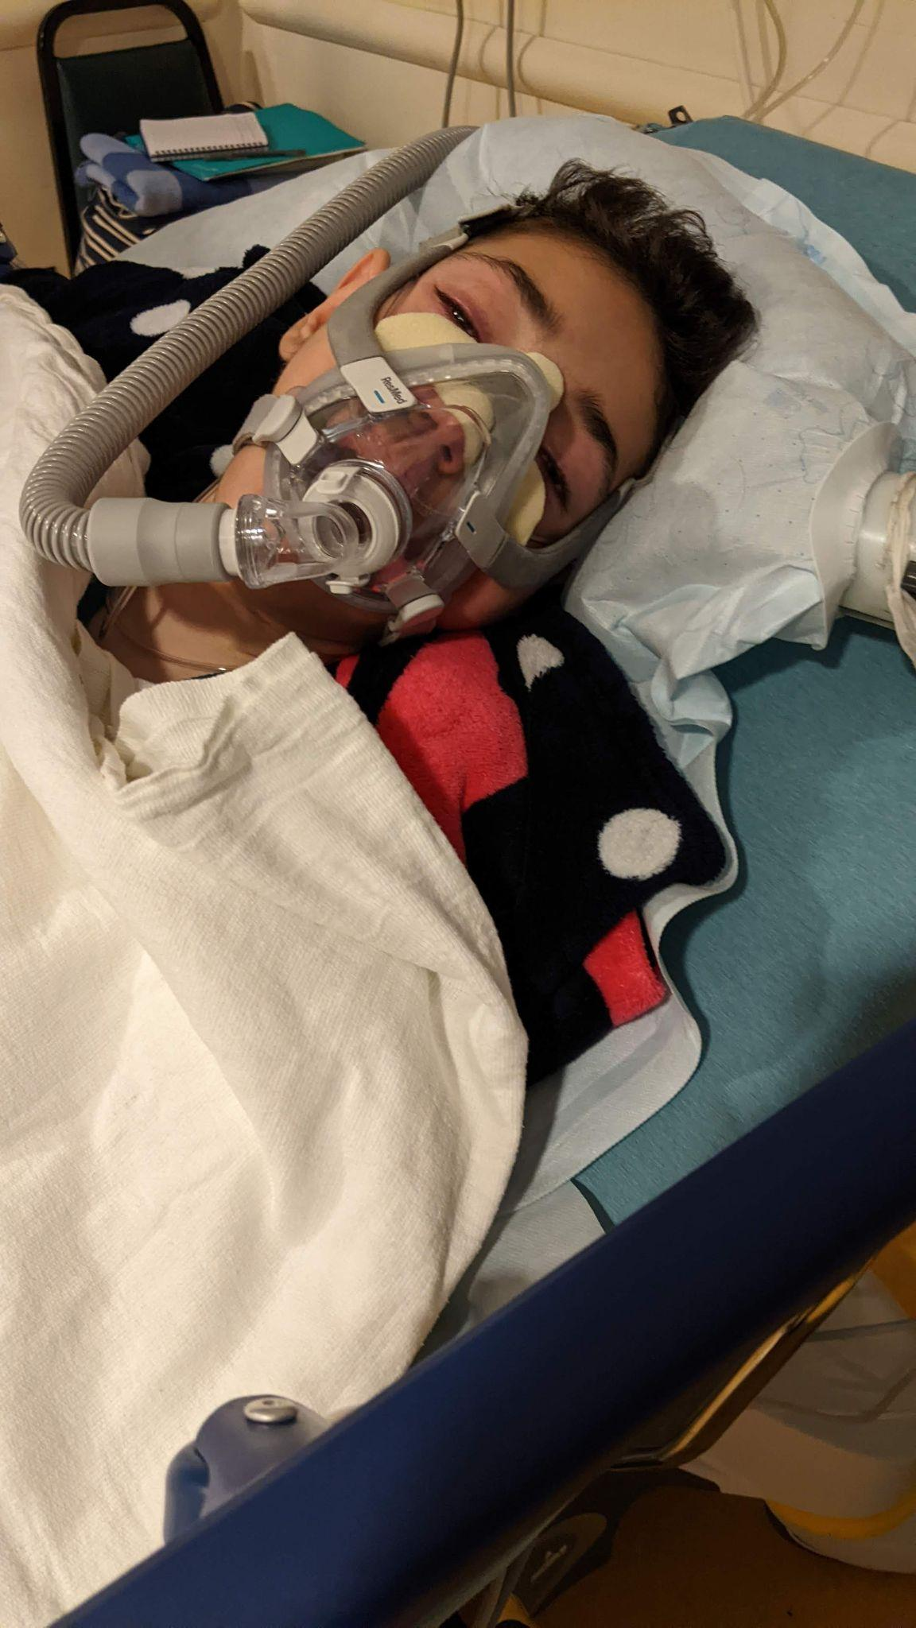
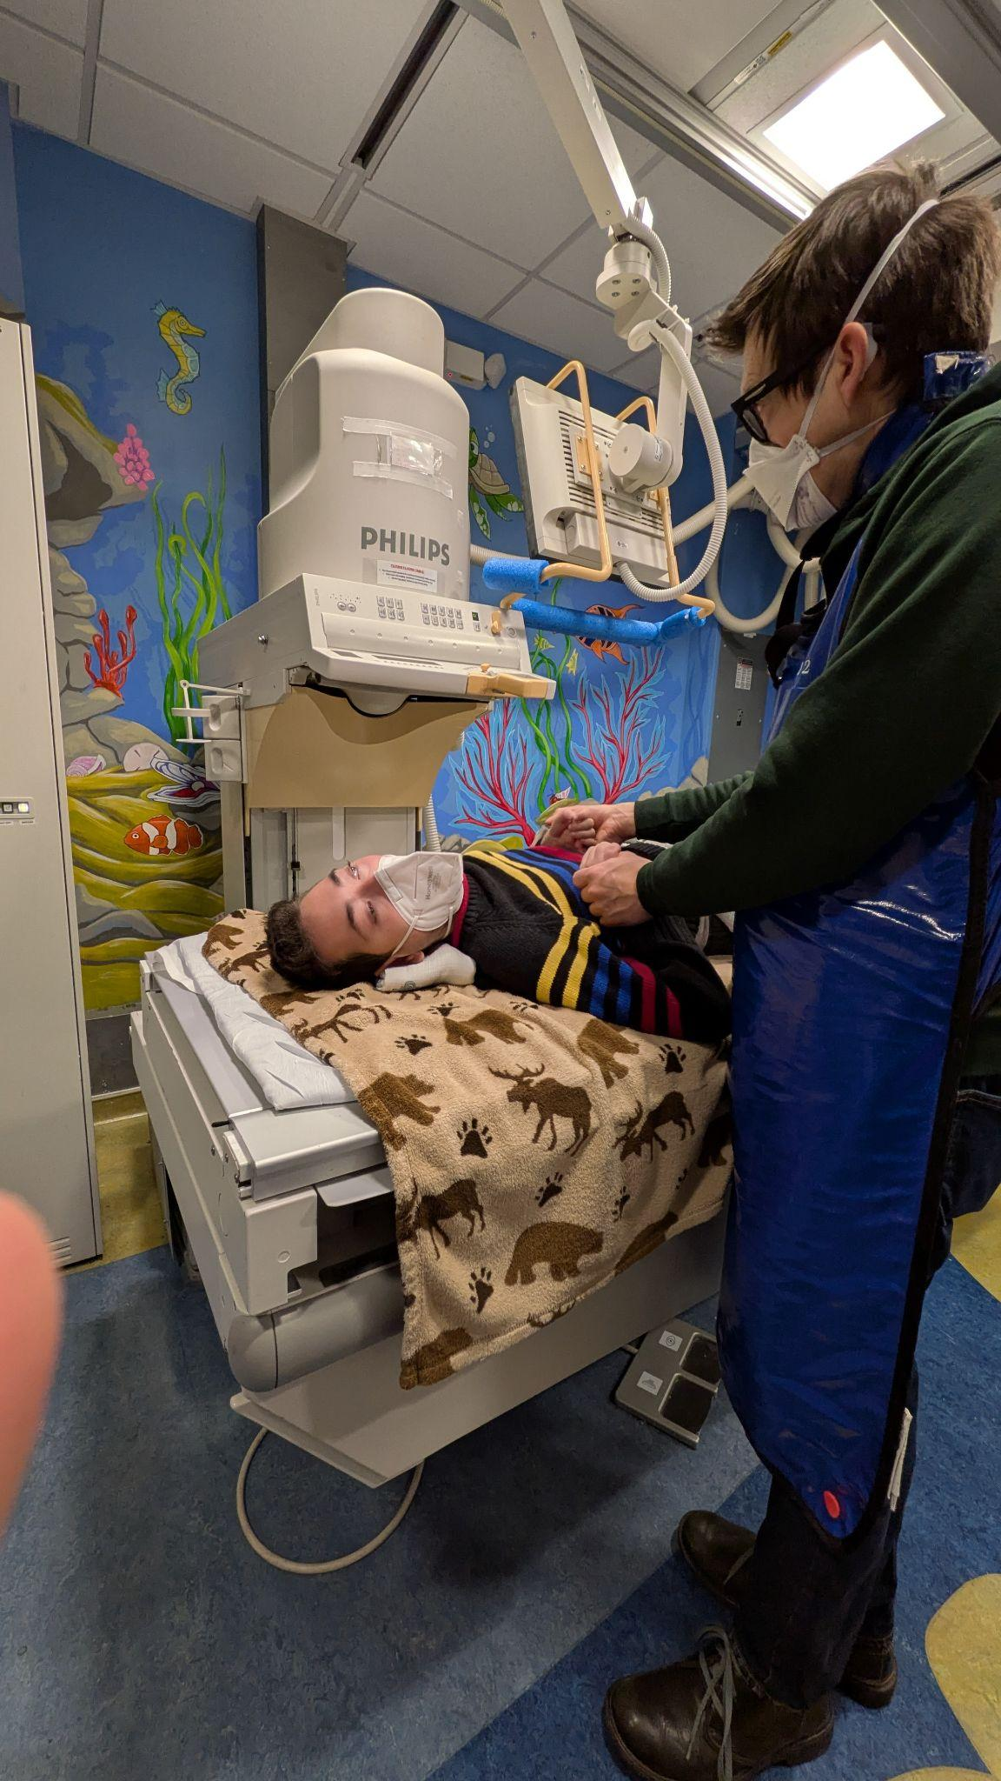
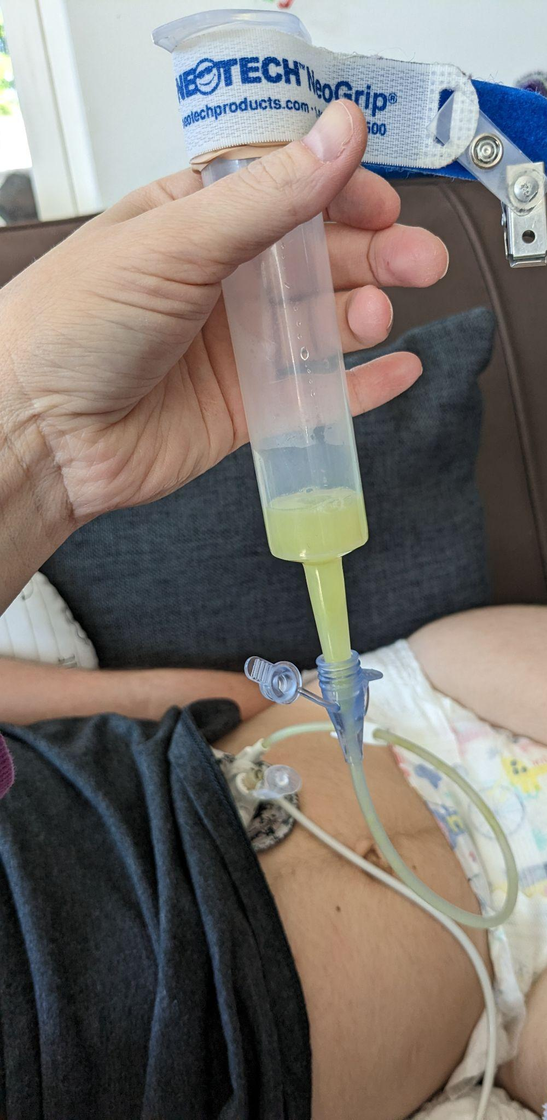
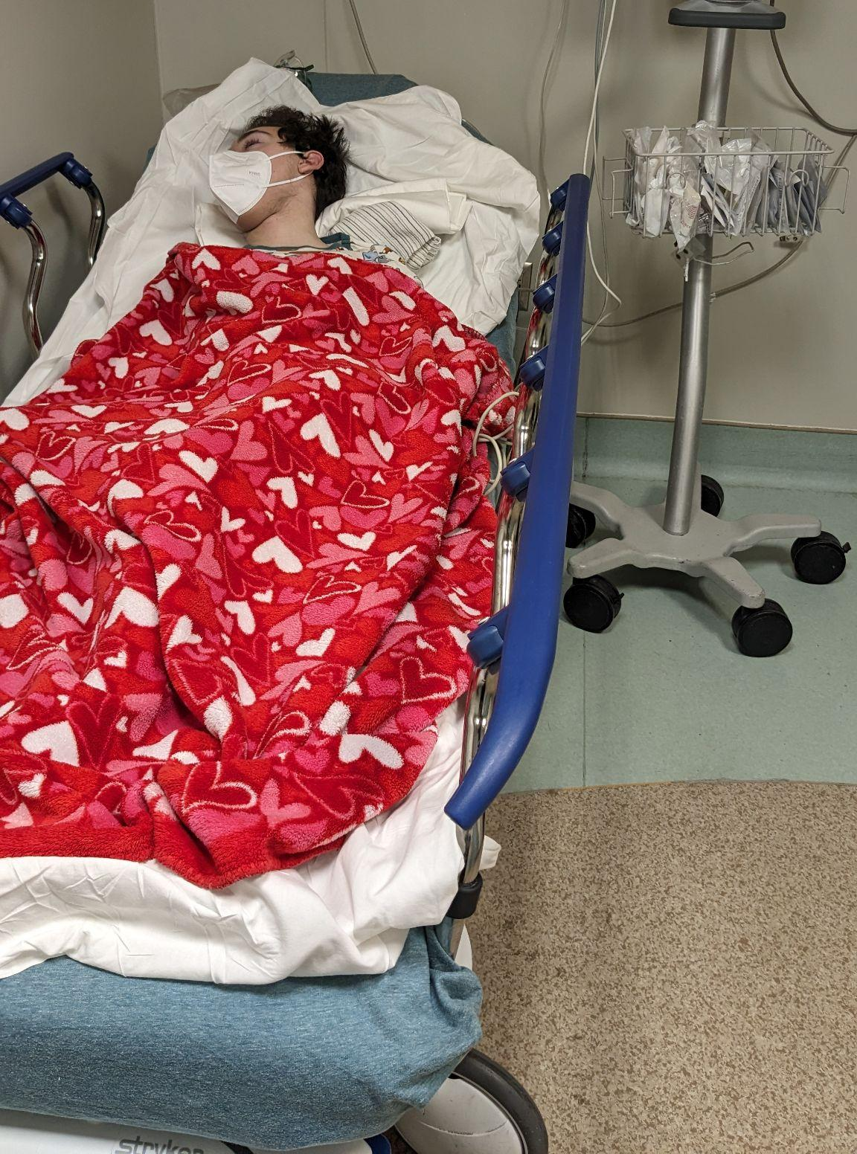

Slide 27

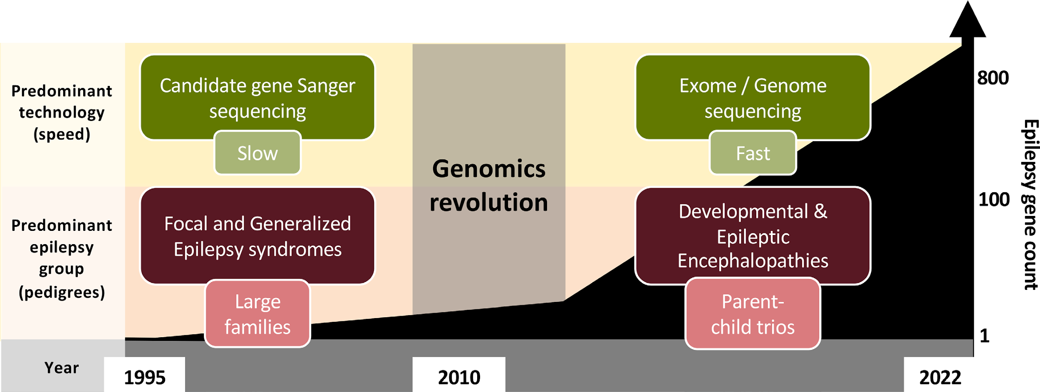
There is Exponential Growth in Gene Discovery
Oliver et al 2023
Nearly 1000 monogenetic conditions causing a DEE condition have been identified.
We cannot only pursue clinical trial readiness one disorder at a time.

Slide 28

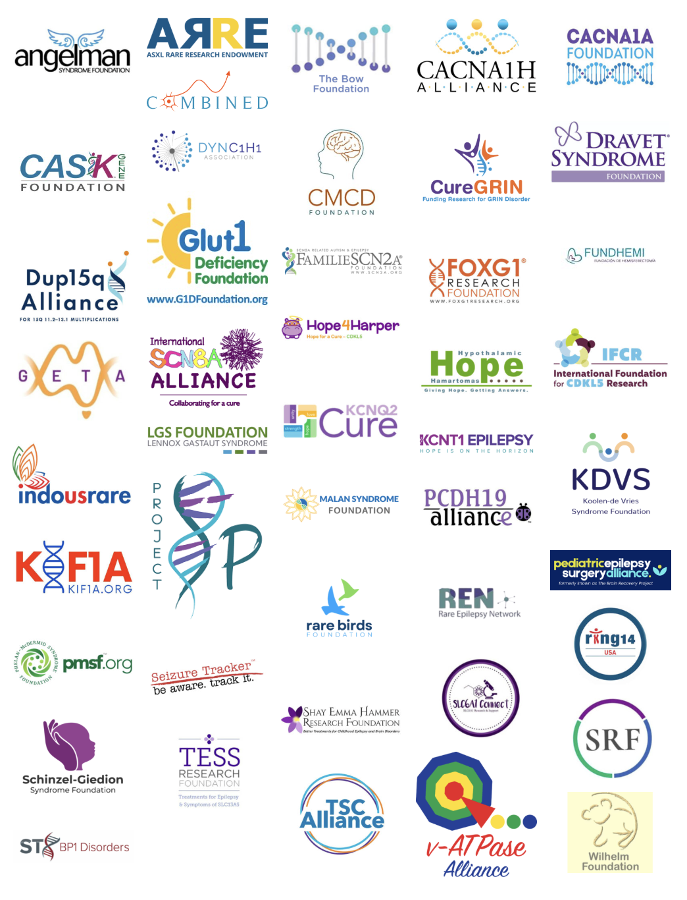
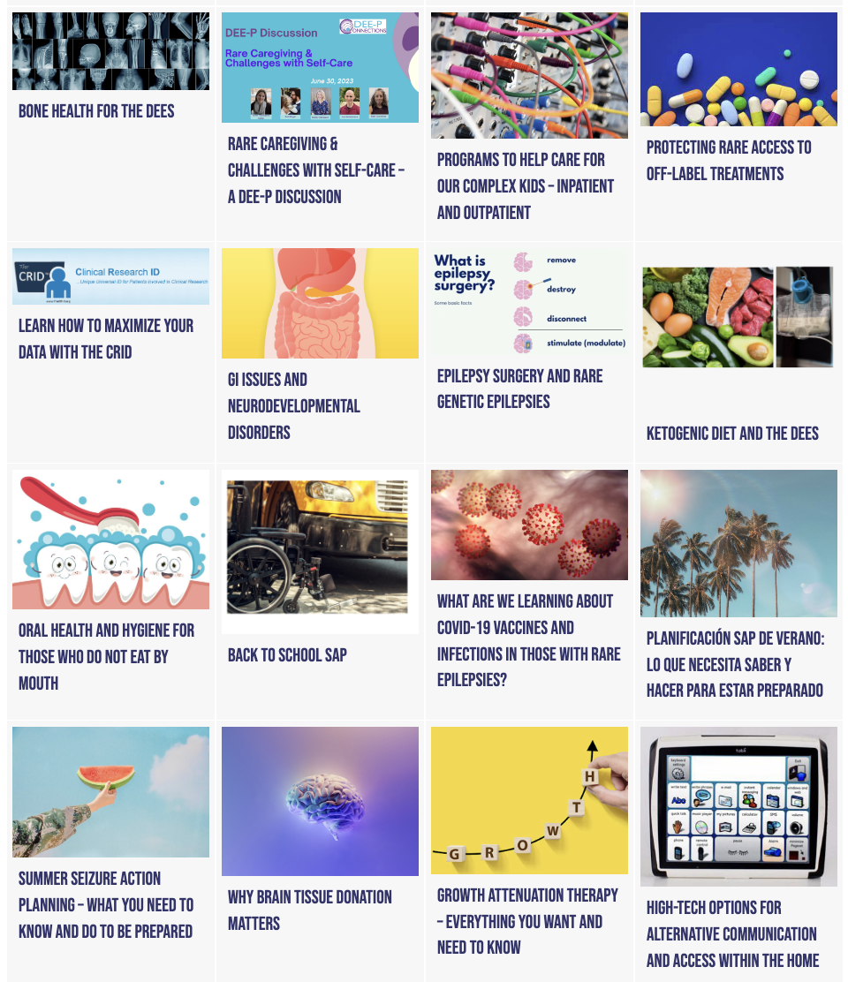


Building DEE-P Connections
Collaboration
Resource Center Hub
Multi-layered Approach
Notes:
Can you add a slide after this that highlights the formation of DEE-P where you can speak to the power of a PAG collaborative and space for the undiagnosed- "DEEs as one". Breaking silos between PAg and industry and within the PAG ecosystem. I think it is important for DEE-P to get visibility during this presentation. Maybe a QR code to my email or an email for those interested in learning more about DEE-P / partnership? Can also be the gateway to the Inchstone slides and main discussion

Slide 29


Guidance on Endpoints
21st Century Cures Act
Provides the impetus for robust inclusion of and reliance on patient experience data when evaluating clinical benefits of new therapies.
This expansive definition of “patient experience data” includes a wide range of opportunities for the collection of information that might be used to inform and provide a greater patient focus in medical product development
The Food & Drug Administration (FDA) Patient-Focused Drug Development (PFDD) guidances
Issued in response to the Act to aid researchers and drug developers in designing clinical outcome assessments (COA) that provide optimal tests of a therapy's benefits.
These guidances focus exclusively on clinical outcomes and emphasize the essential and extensive role of patient-caregiver involvement in most aspects of COA development
Notes:
The “Patient-Focused Drug Development” section of the Cures Act (Title III, Subtitle A) emphasizes the need for patient engagement in drug development, and includes provisions designed to define and standardize the use of patient experience data in regulatory programs.
Patient experience data is defined as “data collected by any person (including patients, family members, and caregivers of patients, patient advocacy organizations, disease research foundations, researchers, and drug manufacturers) that are intended to provide information about patients’ experiences with a disease or condition”.
Specifically
The impact of the disease, condition, or related therapy on patients’ lives
Patient preferences with respect to treatment of the disease or condition.

Slide 30
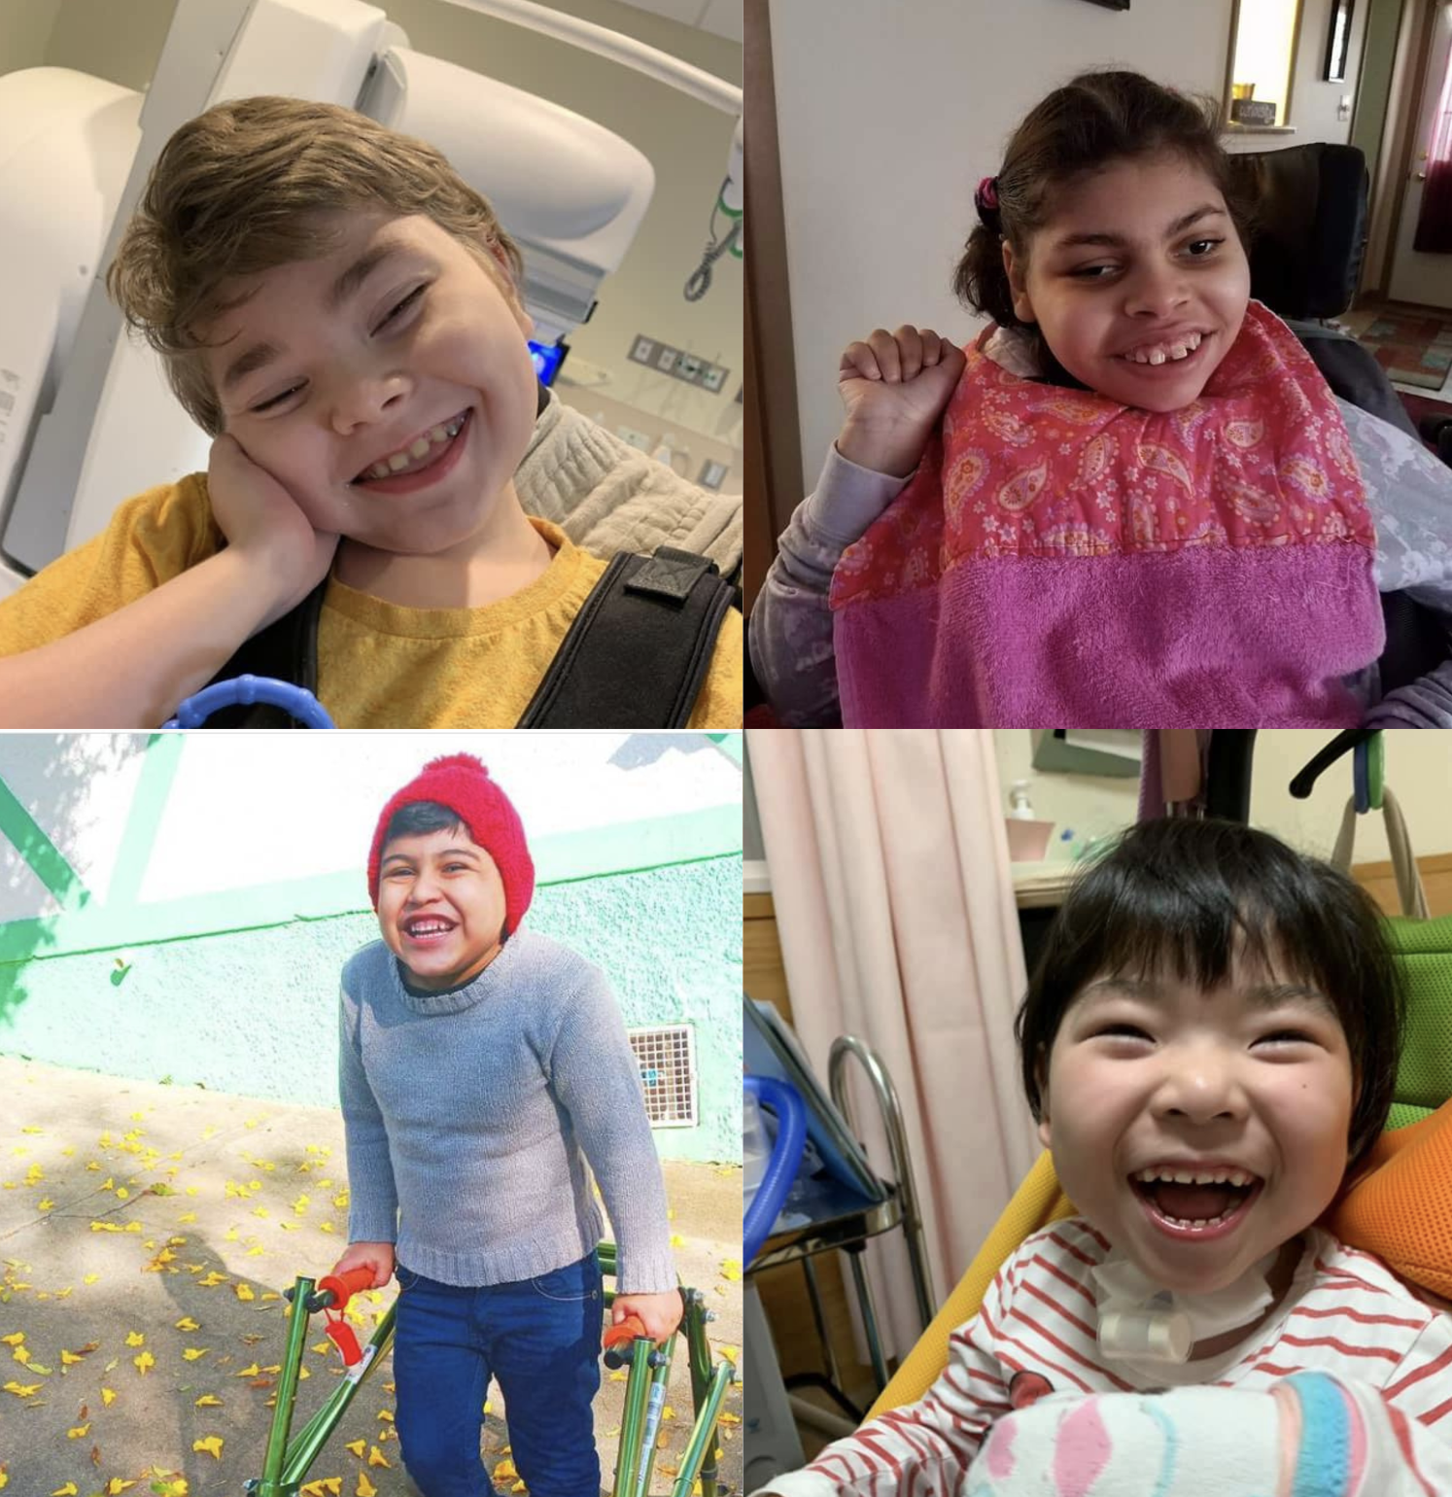
The Inchstone Project
Children with profound developmental impairments have severe challenges.
YET they can do some critically important things.
BUT skills acquisition is slow and takes small steps.
AND available measures do not capture what they can do, growth and regression.

Slide 31


Our Goals
To advance neurodevelopmental measures for individuals with profound ID and severe neurological impairment (SNI) that are
  family-centered, strengths-based, can capture meaningful change.
  have capacity for use in clinical trials and clinical practice.
To facilitate their utilization in clinical practice and trials.

Slide 32

Measuring What Matters Most in the DEEs and those with Severe Neurological Impairment (SNI)
Communication is a top priority, regardless of etiology.
Motor and challenging behavior were also top priorities.
What counts as meaningful change depends on level of functioning
Small improvements in alertness and ability to use a touch screen help quality of life
CVI was common and we need to understand more and find the best way to measure it.
Current measures have potential for use in clinical trials, but they need modifications.
Notes:
DEE Parents Speak Survey, 2023 (PSS1)
N=267, average age 8 years 8 months
20+ gene groups
Severe developmental impairments
5 manuscripts
Challenging behavior was more of a priority when the individual had a higher level of motor functioning

Slide 33

The Inchstone Approach to Suit
Clinical Complexities in SNI
Functional impairments
Developmental Profile - 4 (DP-4)
BSID-IV - cognition domain
Awareness and responsivity
Parents Speak
Survey II
Associated neurological conditions
Cortical visual impairment - based on CVI Range assessment
Motor impairments
Treatment
progress
Goal Attainment Scaling
Meaningful change
Quality of life
Quality of Life Inventory-Disability (QI-Disability)
Achieving fit-for-purpose measures and endpoints for clinical trials
Notes:
The INCHSTONE approach considers the clinical complexities of individuals with NDD+/-E.
Our work involves
Functional impairments – DP-4, BSID, Awareness and responsivity.
Other than epilepsy, there are associated neurological conditions – CVI, motor impairments
Treatment progress – GAS and exploring meaningful change.
Quality of life – QI-Disability
WITH THE GOAL OF FFP OUTCOME MEASURES

Slide 34
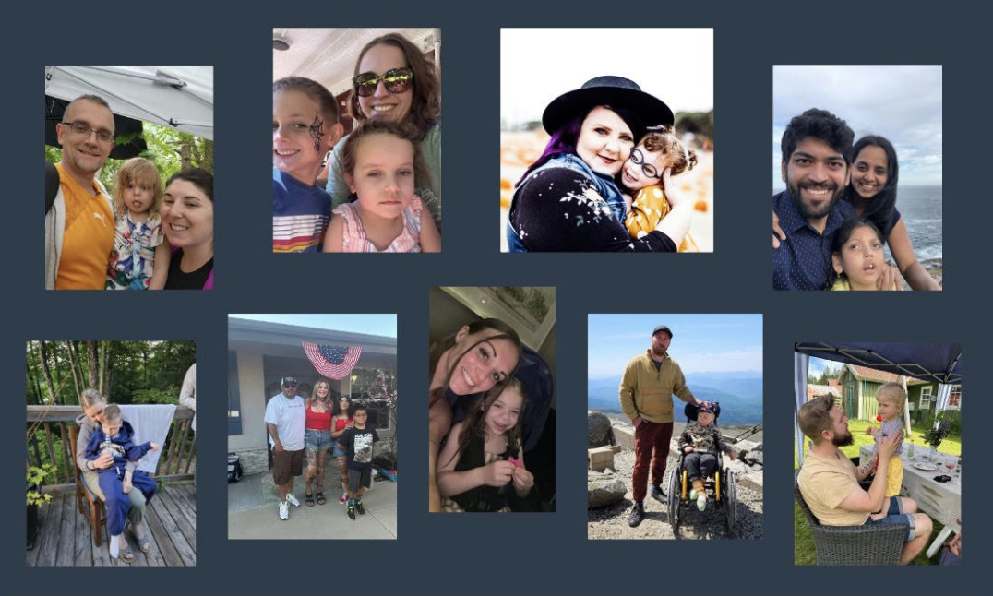
We MUST Embrace Data NOW to Find Cures Tomorrow
The COG Model
HIV Investments
Notes:
and its predecessor organizations have had a pivotal role in transforming childhood cancer from a virtually incurable disease 50 years ago to one with a combined 5-year survival rate of 86% today. Since the merger, COG researchers have published well over one thousand research manuscripts in peer-reviewed scientific journals, and routinely present results of research at national and international meetings. COG is widely recognized as the premier collaborative research organization, having enrolled more children with cancer on clinical trials than any other organization in the world.
COG hospitals treat 90% of children with cancer in the United States, providing the unmatched combination of global expertise and local care. This means that every child and care team has complete access to the latest research and world-class treatments at hospitals within close to home
Multidisciplinary teams consisting of physicians, research scientists, nurses, psychologists, pharmacists and other specialists
In addition to disease specific research, COG conducts studies in developmental therapeutics (new cancer drug development), supportive care, epidemiology, stem cell transplantation, behavioral sciences and survivorship
Test new ways to prevent, diagnose, and treat cancer in children and adolescents.
Include supportive care and childhood cancer survivorship studies.
Invested in mRNA vaccine research that led the way for COVID19 vaccines

Slide 35
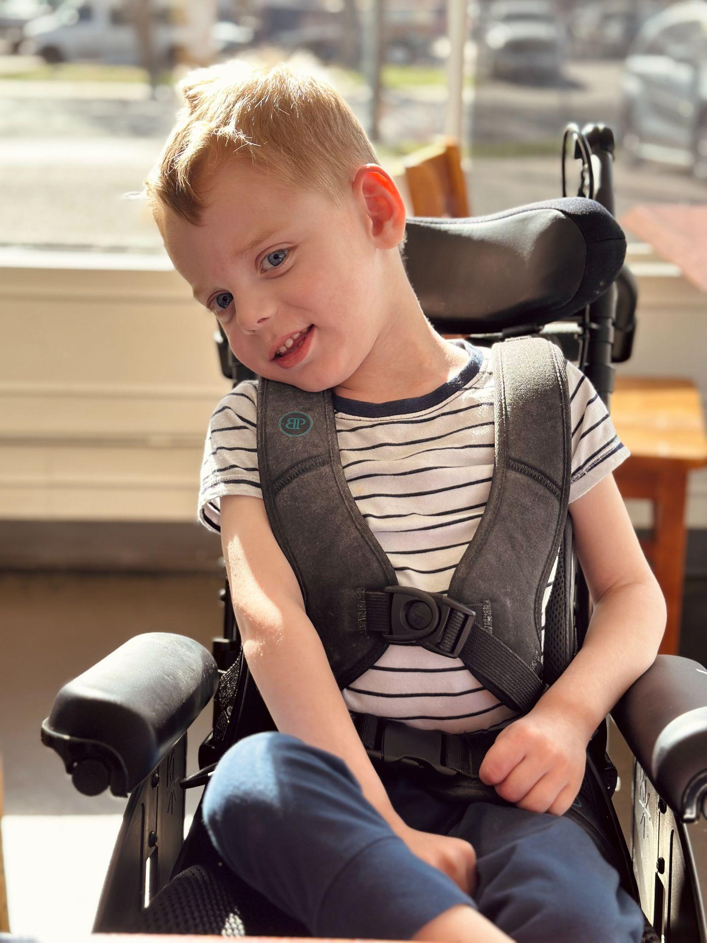
Path to Meaningful Endpoints
Engage Patient Communities from Day 1
Patient priorities need to underpin pre-clinical research and development
Unreliable measurement instruments undermine both NHS and assessment of trial outcomes
Collaborative effort needed across disorders with similar (profound) impacts to validate FFP outcome measurement tools
New DMT are at risk of failure without appropriate measurement tools and endpoints
PLACE AN IMAGE HERE
Notes:
Trial data should not be siloed - Natural history data should merge with CT
Use Data for Decision Making, Policy Making
Advance Digital Endpoints
Decentralized Trials Must be Considered When/Where Possible

Slide 36

The Answers Are Waiting for Us
“Radically new science demands radically new thinking about how we regulate, manufacture, pay for and deliver treatments. Ten years from now, if children are still dying of conditions we know how to correct, it will not be because the science wasn’t ready. It will be because we lacked the imagination to build a system worthy of it. KJ’s story is a miracle. But it should not remain a miracle. It should become a model.”
Dr. Jeff Coller, NYTimes OpEd, April 9th 2026

Slide 37




Be in touch
Notes:
What also became very clear is that the next bottleneck is no longer only science. The next bottleneck is the system.
We as institutional leaders need to match the speed, focus, and courage of these families:
- faster diagnostics,
- integrated data,
- more coordinated digitally enhanced care pathways,
- trial-ready clinical infrastructure,
- and a workforce trained to operate across genomics, neurology, translational science, informatics, and implementation.

Slide 38
Data for Endpoint Selection
Amy Raymond, PhD, PMP
Therapeutic Strategy Lead
Worldwide Clinical Trials

Slide 39
Goal: Safe, Effective, Meaningful Therapeutic Solutions
Submissions
Approval
Patient Access
Pre-Clinical | Clinical Development |  |  | Regulatory Review | Post-Marketing/LTFU
 | Phase I | Phase II | Phase III |  | Phase IV
Product Development Lifecycle

Slide 40
Shared Goal: Safe, Effective, Meaningful Therapeutic Solutions
Sponsor
Patients
Sites
CRO
Regulators
Payors
Submissions
Approval
Patient Access
Pre-Clinical | Clinical Development |  |  | Regulatory Review | Post-Marketing/LTFU
 | Phase I | Phase II | Phase III |  | Phase IV
Product Development Lifecycle

Slide 41
Rarity of Disease is a Spectrum
Rare and Orphan Diseases
Non-Rare / Common Diseases
n = 1
Primary Hyperoxaluria
Heme B
SMA
n = 1
Krabbe
Huntington’s
Sickle
Cell
Hunter Syndrome
Duchenne
Parkinson’s Disease
Type II Diabetes
Gaucher
Alzheimer's
Gaucher Type 2
MPS VI
NPC
ALS
Rett
Rheumatoid
Arthritis
n = 1
Fibrodysplasia Ossificans
MLD
Leigh Syndrome
PKU
Heme A
Stroke
MPS III
1 / 10,000,000
1 / 1,000,000
1 / 100,000
1 / 10,000
1 / 1,000
1 / 100
1 / 10
n = 1
100
1,000
10,000
100,000
1,000,000
10,000,000
5-6 per 10,000

Slide 42
Rarity of Disease is a Spectrum
Rare and Orphan Diseases
Non-Rare / Common Diseases
n = 1
n = 1
CHARACTERIZED
UNDERSTOOD
n = 1
1 / 10,000,000
1 / 1,000,000
1 / 100,000
1 / 10,000
1 / 1,000
1 / 100
1 / 10
n = 1
100
1,000
10,000
100,000
1,000,000
10,000,000
5-6 per 10,000

Slide 43
Expertise Anchored On Spectrum of Rarity
n = 1
“Appropriate” Endpoints
n = 1
Families & Patients
CHARACTERIZED
Science & Medicine
n = 1
n = 1

Slide 44
Expertise Anchored On Spectrum of Rarity X Heterogeneity
Families & Patients
KAND
Lupus
n = 1
n = 1
Families & Patients
CHARACTERIZED
Science & Medicine
n = 1
Primary
Hyperoxaluria
HETEROGENEOUS
n = 1
Hemophilia
Science & Medicine

Slide 45
With Each Decision, What Problem(s) Are We Solving/Making?
Sponsor
Patients
Sites
CRO
Regulators
Payors
Goal:
relief
RELIEF
relief
relief
relief

Slide 46


With Each Decision, What Problem(s) Are We Solving /Making?
Sponsor
Patients
Sites
CRO
Regulators
Payors
Goal:
relief
RELIEF
relief
relief
relief
 |  |  |  | No Constraints |  | No Role in Trial Design
Constraint:
Driver:
RELIEF

Slide 47
Endpoints: Key Attributes
Sponsor
Patients
Sites
CRO
Regulators
Payors
Valid
Interpretable
High-Signal
Low-Noise
Matter
Measurable
Valid
Interpretable
High-Signal
Low-Noise
Valid
Value

Slide 48
Endpoints: Key Attributes
Sponsor
Patients
Sites
CRO
Regulators
Payors

Slide 49
Shared Goal: Safe, Effective, Meaningful Therapeutic Solutions
Sponsor
Patients
Sites
CRO
Regulators
Payors

Slide 50
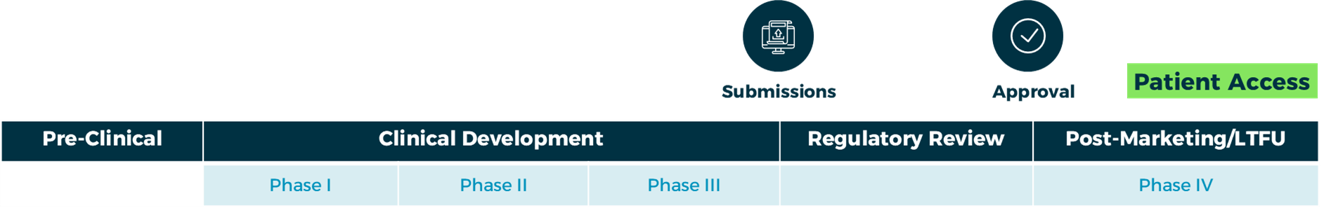
Shared Goal: Safe, Effective, Meaningful Therapeutic Solutions

Slide 51
Shared Goal: Safe, Effective, Meaningful Therapeutic Solutions

Slide 52
Thank You
Amy Raymond, PhD, PMP
Therapeutic Strategy Lead
Worldwide Clinical Trials
Amy.Raymond@Worldwide.com

