Slide 1
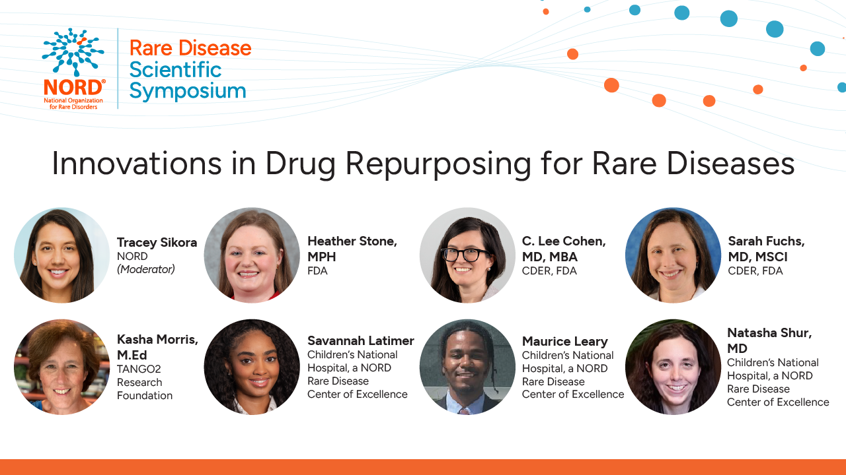

Slide 2
Cover Page

Slide 3
Drug Repurposing for Rare Diseases
Heather Stone, MPH - Health Science Policy Analyst and CURE ID Lead, CDER, Office of Medical Policy
C. Lee Cohen, MD MBA - Medical Officer, CDER, Division of Rare Disease and Medical Genetics
Sarah Fuchs, MD MSCI - Medical Officer, CDER, Division of Rare Disease and Medical Genetics
April 14, 2026

Slide 4
What is Drug Repurposing?
Use of an existing approved drug for a new indication
  Typically refers to FDA-approved products in U.S. regulatory context
  May also apply to drugs approved by other regulatory authorities
  Leverages known safety, pharmacokinetics, CMC (chemistry, manufacturing and controls), and efficacy (clinical and nonclinical)

Slide 5
Why Repurposing for Rare Disease?
Over 10,000 rare diseases¹; <5% have FDA-approved treatments²
  80% have a genetic cause²
  Traditional de novo drug development often not feasible
  Repurposing may cost ≤60% of de novo development³
  Average timeline ~6.5 years vs 13–15 years for new drugs⁴
¹Haendel et al. 2020 PMID 32020066
² The Lancet Global Health 2024 PMID 38365397
³Beachy et al 2014. PMID 24872991
⁴Nosengo et al 2016 PMID 27306171; Pinzi et al. 2024 doi: 10.3389/fddsv.2024.1460100

Slide 6
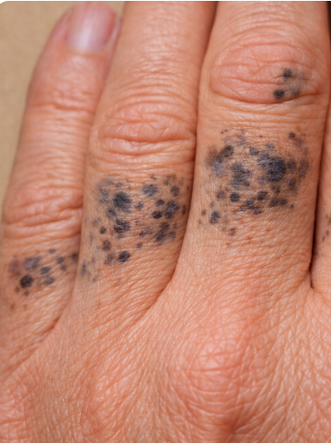
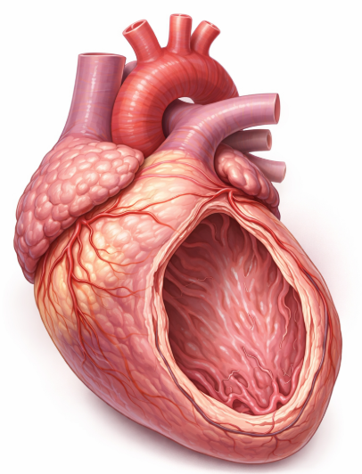
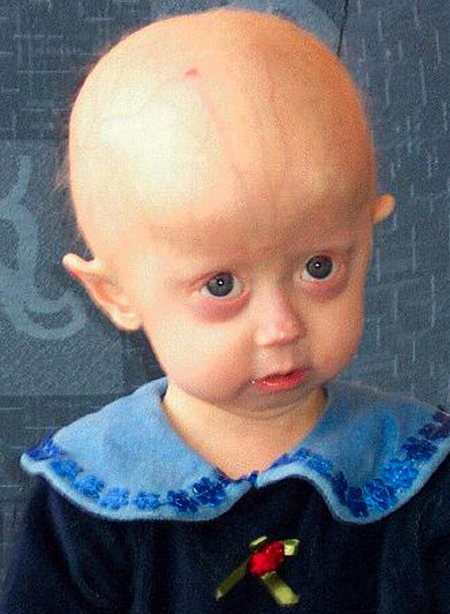
Three Examples
Nitisinone, an HPPD inhibitor used to treat hereditary tyrosinemia Type 1 (HT-1), repurposed to treat alkaptonuria¹
MEK inhibitors, used primarily for oncology, repurposed to treat cardiomyopathy in Noonan Syndrome²
Lonafarnib, investigated as an anticancer agent, used to treat Hutchinson-Gilford Progeria Syndrome³
¹ Ranganath et al 2016 PMID 25475116
² Chaput and Andelfinger 2024 PMID 38432396; Wolf et al. 2025 PMID 40131150
³ Zainzinger 2022 DOI: 10.1021/cen-10024-cover3; Suzuki et al. 2023 PMID 36507973; Dhillon 2021 33590450).
Images: ChatGPT and WikiMedia Commons

Slide 7
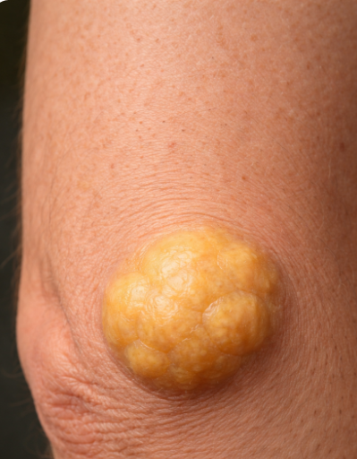
Chenodiol (CDCA): Gallstones to Cerebrotendinous Xanthomatosis
Chenodiol (CDCA): FDA-approved (1983) for radiolucent gallstones
Cerebrotendinous Xanthomatosis (CTX): Rare autosomal recessive disorder affecting bile acid synthesis
History:
  1984:17-patient case series demonstrated clinical and biochemical improvement on chenodiol
  Standard of care for decades before approval
FDA Approval:
  Sponsor (Mirum Pharma) conducted phase 3 RESTORE trial
    Demonstrated reduction in disease biomarkers (cholestanol)
    Leveraged RWE to correlate biomarker and clinical outcomes, and assess long-term safety
  FDA approved chenodiol (Ctexli) for CTX in 2025
Images: ChatGPT

Slide 8
How to Pursue Repurposing (as an Investigator)?
Hypothesis
Mechanism
High-Throughput Screens
CURE ID
Published evidence
Computational models
Proof of Concept
Expanded Access
  Single Patient IND
  Intermediate Size Treatment INDs
Real World Data/Evidence
Investigational INDs/FDA Approval
Meet with FDA early and often, including pre-IND, to build a regulatory-oriented study & development plan
505(b)(2): Bridge to a “Listed Drug”, or rely on published literature
505(b)(1): Partner with Commercial Sponsor or obtain Right of Reference

Slide 9
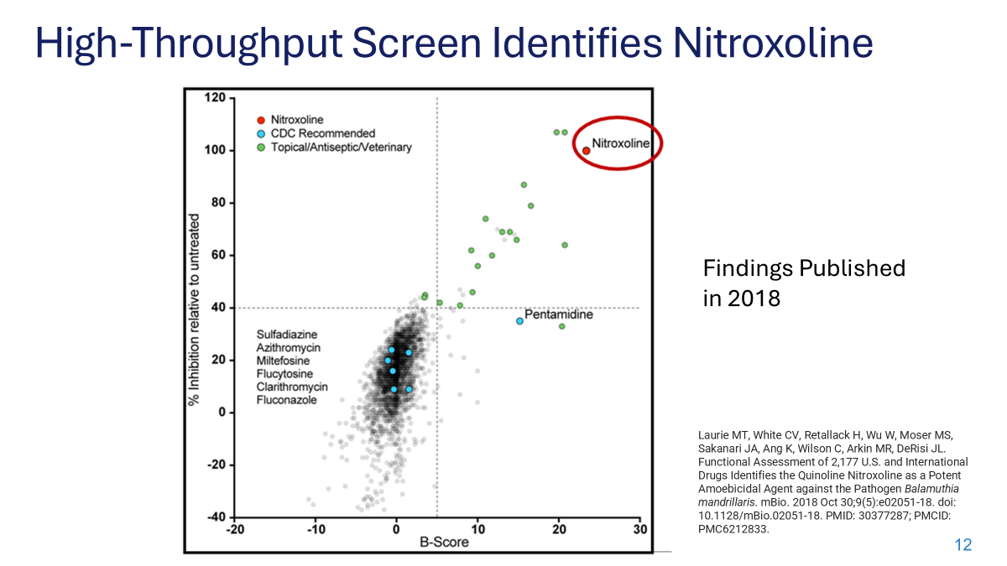
Notes:
“Here is an example of how high-throughput drug screens” can identify promising treatments that can lead to further clinical study. In this case, Joe DeRisi’s lab at UCSF screen 2000+ approved products and identified a single drug, nitroxoline, that had tremendous previously unknown amoebicidal activity.

Slide 10
How to Pursue Repurposing (as an Investigator)?
Hypothesis
Mechanism
High-Throughput Screens
CURE ID
Published evidence
Computational models
Proof of Concept
Expanded Access
  Single Patient IND
  Intermediate Size Treatment INDs
Real World Data/Evidence
Investigational INDs/FDA Approval
Meet with FDA early and often, including pre-IND, to build a regulatory-oriented study & development plan
505(b)(2): Bridge to a “Listed Drug”, or rely on published literature
505(b)(1): Partner with Commercial Sponsor or obtain Right of Reference

Slide 11
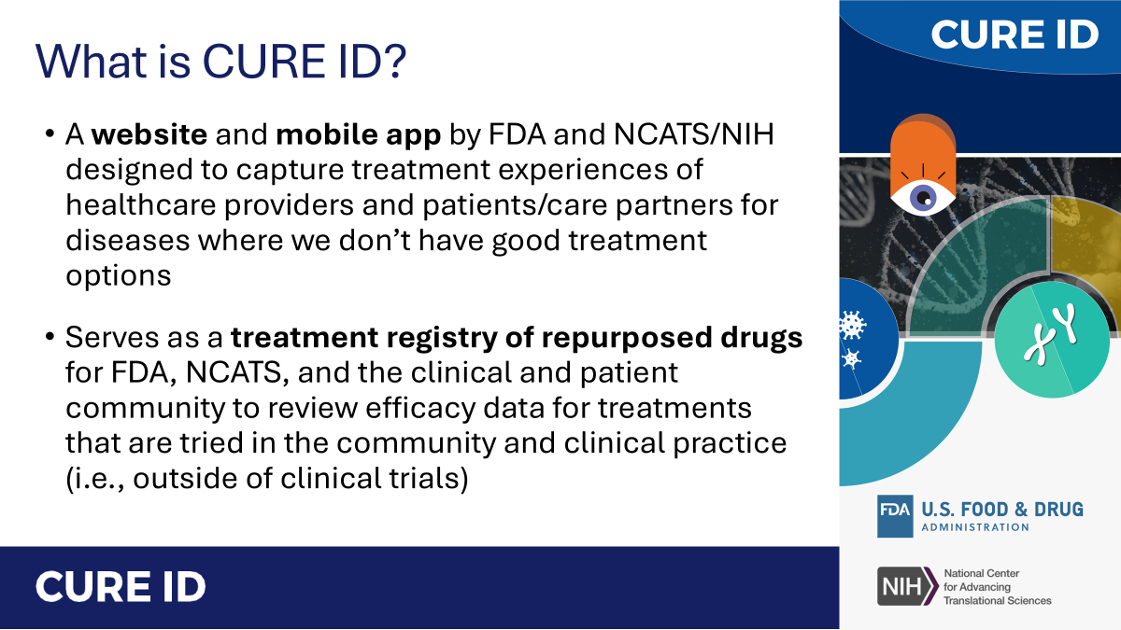

https://cure.ncats.io

Slide 12
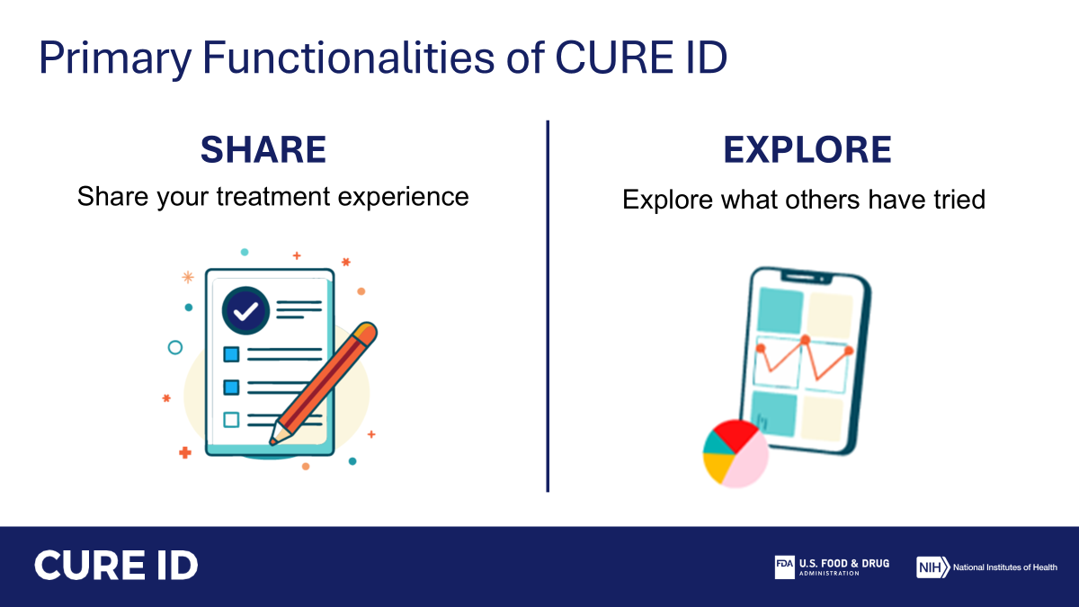
https://cure.ncats.io

Slide 13
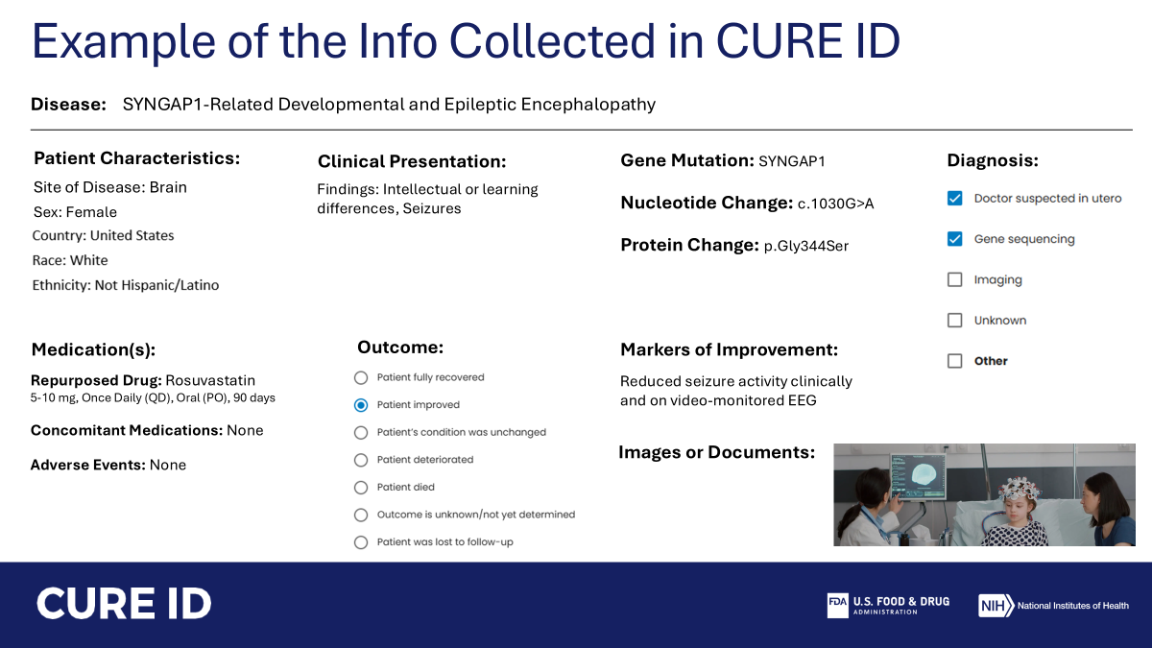
https://cure.ncats.io

Slide 14
How to Pursue Repurposing (as an Investigator)?
Hypothesis
Mechanism
High-Throughput Screens
CURE ID
Published evidence
Computational models
Proof of Concept
Expanded Access
  Single Patient IND
  Intermediate Size Treatment INDs
Real World Data/Evidence
Investigational INDs/FDA Approval
Meet with FDA early and often, including pre-IND, to build a regulatory-oriented study & development plan
505(b)(2): Bridge to a “Listed Drug”, or rely on published literature
505(b)(1): Partner with Commercial Sponsor or obtain Right of Reference

Slide 15


Resources for Treatment and Investigational INDs
FDA Guidances
Pre-IND Meetings and FAQs
IND Submission Process
FDA Rare Disease Innovation Hub
  Rare Disease Innovation, Science, and Exploration (RISE) workshops, Rare Disease Evidence Principles (RDEP), patient engagement
Orphan Drug Act Incentives
  Market exclusivity, tax credits, waiver of user-fees, protocol assistance
Accelerating Rare disease Cures (ARC) Program
  Leader 3D Initiative
Reagan-Udall Expanded Access eRequest

Slide 16
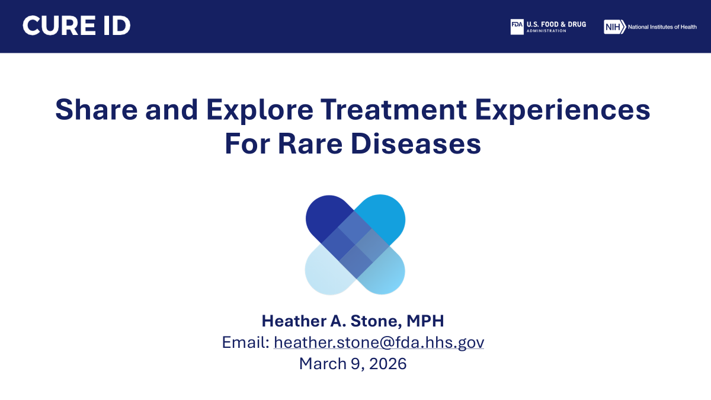

Slide 17
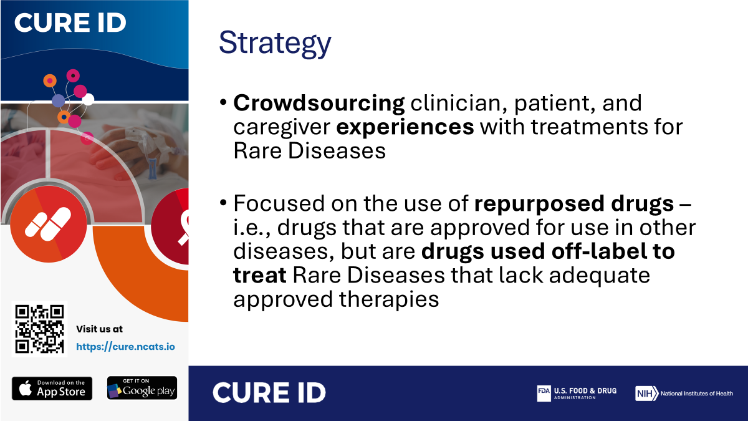

Slide 18
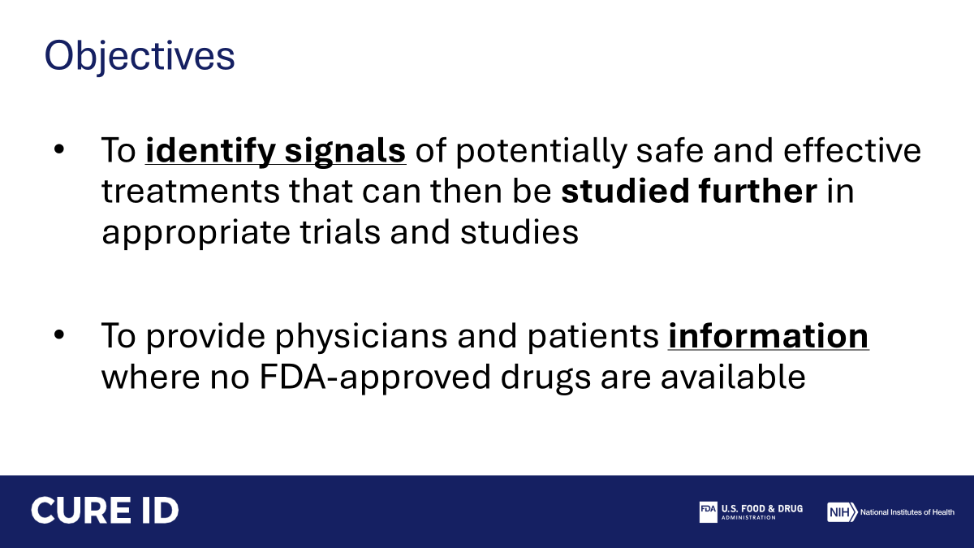

Slide 19
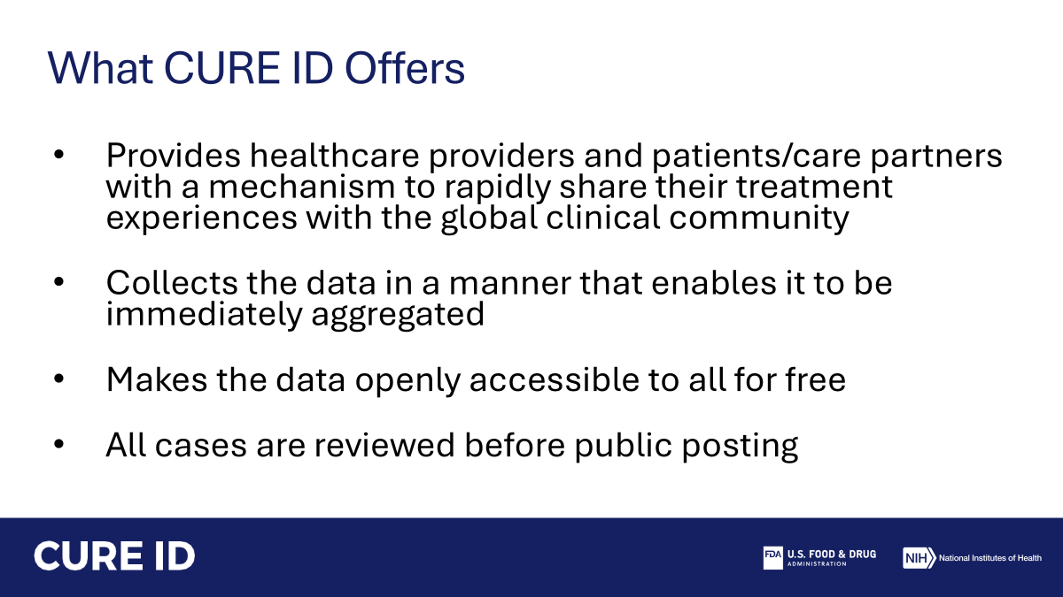

Slide 20
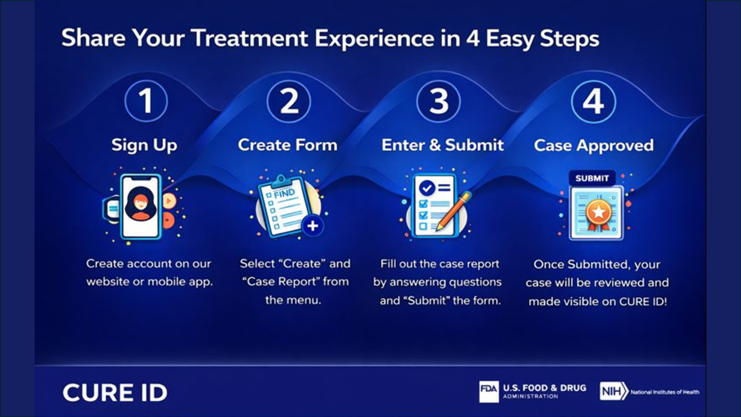

Slide 21
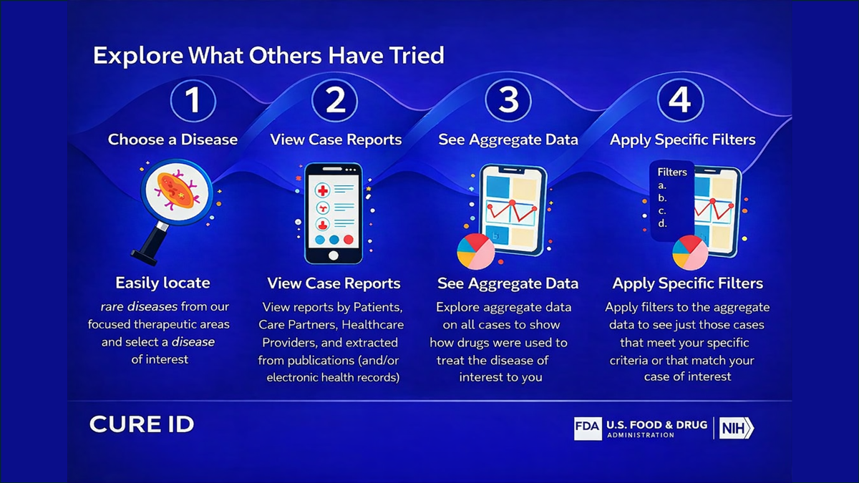

Slide 22
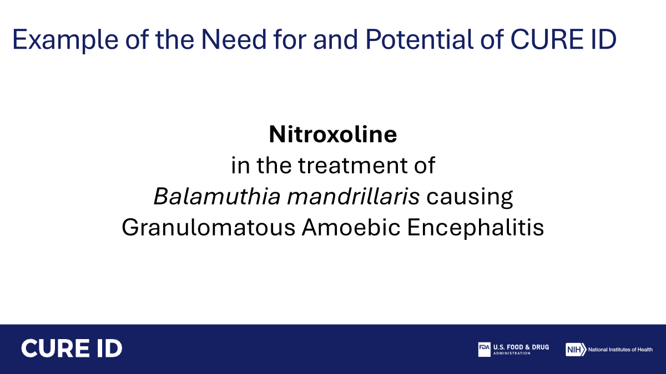

Slide 23
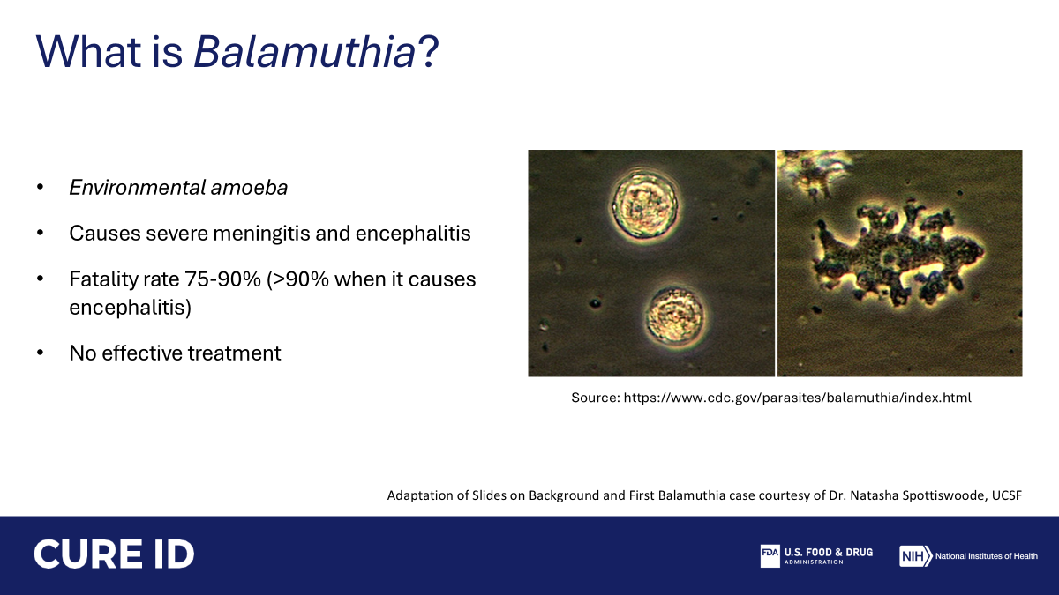

Slide 24
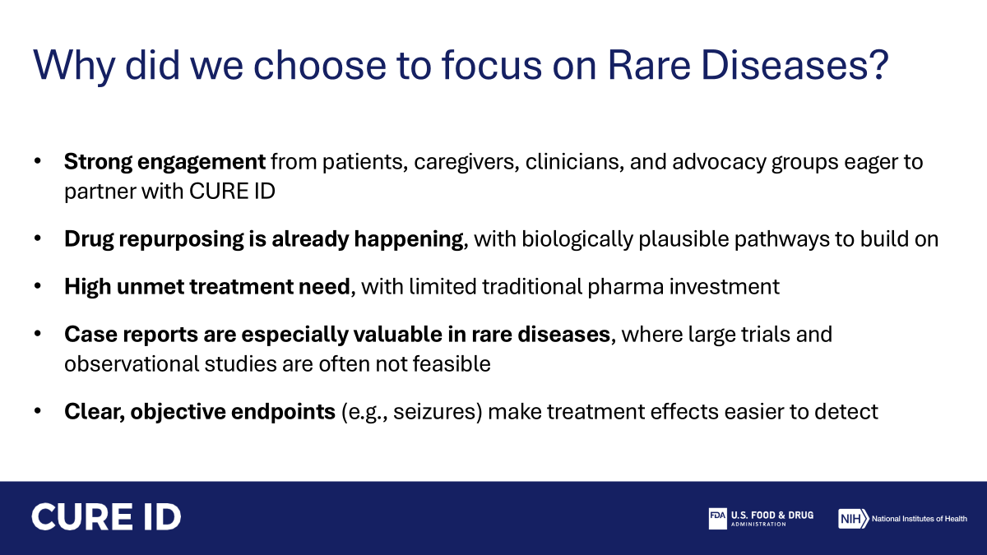

Slide 25
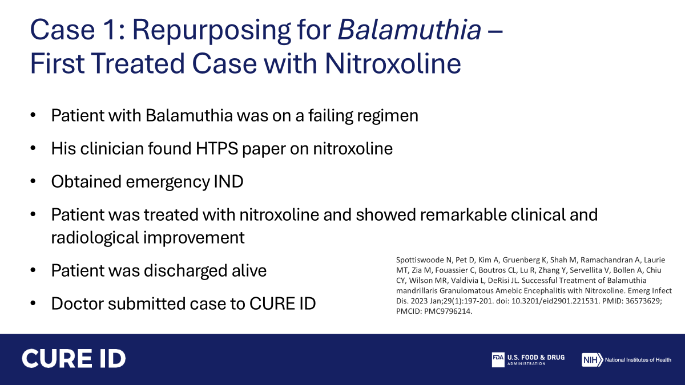

Slide 26
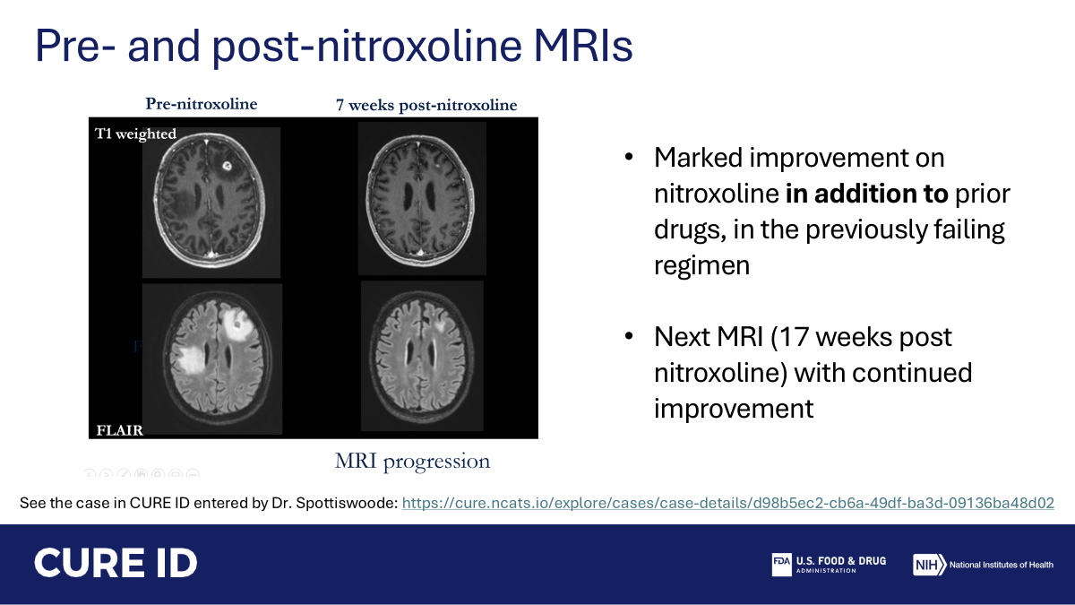

Slide 27
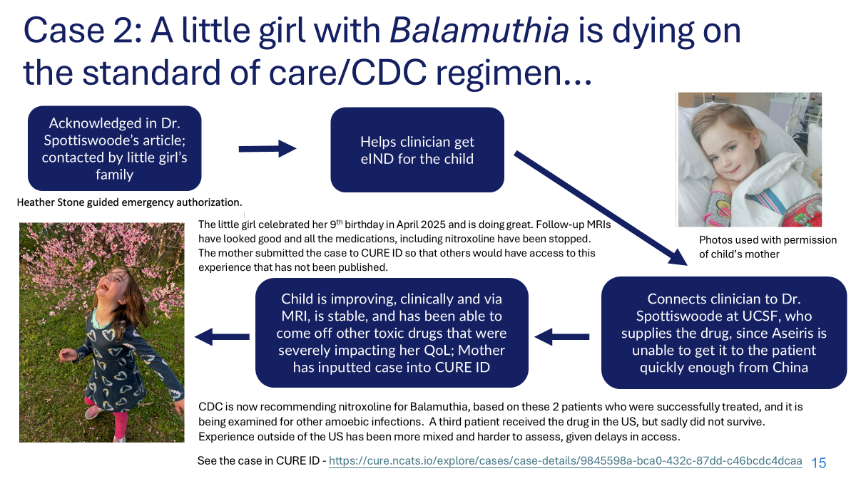

Slide 28


Slide 29
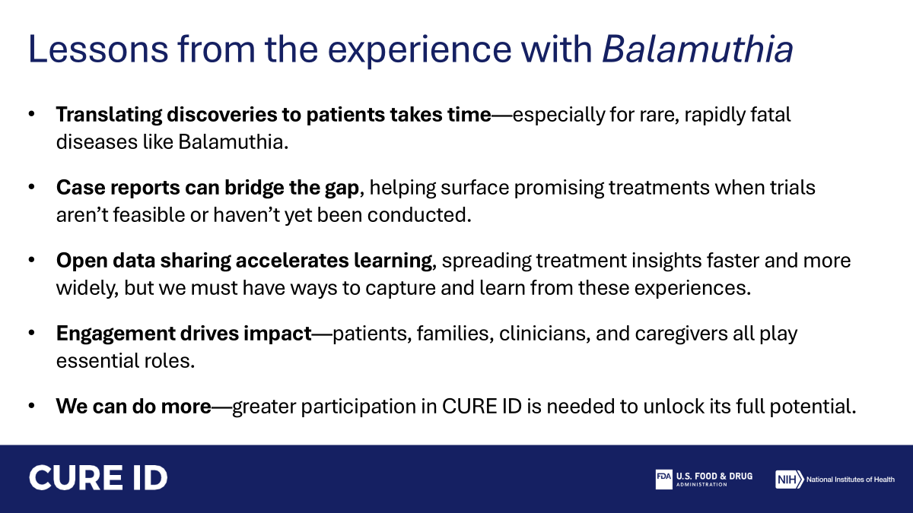

Slide 30
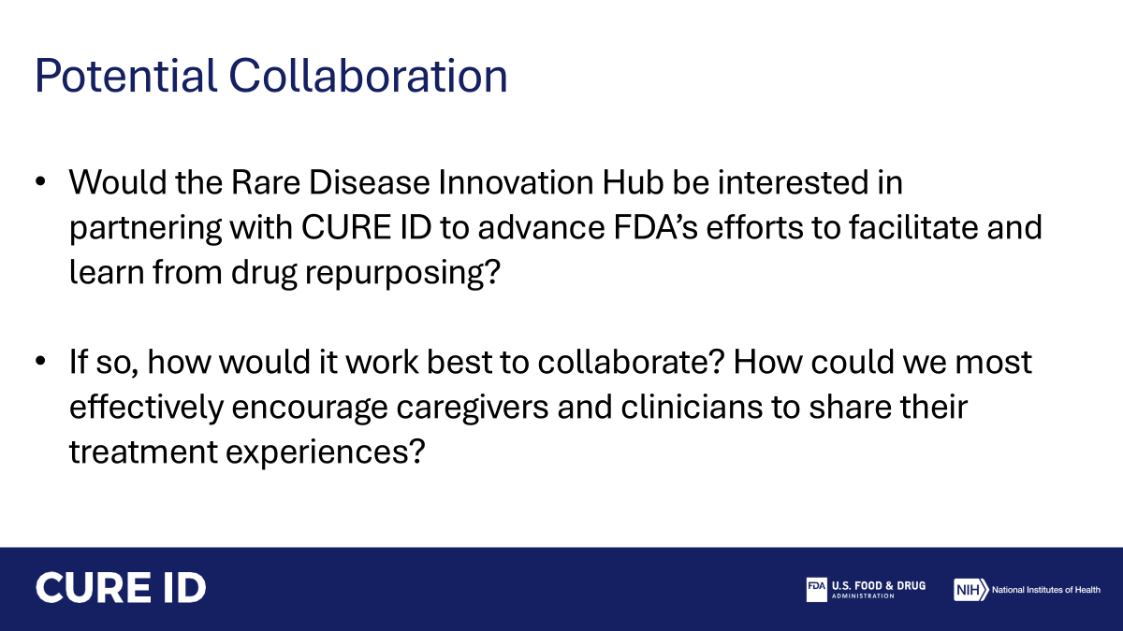

Slide 31
D-React: Dexamethasone for Rhabdomyolysis: From Case Study to Clinical Trial
PI: Dr. Natasha Shur
Co-Investigators Children’s National Hospital
Bobbe Thomas, Savannah Latimer, Maurice Leary, Dr. Seth Berger, Dr. Marissa Horrigan, Dr. Elaise Hill, Dr. James Novak, Dr. James Chamberlain
Presenters
Savannah Latimer B.S., Maurice Leary B.S., Natasha Shur M.D.
Children’s National Rare Disease Institute, Children’s National Emergency Room Washington DC

Slide 32
Conflicts of Interest
Funded by Cures Within Reach

Slide 33
Background

Slide 34
Rhabdomyolysis: Background
Pediatric rhabdomyolysis is a condition characterized by muscle breakdown and risk of kidney damage
More recent data from the US inpatient database indicate an average of 37,000 rhabdomyolysis-related hospitalizations per year between 2016 and 2018
Symptoms: darkened urine, significant muscle pain, trouble moving, periodic paralysis, risk for kidney injury and even death
Therapy: limited to fluid resuscitation and supportive care.

Slide 35
Rhabdomyolysis: Background
Need
Increased incidence in paediatric cases with infection, and in all populations with intensive exercise (military recruits), obesity, and sickle cell carriers
Significant unmet need for improved interventions to decrease pain and morbidity
Pain is a very significant complaint and reason for admission
Understudied condition

Slide 36
Clinical Trial

Slide 37
Rhabdomyolysis Project Inspiration
Case:
Viral illness/ C diff
CKs would not go down for five days
Consulted with Jerry Vockley, MD, PhD, FACMG
He said, “Try some steroids.”

Slide 38
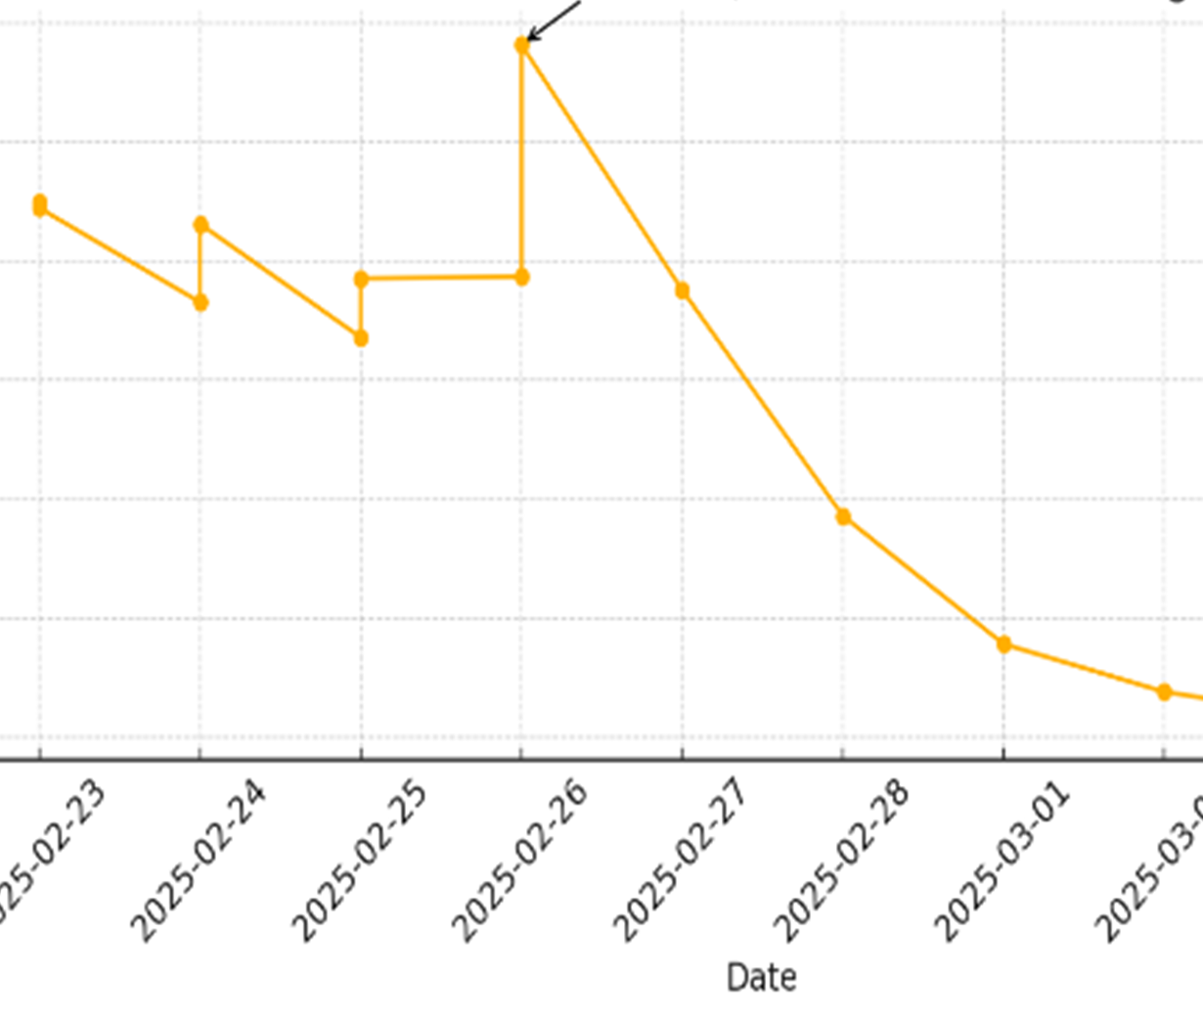
Rhabdomyolysis post-flu
Case
16-year-old unvaccinated patient
Genetics at our Institution consulted on day 3
Dexamethasone initiated on the arrow
Pain relief

Slide 39
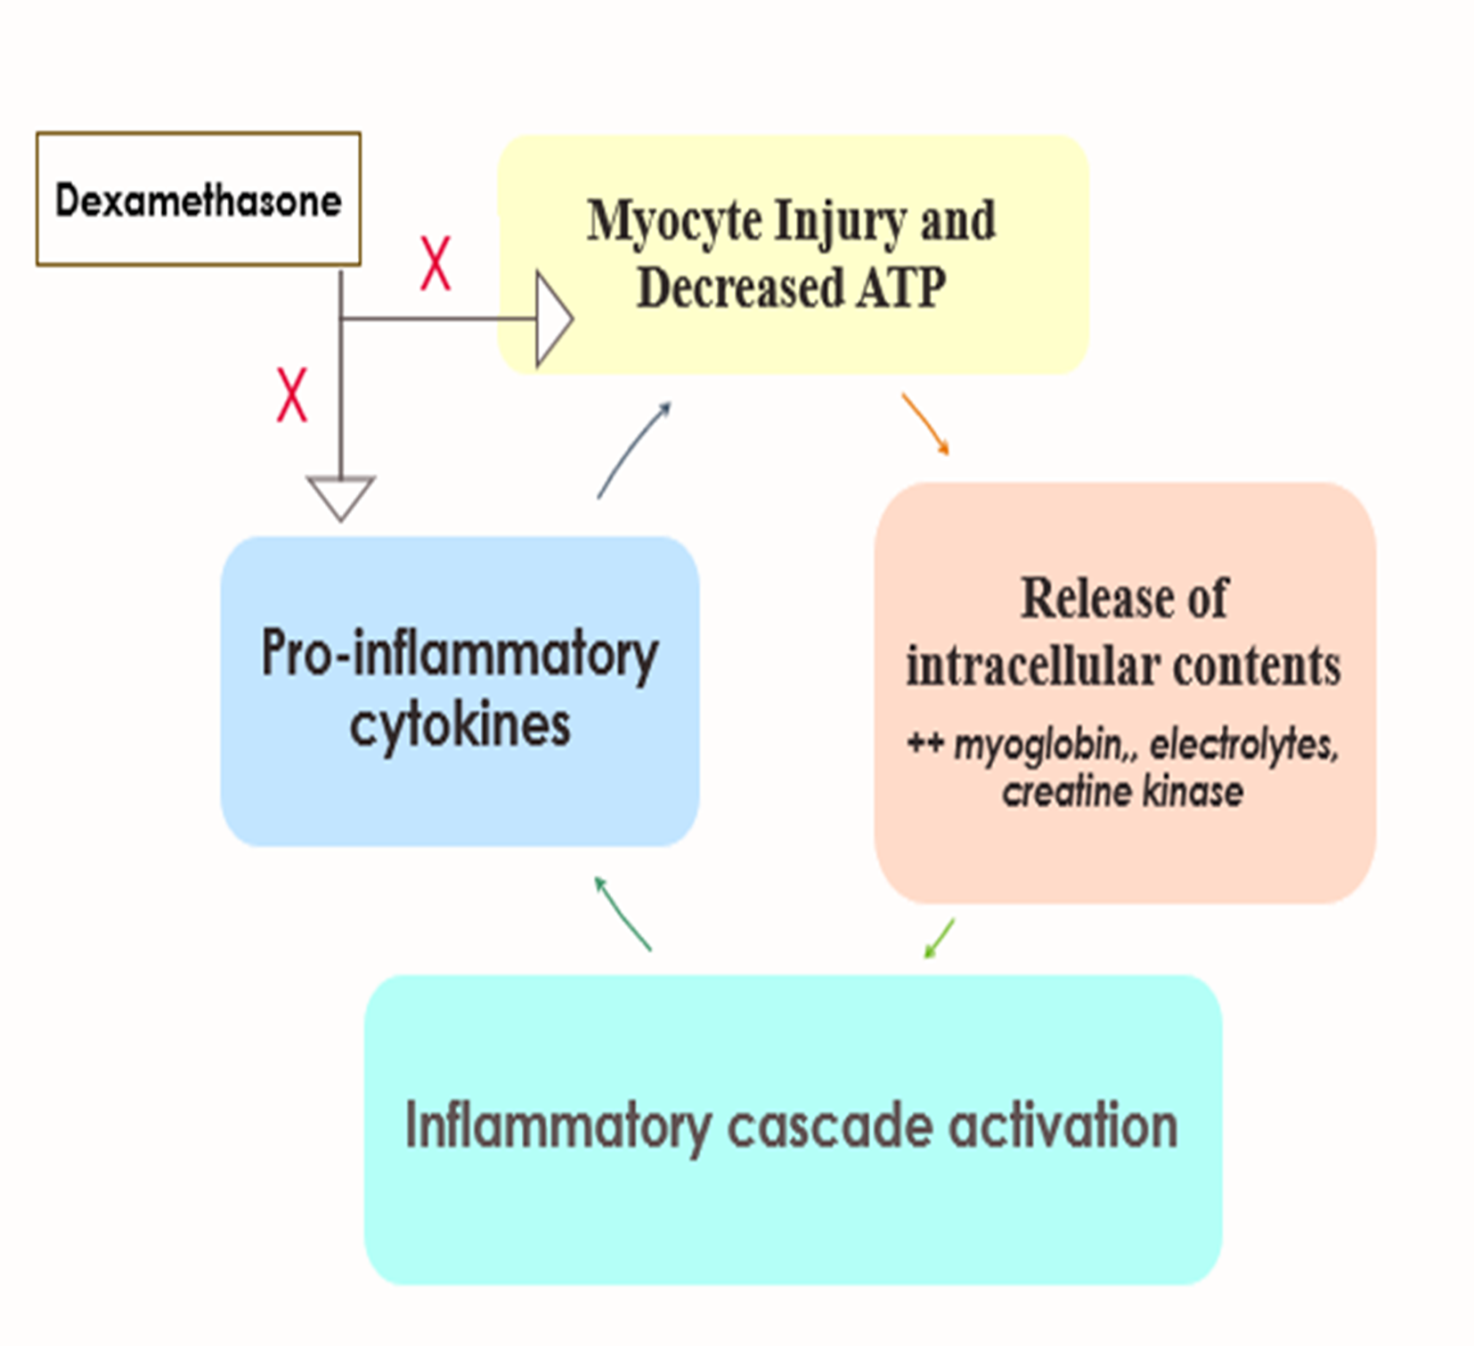
Proposed Dexamethasone Counteraction
1. In pathologic states, there is prolonged presence of high calcium levels sustained myofibrillar contraction that further depletes ATP/ energy
2. This results in inflammatory, self-sustaining myolytic cascade that causes muscle necrosis and releases the muscle contents into the bloodstream
3. Dexamethasone counteracts the inflammatory cascade

Slide 40
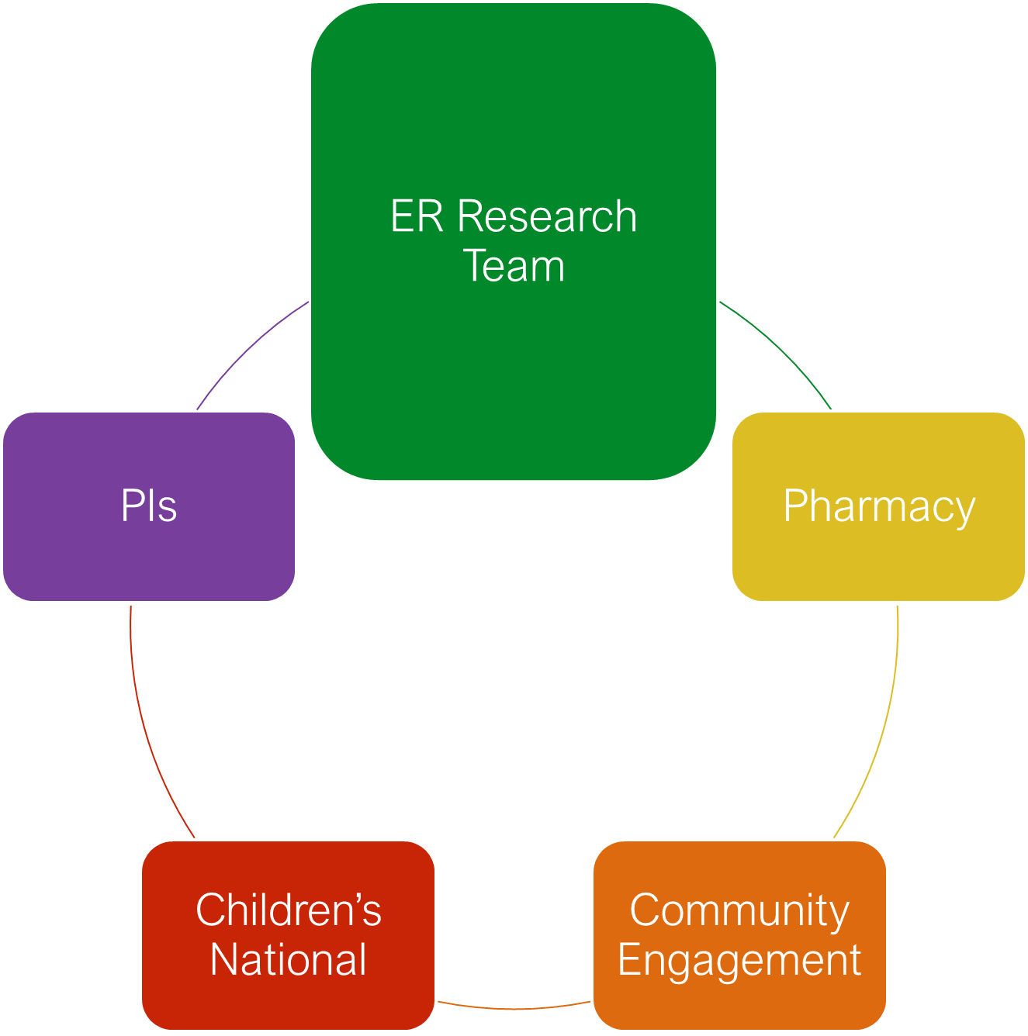
Cures within Reach Study Design
Randomized, placebo-controlled, double-blind trial
  2:1 randomization (dexamethasone:placebo)
  0.6 mg/kg, max 16mg per dose.
Population: Ages 6 months–21 years, CK >5,000, non-traumatic rhabdomyolysis
Primary outcome: CK clearance rate (half-life)
Secondary outcomes: AKI, length of stay, admission rate, pain scores
Study status: IRB, SRC, IND received, currently launched, enrollment 6/7 consented
Limitations/ Lessons Learned: Better to have 50/50 treatment/ placebo group going forward and pain functional score may be a better primary outcome for future studies
Notes:
SRC - Scientific Review Committee

Slide 41
SPEC AIM
Evaluate the safety and efficacy of steroid use in pediatric emergency departments to inform international treatment protocols using a low-cost, widely available intervention.
Details: 2:1, up to five doses of dexamethasone 24 hours apart versus placebo group.
Dose: 0.6 mg/kg, max 16mg per dose.
Primary Hypothesis: Dexamethasone will result in a more rapid decline in CK levels than placebo.

Slide 42
Primary & Secondary Outcomes
Primary : CK half-life (T½) for serum CK to decrease by 50% from peak value. average CK half-life is approximately 36 hours (13, 14). CK will be collected every 12 hours until < 5000, and we will use model CK using exponential regression and a t-test for calculation.
Secondary Outcomes include:
  Length of Stay
  Quality of life
Instruments will include REDCap patient and family surveys
Notes:
IV vs. Placebo

Slide 43
Exploratory Aim
Goal
To identify early predictive biomarkers and clinical features associated with severe outcomes in pediatric rhabdomyolysis.
Justification
Rhabdomyolysis presentations vary: Some resolve quickly, others progress to AKI or prolonged hospitalization.
No current predictive tools to triage high-risk patients early.
Biomarker profiling (e.g., CK kinetics, inflammatory markers) may reveal patterns not visible through standard labs.

Slide 44
Community Engagement

Slide 45

Objective
To gauge community perspectives on a proposed study for rhabdomyolysis
Facilitates equitable community involvement and is integral to community engaged research.

Slide 46
Study Design
Estimated eligible:
Conducted
  Focus Groups
    Gather in-depth insights and perspectives from participants regarding
  Surveys
    More than 400 hundred participants interviewed
  One-on-one interviews with coaches and target population athletes
  Developed an educational video

Slide 47
References
  Stanley M, Chippa V, Aeddula NR, et al. Rhabdomyolysis. [Updated December 11, 2024]. In: StatPearls [Internet]. Treasure Island (FL): StatPearls Publishing; January 2025–. Available from: https://www.ncbi.nlm.nih.gov/books/NBK448168/
  Nelson DA, Deuster PA, Carter R III, Hill OT, Wolcott VL, Kurina LM. Sickle cell trait, rhabdomyolysis, and mortality among U.S. Army soldiers. N Engl J Med. 2016;375(5):435-442. doi:10.1056/NEJMoa1516257
  Nelson DA, Cox JM, Sallis RE, et al. Exertional rhabdomyolysis: an epidemiologic study of emergency department visits and hospitalizations. J Sports Med Phys Fitness. 2021;61(10):1343-1350. doi:10.1080/00913847.2021.1956288
  Shah SS, Balamuth F, McGlinchey P, et al. Pediatric rhabdomyolysis: epidemiology and hospital outcomes. Pediatr Emerg Care. 2022;38(12):e1121-e1126. doi:10.1097/PEC.0000000000002607
  Torres PA, Helmstetter JA, Kaye AM, Kaye AD. Rhabdomyolysis: pathogenesis, diagnosis, and treatment. Ochsner J. 2015 Spring;15(1):58-69. PMID: 25829882; PMCID: PMC4365849.
  Coutinho AE, Chapman KE. The anti-inflammatory and immunosuppressive effects of glucocorticoids, recent developments and mechanistic insights. Mol Cell Endocrinol. 2011 Mar 15;335(1):2-13. doi: 10.1016/j.mce.2010.04.005. Epub 2010 Apr 14. PMID: 20398732; PMCID: PMC3047790.
  Johnson DB, Lopez MJ, Kelley B. Dexamethasone. Treasure Island (FL): StatPearls Publishing. 2023 May 2; https://www.ncbi.nlm.nih.gov/books/NBK482130/ [ncbi.nlm.nih.gov]
  Lewis SS, Valberg SJ, Nielsen IL. Suspected immune-mediated myositis in horses. J Vet Intern Med. 2007 May-Jun;21(3):495-503. doi: 10.1892/0891-6640(2007)21[495:simih]2.0.co;2. PMID: 17552457.
  Lin, JW., Huang, YM., Chen, YQ. et al. Dexamethasone accelerates muscle regeneration by modulating kinesin-1-mediated focal adhesion signals. Cell Death Discov. 7, 35 (2021). https://doi.org/10.1038/s41420-021-00412-4
  Yeganeh M, March K, Jones C, Ho G, Selby KA, Chanoine JP, Stockler S, Salvarinova R, Horvath G, Brunel-Guitton C. Use of dexamethasone in acute rhabdomyolysis in LPIN1 deficiency. Mol Genet Metab Rep. 2023 Mar 10;35:100961. doi: 10.1016/j.ymgmr.2023.100961. PMID: 36941958; PMCID: PMC10024045.
  Leary M, Latimer S, Thomas B, Lee A, Horrigan M, Shur N, Berger S. A retrospective natural history study of rhabdomyolysis in a diverse pediatric hospital: findings of a bimodal age distribution and healthcare disparity. Poster presented at: Children’s National Research and Innovation Week; 2025.
  Summerlin ML, Regier DS, Fraser JL, et al. Use of dexamethasone in idiopathic, acute pediatric rhabdomyolysis. Am J Med Genet A. 2021;185(2):500-507. doi:10.1002/ajmg.a.62000
  Cunha M, Pinho I, Lopes M, Trigueiros F, Braz S, Medeiros F. A case of corticosteroid-responsive SARS-CoV-2 related massive rhabdomyolysis. IDCases. 2020;22:e00946. doi: 10.1016/j.idcr.2020.e00946. Epub 2020 Sep 4. PMID: 32901220; PMCID: PMC7471856.
  Hammers M, Hashim F, Hanna C, Farris A, Blasick S. Refractory rhabdomyolysis responsive to corticosteroid therapy. Proc (Bayl Univ Med Cent). 2020 Dec 14;34(2):314-315. doi: 10.1080/08998280.2020.1851627. PMID: 33678976; PMCID: PMC7901411.
  Cures Within Reach. Using steroids to improve rhabdomyolysis outcomes in pediatric patients. Accessed April 3, 2025. https://www.cureswithinreach.org/
  Horrigan M, Latimer S, Thomas B, Berger S, Shur N. Lessons learned from the pre-initiation process of an investigator-initiated trial for pediatric rhabdomyolysis. Poster presented at: Children’s National Research and Innovation Week; April 1, 2025; Washington, DC.

Slide 48
Special thank you to Dr. Natasha Shur, Bobbe Thomas, and Dr. Jim Chamberlain for their guidance and leadership.
Thank you to the National Organization for Rare Diseases for the opportunity to share this research.
Lastly, thank you Children’s National Hospital, without which, this would not be possible!

Slide 49


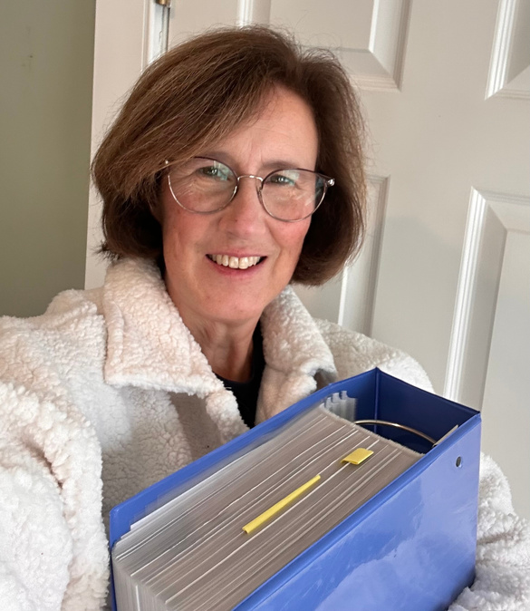

TANGO2 -
related deficiency disorder
“B-lieve”
What if the antidote for a genetic killer was a common household vitamin sitting on
your kitchen counter?

Slide 50
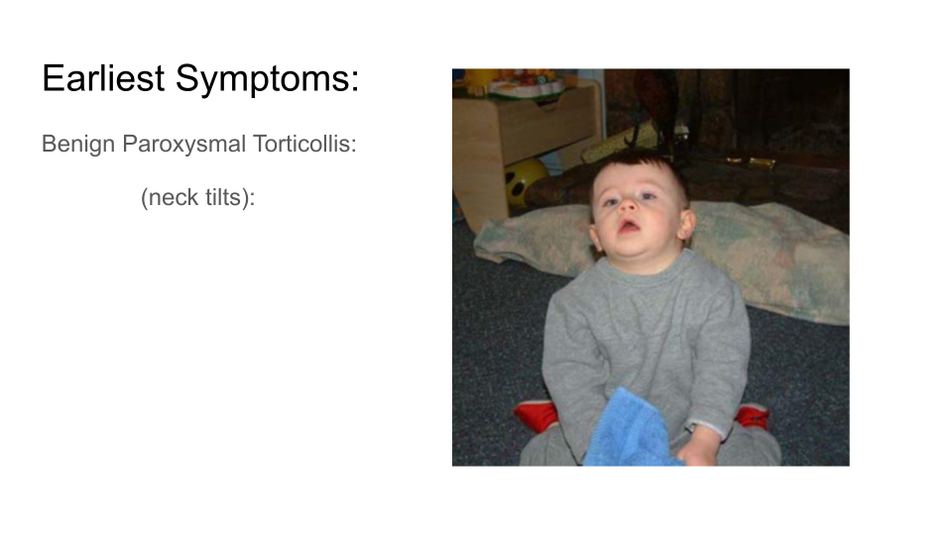
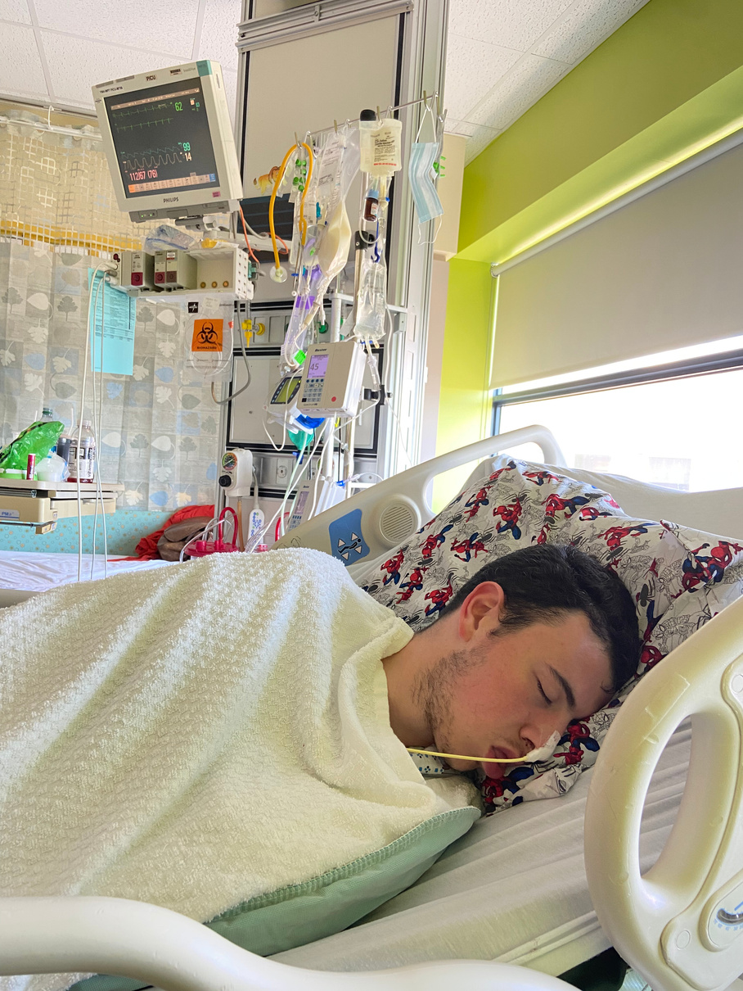
What if the antidote for a genetic killer was a common household vitamin sitting on
your kitchen counter?
Ryan’s Diagnostic Journey
~15 years

Slide 51
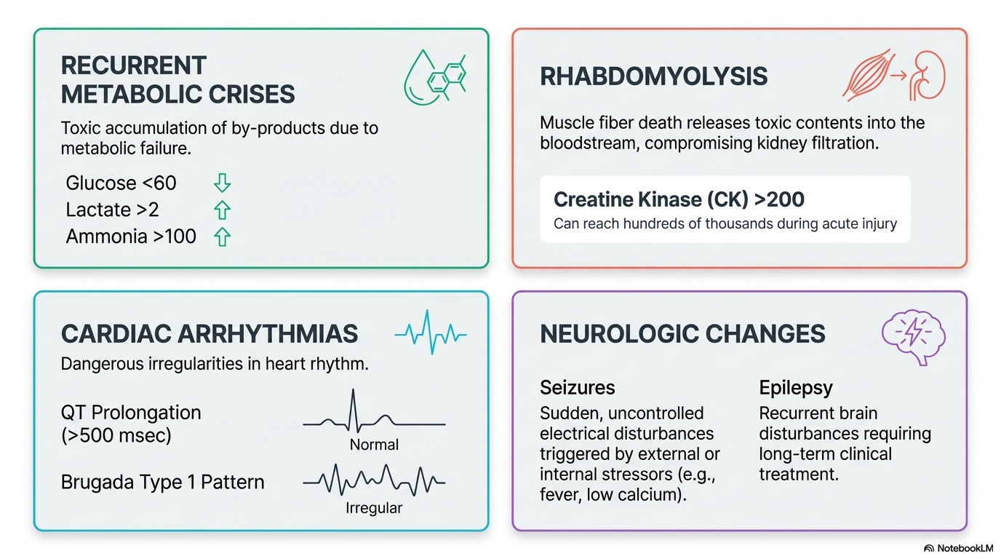
TANGO2 Deficiency Disorder

Slide 52

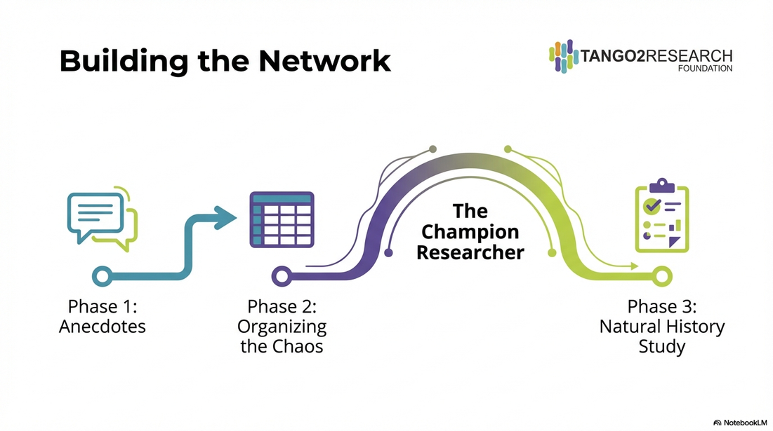

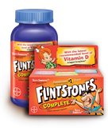

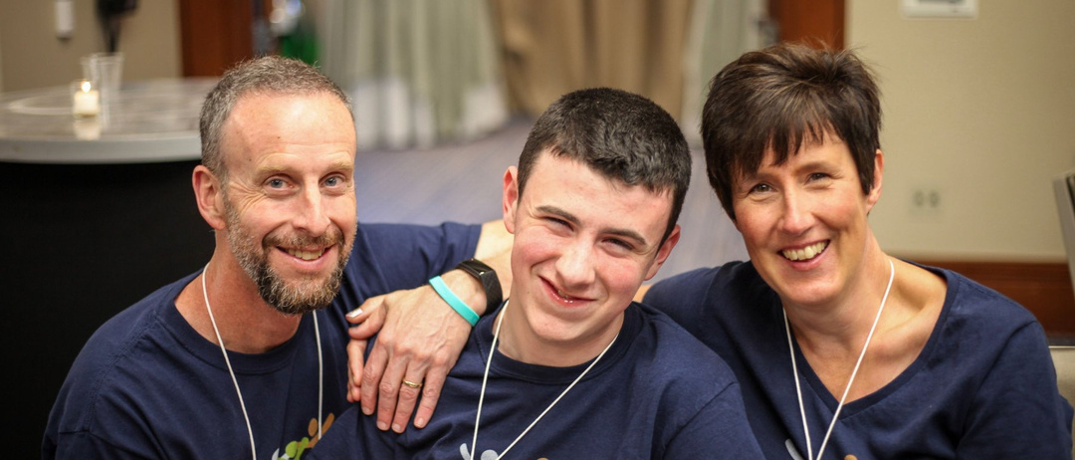
MISSION
  Natural History Study
Our mission is to lead the way in finding a cure for TANGO2 deficiency disorder.
  12 initial patients in NHS
  Pattern emerges
Notes:
Mike and I decided to start the TANGO2 research Foundation in 2018 in hopes that we could help fast forward research so that it might benefit Ryan and others like him. We couldn’t sit at home waiting for research information to eventually trickle down to us sometime in the distant future. I remember saying, “We don’t know how to run a research foundation.” and Mike’s reply, “We’ll just figure it out as we go.”
So we gathered other families from the fb group and we got to work. Like a spoke in the center of a wheel we worked to make connections to doctors, researchers, families, anyone touched by or interested in Tango2. My spreadsheet of notes started to grow and it would eventually become the basis for a natural history study of the disease.
Those first 12 families joined the NHS and answered over 100 questions about their child. We were looking for patterns. Why did some kids have metabolic crisis and heart arrhythmias and others like Ryan didn't? How come some survived while almost 20% didn't? And just like he had for the past 14 years, Mike made a point to bring up the Flinstone vitamins and how it seemed to help Ryan way back in 2003. This time someone listened. The lead researcher of the NHS was very interested in understanding why Ryan had never had a metabolic crisis while other children had many. Some kids couldn’t walk or talk, while Ryan could. Why was his case milder? So the mention of the vitamins and how it seemed to help was of real interest to her. She started to ask other families in the study about vitamins. Did their child take any? When? What kind?
At our very first t2 family conference just over a year after we started the foundation, we first heard about some of the early indications coming from the study. Even with only 12 participants, a pattern was still emerging showing that kids who had never had a life threatening crisis at all like Ryan, were taking vitamins in particular, B vitamins. She told us after her talk that it was the mention of Flinstones vitamins that got her interested in following that lead that led to this finding.
Over the following few years we continued to enroll more patients in the NHS and funded lab research trying to get at the function of the TANGO2 gene. By 2023 There were about 100 patients enrolled in the NHS and the evidence supporting the role of vitamins was getting stronger.

Slide 53
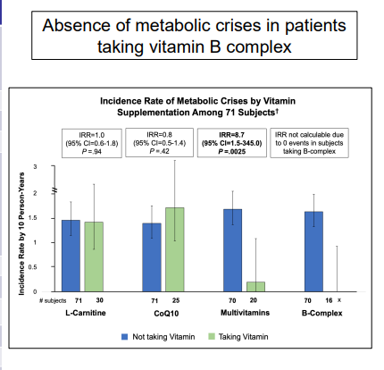
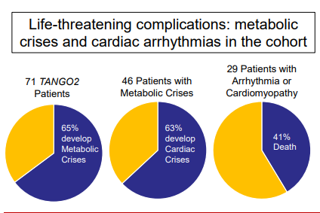
Those taking
B vitamins had no crises
  Miyake, C. Y., Lay, E. J., Soler-Alfonso, C., Glinton, K. E., Houck, K., et al. (2023). Natural history of TANGO2 deficiency disorder- Baseline assessment of 73 patients. Genetics in Medicine, 25(4).

Slide 54
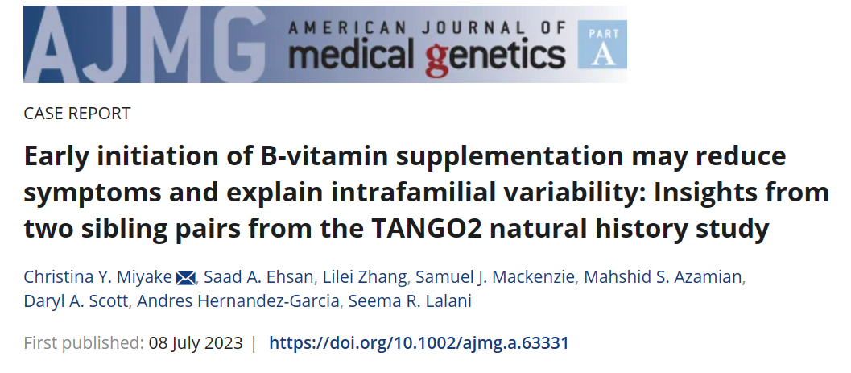

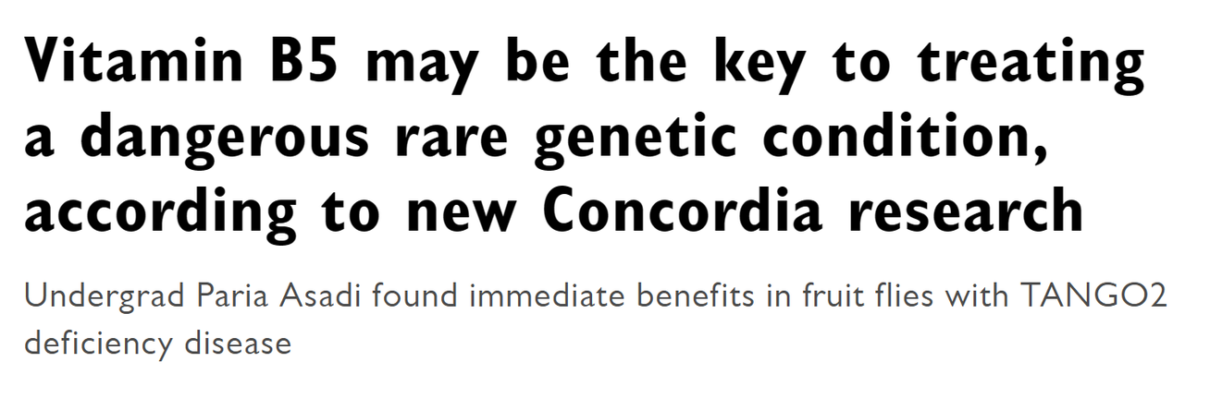
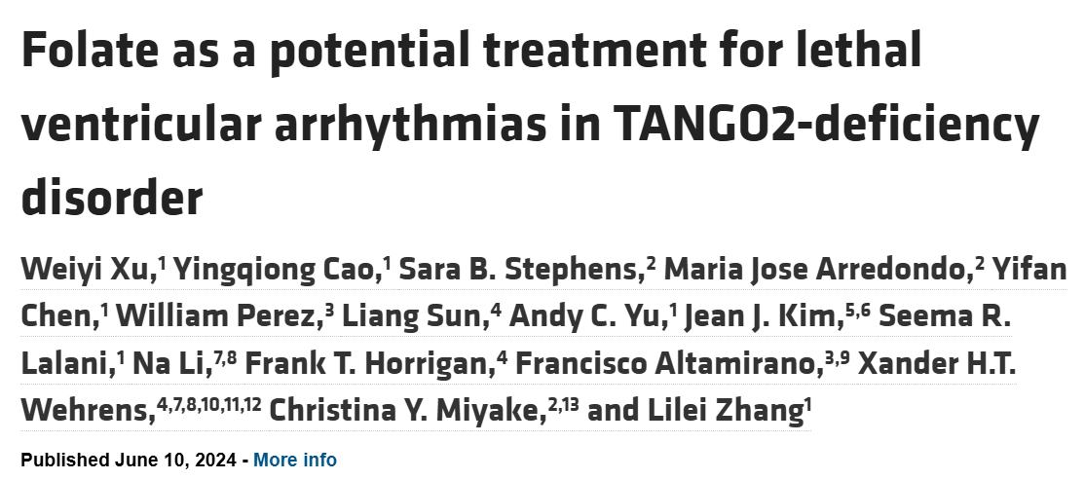
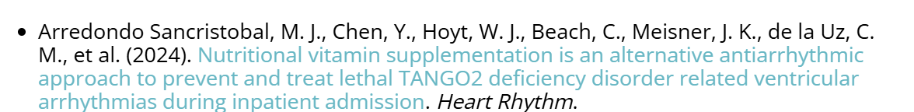
2023
2022
2024

Slide 55
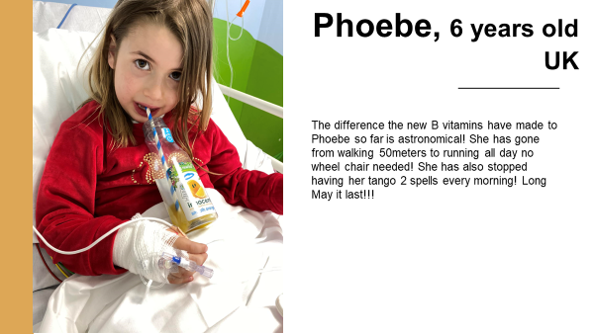
Phoebe, 6 years old
UK
“The difference the new B vitamins have made to Phoebe so far is astronomical! She has gone from walking 50 meters to running all day no wheel chair needed! She has also stopped having her TANGO2 spells every morning! Long may it last!!!!”

Slide 56
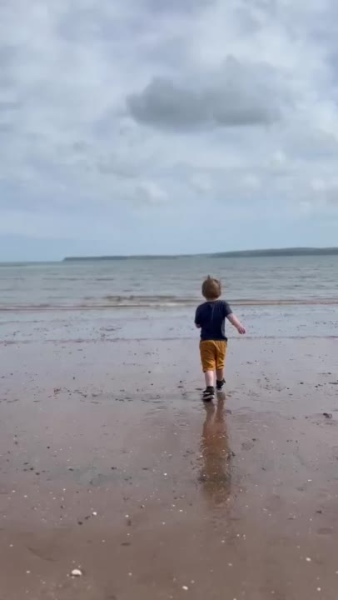
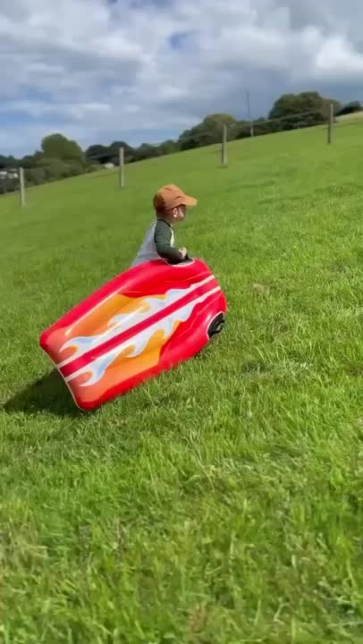
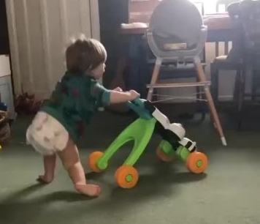
Otis, United Kingdom
Here is Otis before taking the vitamin B
Here he is this summer after taking the vitamin B

Slide 57
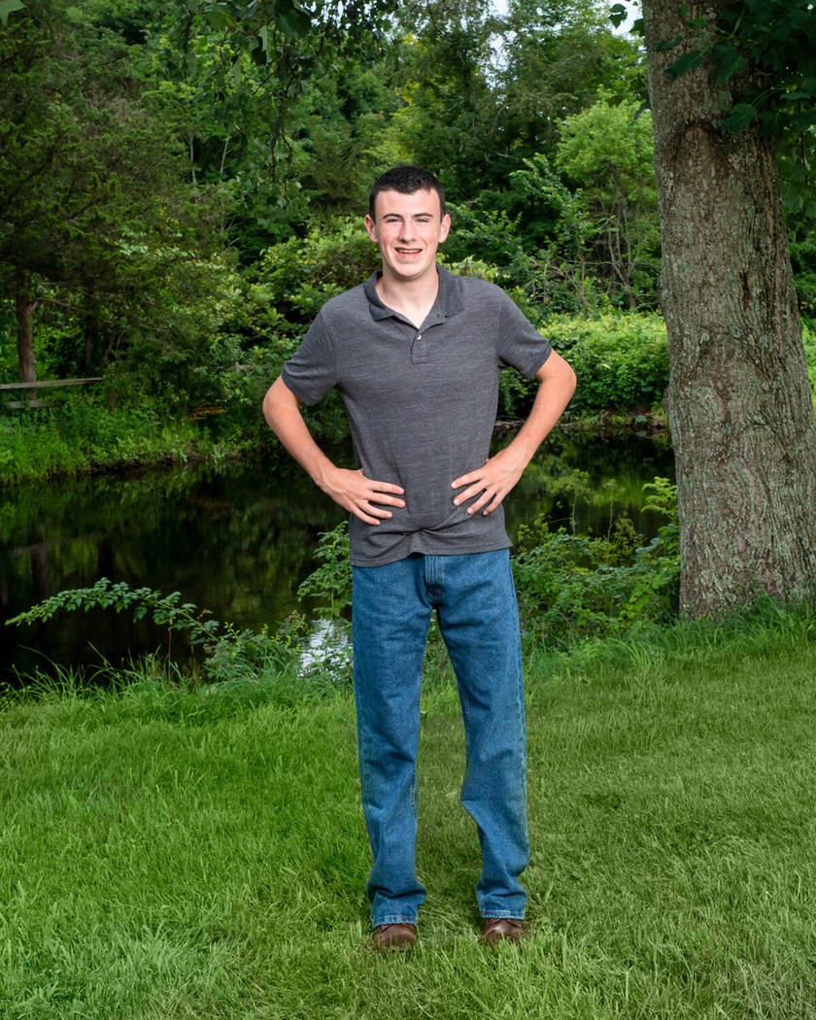
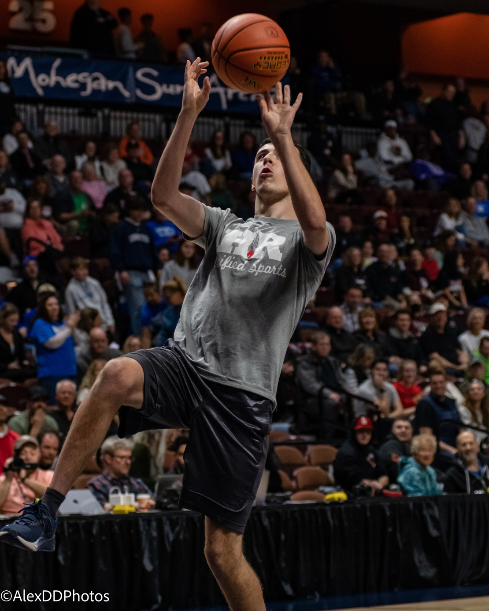
Ryan,
24 years old
750mg B5
Ryan,
20 years old
100mg B5

Slide 58
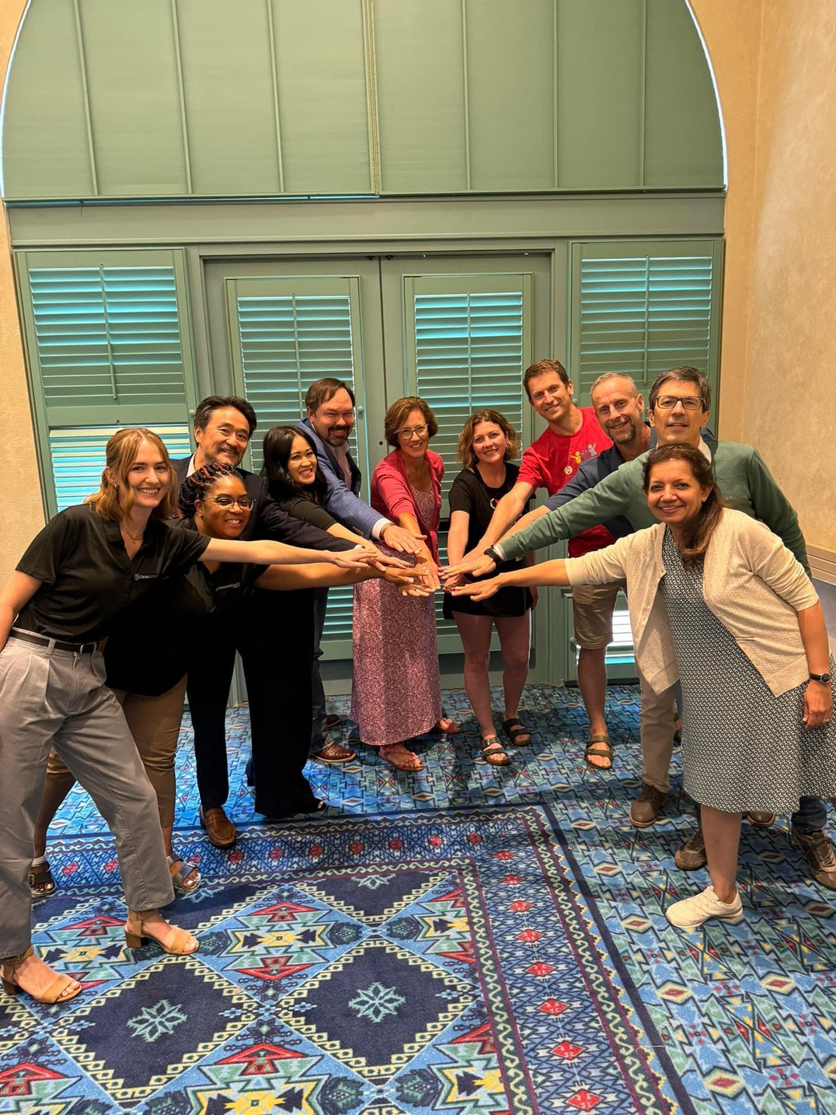
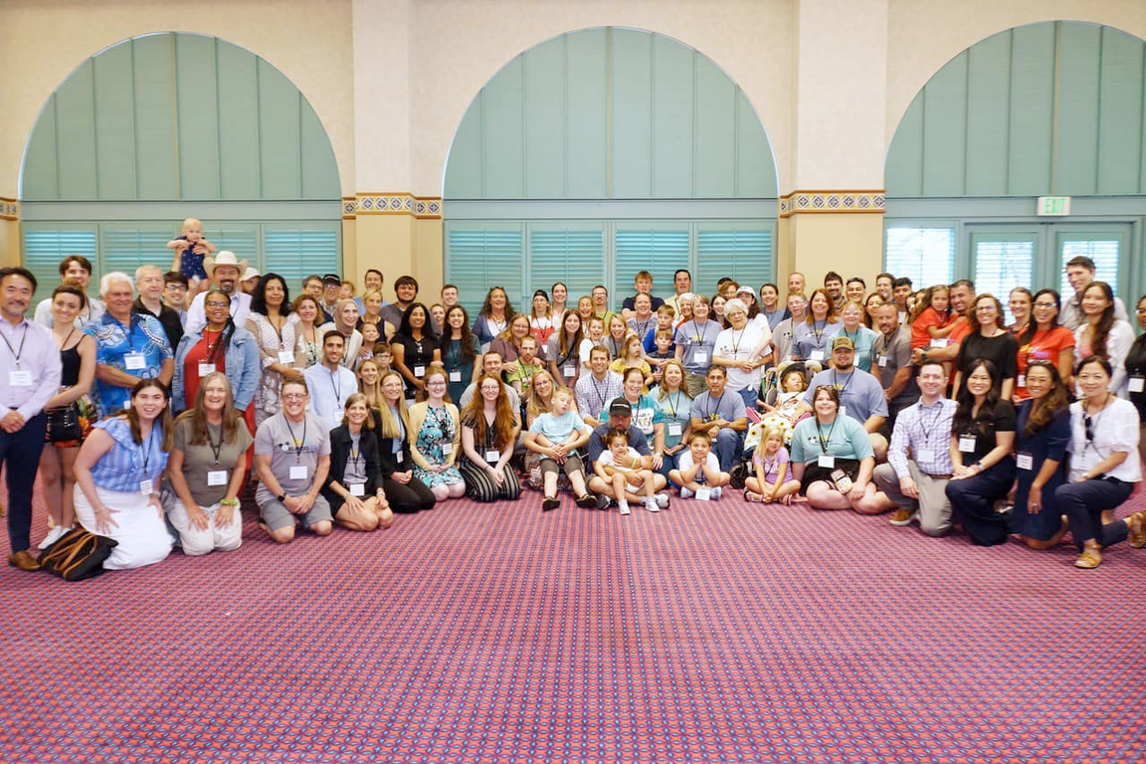
With continued collaboration...
We can...
  Determine function of TANGO2
  Understand why B vitamins work?
  Focus on early diagnosis
  Add prospective NHS
  Find just right dosage

Slide 59



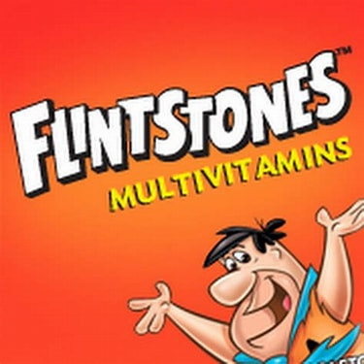
Thank you!
Ya, ba, da,
ba, do!
Kasha Morris
TANGO2 Research Foundation
Co-founder & parent
kasha.morris@tango2research.org
kashamurraymorris.com
For additional information:info@tango2research.org

