Slide 1
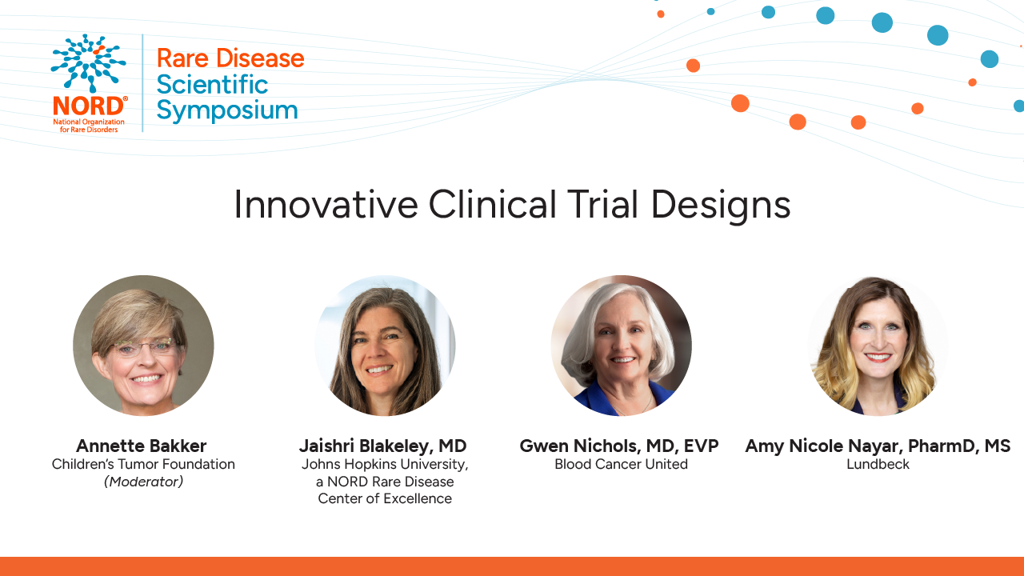

Slide 2
Innovative Clinical Trial Design
Amy Nicole Nayar, PharmD
Vice President, US Medical Affairs
Rare Neurology, Lundbeck

Slide 3
Developmental and Epileptic Encephalopathies (DEEs)
DEE subtypes have commonalities (Triad definition)
  Characterized by severe, often treatment-resistant seizures
  Frequent epileptiform discharges on EEG
  Associated with developmental delay and/or regression
Developmental impairment in DEEs is multifactorial
  May result from the epileptic activity itself and reflect the impact of the underlying etiology, when known
Etiology remains unknown in many patients
  Although many DEEs have identified genetic causes (900 genes), ~half have UNKNOWN etiology
Scheffer IE et al. Nat Rvws Disease Primers. 2024; 10:61. EEG: electroencephalogram

Slide 4
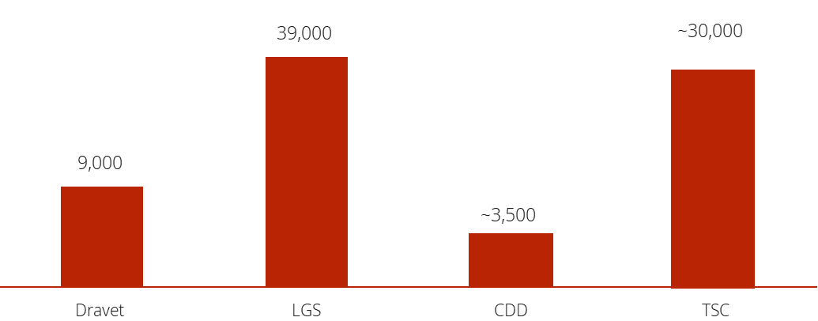
4 DEE Syndromes Have Approved Therapies; Hundreds Have None
“Approved 4” DEE Prevalence (US)
Other DEEs
DUP15q Syndrome
SCN2A-DEE
SCN8A-DEE
KCNQ2-DEE
KCNQ3-DEE
Angelman Syndrome
Landau-Kleffner Syndrome
Early Myoclonic Encephalopathy
KCNT1-DEE
SynGAP1-DEE
Rett Syndrome
Ohtahara Syndrome
PCDH19
EE w/ Continuous Spike-Wave
Myoclonic Atonic Epilepsy
Ring14
Ring20
Others
The prevalence of all "Other DEEs" could exceed the total of the “Approved 4” combined
Highlighting the considerable UNMET NEED
Yes
Yes
Yes
Yes
FDA Approved Therapies
NO SPECIFICALLY APPROVED THERAPIES

Slide 5
Understanding & Defining the DEE Population
Clinical subtype and etiology are not the same
  The DEE subtype refers to the clinical syndrome or phenotype (e.g. Dravet, Angelmann, Rett)
  The etiology refers to the underlying cause
  A single clinical DEE subtype can arise from multiple different etiologies e.g. LGS
Our trial represents the diverse, real-world DEE population
  Includes well-characterized DEEs with approved therapies, such as CDKL5
  Includes other DEEs with known genetic etiologies, for example SYNGAP
  Includes DEEs with genetic, structural, immune, infectious, or unknown etiologies
Why this matters
Using the DEE triad definition as enrollment criteria -we are changing the paradigm of conducting trials on one subtype at time
Enables participation of historically under-represented DEE populations
Supports rapid generation of large-scale safety & efficacy data across the diverse DEE population
Notes:
using the DEE triad definition as enrollment criteria -we are changing the paradigm of conducting trials on one subtype at time. This especially helps the smallest communities who may not otherwise have a trial on only their subtype.

Slide 6
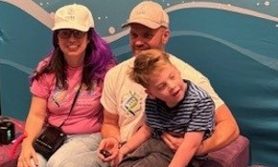
What is innovation?
Innovation can mean precision medicine— delivering more targeted treatments to the right patients.
But it can also mean innovative design: expanding how we assess treatments so we can learn across multiple DEE subtypes simultaneously.
True innovation is not just about narrowing focus; it is also about broadening how we generate evidence to include and create impact for as many rare families as possible.
DEE: Developmental and Epileptic Encephalopathy

Slide 7
Practical considerations for clinicians
"We want to stop the seizures with as few side effects as possible. We don't need to know the etiology immediately, but we do want to stop the seizures. With 900 genetic etiologies, it will be very challenging to develop a targeted therapy for all genetic causes anytime soon. And even as precision therapies advance, that still leaves about half of DEE patients with unknown etiologies or acquired causes with no treatments proven to be effective.“
- Dr. Dennis J Dlugos, MD
Director, Epilepsy Program
Children’s Hospital of Philadelphia
Vice President, The Epilepsy Study Consortium
DEE: Developmental and Epileptic Encephalopathy
Notes:
Dr Dlugos is the Head PI and co-chair of the Epilepsy Study Consortium responsible for appropriate categorization of DEEs in the trial

Slide 8
Benefits and challenges in trials including a large spectrum of DEEs
Must maintain consistency across all sites by:
  Identifying inclusion/exclusion criteria to allow for broad patient population
  Ensure all seizures are classified and captured correctly
  Confirm diagnosis across the various known subtypes of DEE
Role of the Epilepsy Study Consortium (ESC)
Epilepsy Study Consortium uses expert epileptologists at academic medical centers in the United States and abroad to perform independent patient adjudication.
Diagnostic review form must be submitted to ESC following screening visit, will be reviewed and discrepancies will be communicated to the site
Detailed eligibility form – review each patient individually to ensure they align with ILAE criteria. Signed approval determination sent from ESC to the site
DEE: Developmental and Epileptic Encephalopathy; ILAE: International League Against Epilepsy

Slide 9
Lundbeck Development Program
Bexicaserin is an investigational drug for the treatment of seizures associated with Developmental and Epileptic Encephalopathies (DEEs), being evaluated in a global Phase 3 clinical program (the DEEp Program).
Bexicaserin (LP352) is an oral, centrally acting 5-hydroxytryptamine 2C (5-HT2C) receptor superagonist with no engagement of the 5-HT2B and 5-HT2A receptor subtypes, potentially minimizing the risk of cardiovascular toxicity.
The most common TEAEs associated with bexicaserin the PACIFIC trial were somnolence, decreased appetite, constipation, diarrhea, lethargy, tremor, urinary tract infection, fatigue, pyrexia, agitation, and hypertension.
The FDA has granted Breakthrough Therapy designation for bexicaserin for the treatment of seizures associated with DEEs for patients two years of age and older.
TEAEs: treatment emergent adverse events

Slide 10
Thank You

Slide 11
Innovative Clinical Trials:
Platform Trials for Diverse NF1 and NF2
Driven Tumor Manifestations
Jaishri Blakeley, MD
Johns Hopkins University
Director, The Johns Hopkins Comprehensive Neurofibromatosis Program
Executive Director, The Neurofibromatosis Acceleration Program

Slide 12
The Neurofibromatoses
Manifestation | NF1 (1/2600) | NF2-Schwannomatosis (~1/30,000) | Non-NF2 Schwannomatosis (SMARCB1, LZTR1) (>1/500,000)
Café-au-lait spots | X | X
Freckling | X
Dermal NF | X
Plexiform NF | X
Schwannoma |  | X | X (not bilateral vestibular, LZTR1)
Glioma | X (optic pathway) | X (ependymoma)
Meningioma |  | X | X (SMARCB1)

Slide 13
NF2-Schwannomatosis and INTUITT

Slide 14
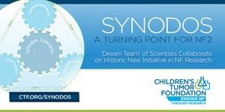
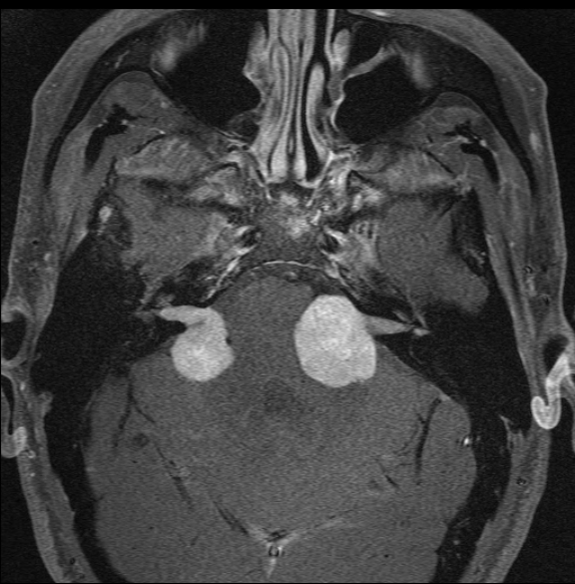
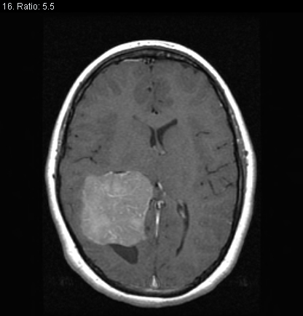
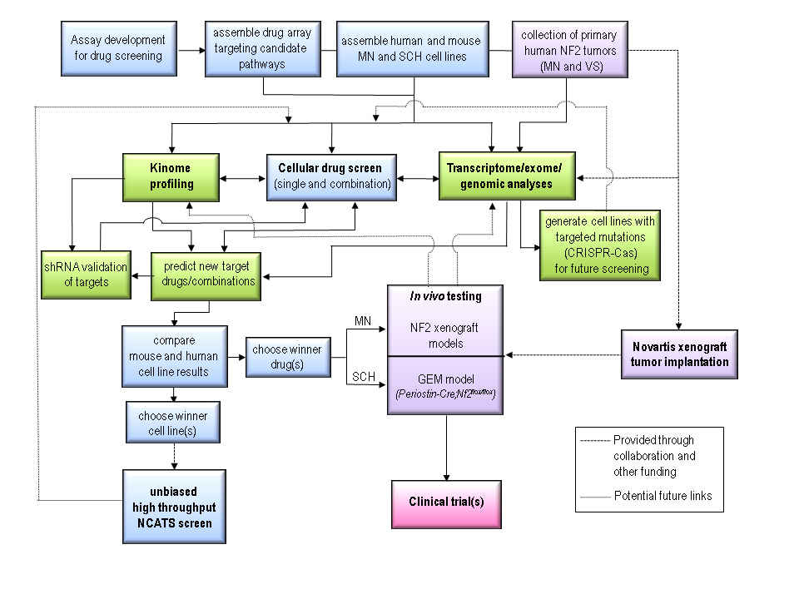
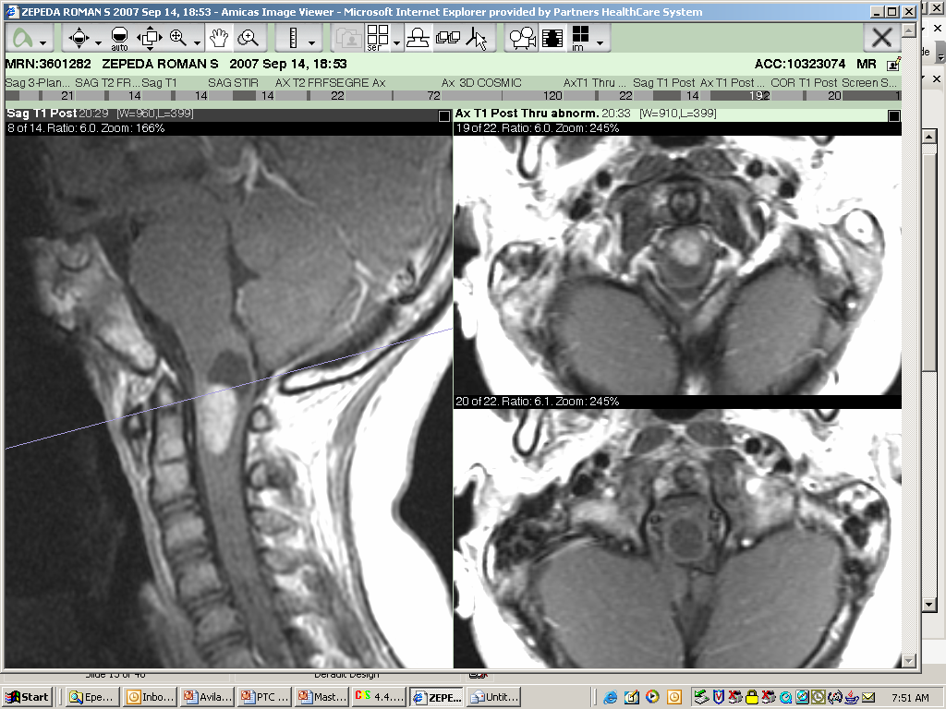
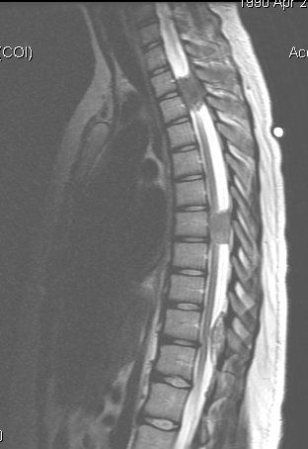
NF2-related schwannomatosis: CTF Synodos
Vestibular schwannoma
Meningioma
Ependymoma
Schwannomas
1/30,000 prevalence
Collaborators:
Surgeons
Molecular geneticists
Animal model experts
Neuroscientists
Chemists
Cancer Biologists
Clinical trialists

Slide 15
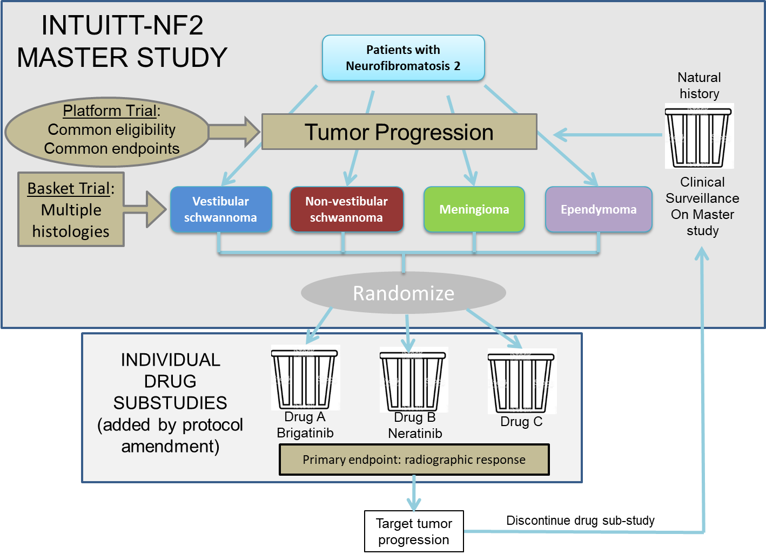
INTUITT-NF2: Perpetual Platform-Basket Trial for NF2-SWN
Participating sites
Johns Hopkins (Jaishri Blakeley)
Mass General Hospital (Scott Plotkin)
Mayo Clinic (Dusica Babovic-Vuksanovic)
New York University (Kaleb Yohay)
University of Miami (Christine Dinh)
University of California, Los Angeles (Leia Nghiemphu)
Drug with good activity against a particular tumor(s) moved to a dedicated study to confirm the level of success and safety needed to pursue regulatory approval
Slide Courtesy of Scott Plotkin

Slide 16

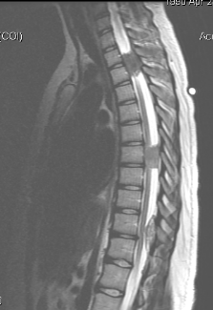


Brigatinib Sub-study: Key Participant and Tumor Characteristics
40 participants, median age 26 (12-54)
165 tumors (40 target, 125 non-target)
32%
68%
70%
30%
KPS/
LPS
100: 2
90:16
80: 17
70: 4
 | VS | Non-VS | Meningioma | Ependymoma
Target | 10 | 8 | 20 | 2
Non-target | 37 | 48 | 37 | 3
Total | 47 (28%) | 56 (37%) | 57 (38%) | 5 (3%)
93%
23%
58%
Plotkin et al, NEJM, 2024

Slide 17
Clinical Activity of Brigatinib in a Range of NF2-related Tumors Based on MRI Tumor Volume Reduction
Overall response rate: 10% (4/40)
Non-vestibular schwannoma: 22% (2/9)
Meningioma: 11% (2/19)
Vestibular schwannoma: 0% (0/10)
Ependymoma: 0% (0/2)
Plotkin et al, NEJM, 2024

Slide 18
Neurofibromatosis Type 1 and EU PEARL

Slide 19







Manifestations of NF1 Over a Lifetime
Skinfold freckling
Scoliosis
CALMs
Lisch nodules
Vascular
Orbital dysplasia
Plexiform neurofibroma
Tibial dysplasia
Paraspinal neurofibroma
Pseudarthrosis
Motor and/or speech delays
Cutaneous neurofibroma
Optic pathway glioma
ADHD
MPNST (sarcoma)
Breast cancer
Learning deficits
Brainstem glioma/HGG
Low Grade Glioma
Birth
Infancy
Early Childhood
Adolescence
Early Adulthood
Adulthood
Late Adulthood

Slide 20
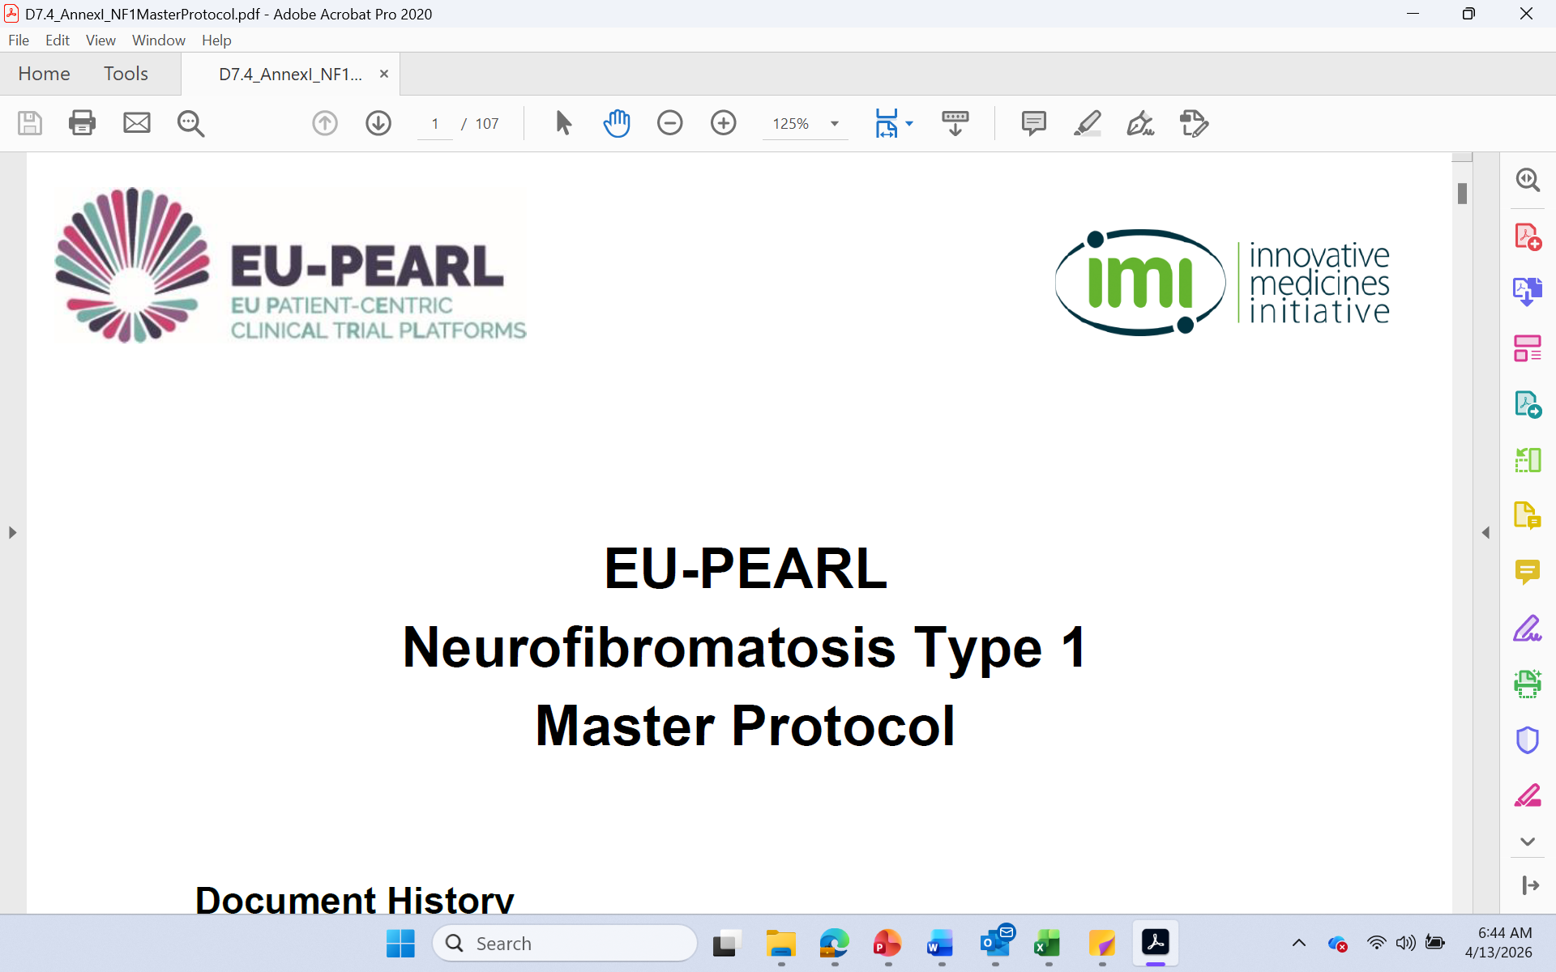

EU PEARL: NF1
A multicentre, open-label, Phase 1 / Phase 2 proof-of-concept, platform basket study to investigate single-arm study interventions against historical response rates in participants with manifestations of neurofibromatosis type 1 (NF1) including cutaneous or plexiform neurofibroma; optic pathway glioma or low-grade glioma.
Across EU NF specialty care centers; in collaboration with US CDMRP NF Clinical Trials Consortium
Master protocol + Arm Specific Appendices design EMA approved:
  Two potential purposes: signal finding versus registration enabling via uniform endpoints and definition of response independent of intervention, specific to manifestation.
  Master protocol defines: Shared design, endpoints, schedules and governance.
  Arm‑Specific Appendices: Therapeutic specific details re: dosing, timeline and correlative endpoints.

Slide 21
Thank You

Slide 22
PedAL Global Master Clinical Trial
Gwen Nichols, MD
Chief Medical Officer
Blood Cancer United
Notes:
We are moving right along and next up is a big component of Dare to Dream, the PedAL Global Master Clinical Trial. It is complex, it is global, it is ground-breaking and it is well underway AND it is going to establish a new blueprint for how to get new treatments into the hands of pediatric patients. We’ve seen tremendous progress with PedAL, as Andy alluded to, in the past couple of years, to be sure.

Slide 23


We Must Do Better
Outcomes for newly diagnosed leukemia in children
100%
Targeted intensity
Targeted therapies
80%
60%
Maximal intensity
Improved supportive care
Overall survival (probability)
40%
20%
Notes:
PedAL is the full-throated acknowledgment that we simply must do better in the treatment of pediatric blood cancer in general and in AML in particular.
Gains in ALL, driven by development of targeted therapies were not being realized in AML, where improvement in clinical outcomes were largely driven by increased intensity of chemotherapy (consequential toxicity) and improvements in supportive care

Slide 24



Childhood AML
Most aggressive leukemia in children
  Leading cause of death from leukemia
  Extremely high short- and long-term toxicity/mortality
Distinct Biology – Different from adult
  Most drugs developed in adults – many with limited utility in children
  Targets seen in older adults not always seen in children, and vice versa
Novel Targets
  Chemotherapy hasn’t changed since the ‘70s and causes severe long-term toxicity
  Targetable mutations are rare in children
  Targeted therapies DO WORK in children
  Discovery of actionable targets a must for developing curative therapies
Notes:
Complexity of treating AML in children

Slide 25

The Challenge We Faced
Pediatric leukemia is rare and there are many biologic subsets and targets
The biology of pediatric leukemia is distinct from leukemia in adults, yet new drugs are mostly developed in adults
A comprehensive, global effort for trials is necessary to be successful
Despite regulatory incentives, only seven drugs were approved for pediatric cancers (US) in the past 10 years, while more than 100 new drugs were approved for adults
Essential data existed within individual international consortia and pediatric hospitals; data sharing was a challenge
Notes:
The challenges of clinical trials and therapeutic approach in such a complex disease
Rare and subsets defined by molecular targets make the populations of study even smaller
Over 100 new/novel drugs for adults; another 100 drugs received additional/supplemental approvals in adult cancers
Approvals in kids for drugs previously approved for adults are taking an additional 6-9 years!

Slide 26
A solution: PedAL
SCREEN – Via the PedAL screening trial, screen all children with relapsed leukemia for precision-medicine trial eligibility based on clinical data, leukemia cell surface markers and next-generation genomic sequencing
DISCOVERY – sample acquisition for correlative biology, target discovery, and biobanking
ACCESS – Partner with pharma, NCI and FDA/EMA, and European study groups to support drug development platform that achieves regulatory objectives to ensure that children have early access to effective therapies
DATA - Improve data collection to inform changes in primary outcome measures and toxicity definitions that are essential for approval of new therapies for children with leukemia
Blood Cancer United is the trial sponsor and works collaboratively with academia and pharma partners to collect regulatory quality data
Notes:
The molecular profiling offered to every child enrolled in the screening trial yields critical information influencing choice of effective therapy.
The samples provides for correlative study drives discovery and clinical study of new therapies.
The PedAL subtrials are conducted in collaboration with pharma and European study groups to promote access to new therapies and drive regulatory approval. Importantly the trials define dosing and safety understanding in the pediatric population
We’re centralizing and democratizing the data- formerly siloed in individual datasets and not easily shared. Especially important in rare diseases to establish trusted datasets to enable analyses in rare disorders

Slide 27





PedAL Progress
screening
trial
venetoclax
subtrial
ziftomenib
subtrial
182
88
20
sites
sites
sites
3rd trial in contract
611
102
24
patients
patients
patients
4
20
7
countries
countries
countries

Slide 28
W
Where we go next: Real World Evidence Project
Time and cost for trials remains high.
Large randomized trials are not feasible in targeted subsets of patients
Having evidence for regulators of target efficacy and outcomes with standard of care could decrease the time and cost of trials in rare diseases
Blood Cancer United is partnering with Tempus AI to create a RWD repository in pediatric AML using parental/patient consent.
RWE can be generated from this database for proposed trials. This will be freely available for investigators and available at cost to pharma.

Slide 29


