Slide 1
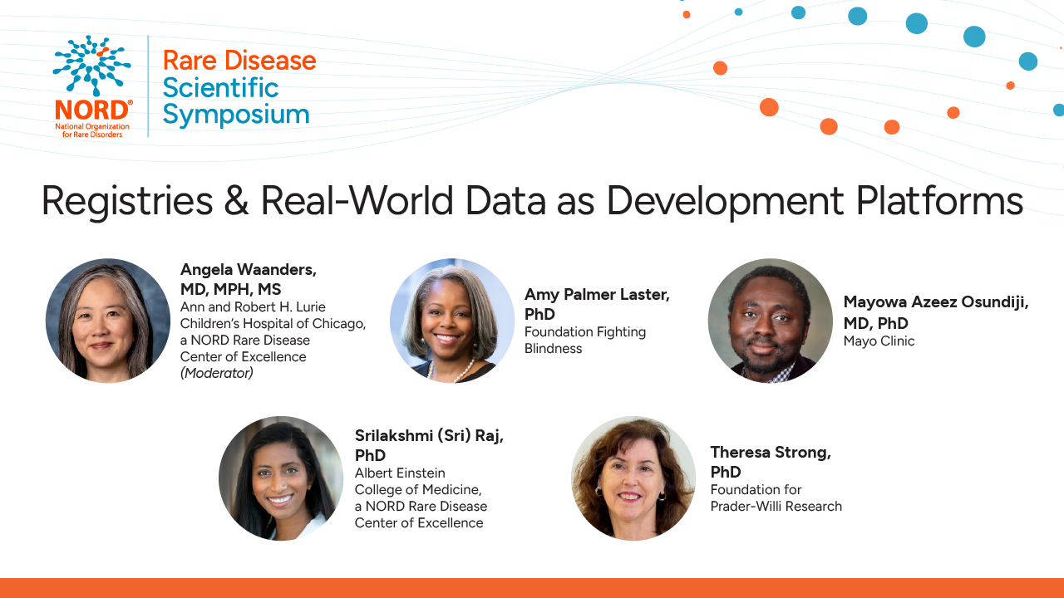

Slide 2
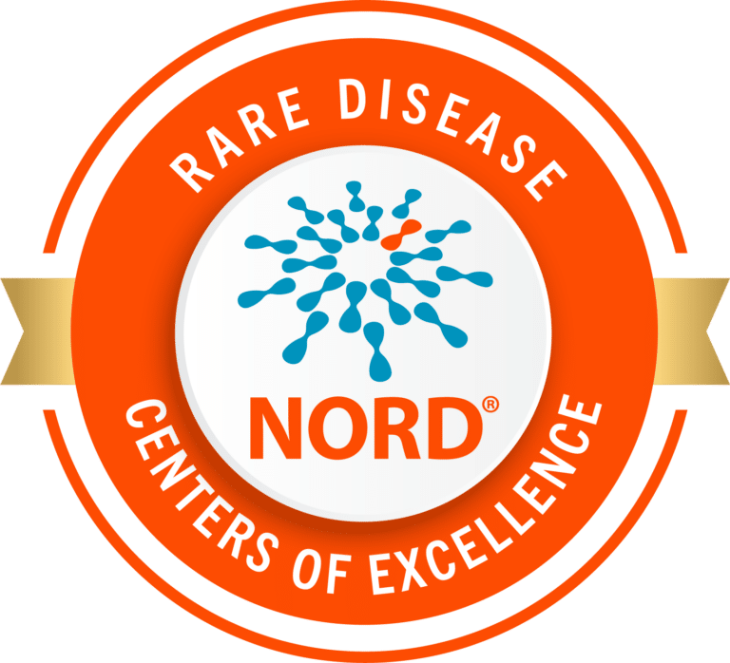
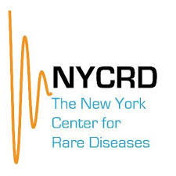
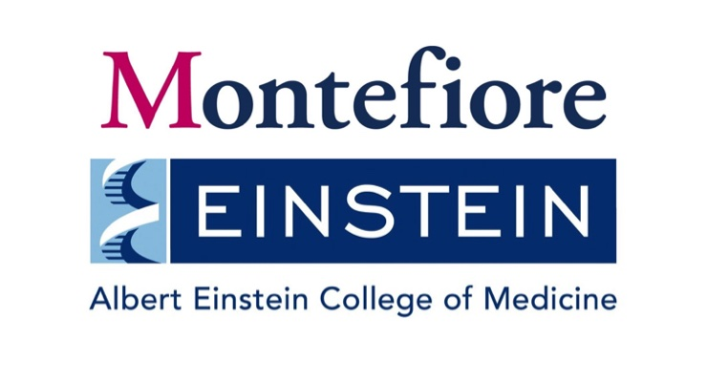
Biobanks in Rare Disease Research: Insights from All of Us
Srilakshmi Raj, Ph.D.
Albert Einstein College of Medicine
15-April-2026
Notes:
Good afternoon, I’m Sri, an assistant professor of genetics at Albert Einstein in the bronx. I’ll talk to you about my research leveraging biobanks for rare disease research

Slide 3
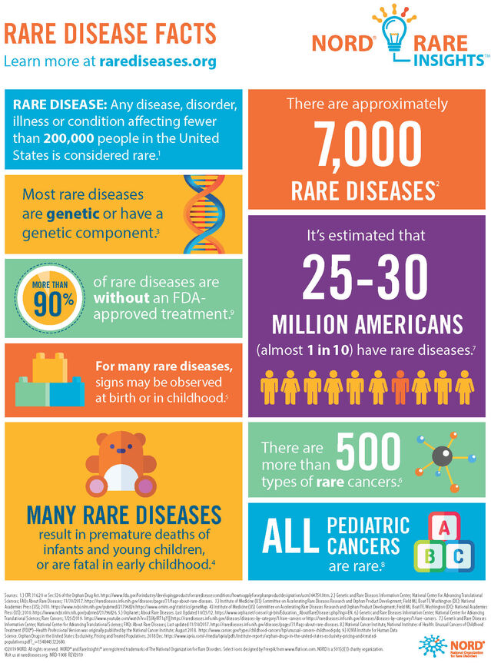
Rare Disease is collectively common
Economic impact:
$1 trillion/year in the US
10x higher costs per person than common disease
Early diagnosis and treatment can save $500,000/person
Notes:
You all know that rare diseases have an incredible economic impact, and there are equally large economic incentives to pursue early diagnosis.
https://www.sciencedirect.com/science/article/pii/S295000872400019X
8000 rare diseases

Slide 4
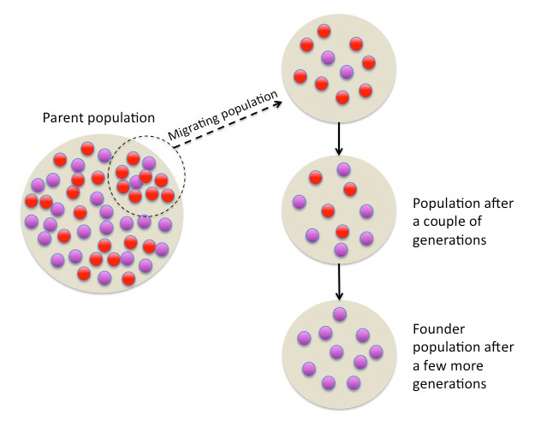
What if a disease that is rare globally is common locally?
Founder population
Known: family level
Patterns observable at the population level?
Wikipedia (2015)
Notes:
Traditionally, family-based studies have shown where rare genetic diseases may aggregate, facilitating these diagnoses. We also know that rare disease can be enriched at the founder population level, or when a group of individuals split off from a larger population, constraining the genetic diversity and altering the frequency of genetic variants such that variants that are otherwise rare become common in this group.
Rare diseases affect ~1 in 10 Americans, but individual variants are often "ultra-rare" in global databases (like gnomAD).
The Founder Effect: In specific communities, a "founder" variant can drift to high frequency.
Shift in Perspective: Moving from a "Global Average" to "Community-Specific" risk.
Take-home: Our definition of "rare" depends entirely on which population we are looking at.

Slide 5
What if a disease that is rare globally is common locally?
Founder population
Population genetics is key to identifying these patterns
Wikipedia (2015)
Notes:
Here’s where i come in, as a population geneticist. I can use techniques that help identify these groups of individuals with shared relatedness, founder populations, and groups that are basically very large family pedigrees who may not even know they belong to this large group. Essentially, we can do rare disease genetics not just at the family level, but then extending this to the population level.

Slide 6
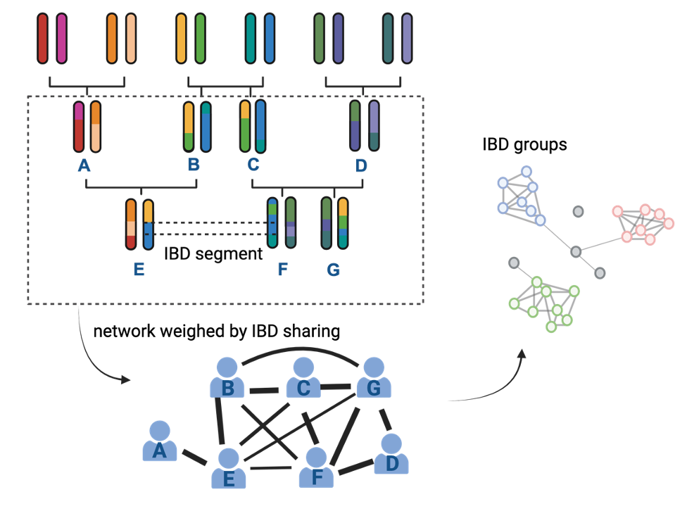
What if a disease that is rare globally is common locally?
Identity-by-descent: DNA sequences shared between two individuals inherited from a common ancestor
Founder population
Wikipedia (2015)
Mariko Isshiki
Notes:
We use IBD, or identity by descent, identifying where DNA sequences are shared between two individuals inherited from a common ancestor. This helps us construct a pedigree of sorts, except that this group can be traced back 50 generations.

Slide 7
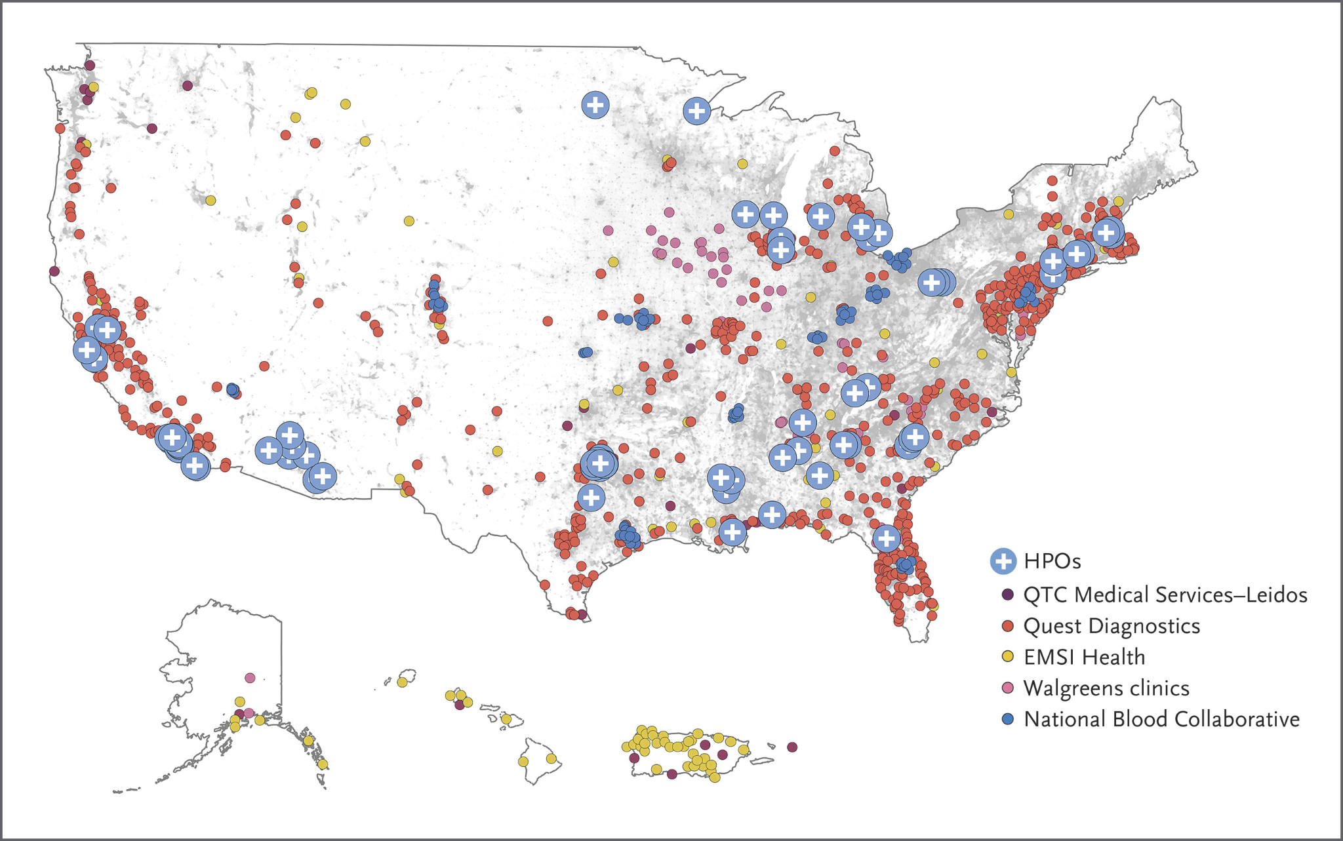
Leverage biobanks to identify rare disease risks particularly in founder populations
Current data (2025):
>633,000 participants
>393,000 EHR
>414,000 short-read WGS
Notes:
Now, here’s where the biobank part comes in. We need a lot of data to construct these large pedigrees to identify founder populations and other related groups. We work with many biobanks, but for this talk I’ll tell you about NIH’s All of Us. This is the NIH's Flagship National Biobanking effort, aiming to sequence 1 million participants across the USA that reflects the diversity of this country. Currently they are on track towards achieving this goal, and is already the world's most diverse.
Diversity by Design: Unlike historical biobanks (90%+ European), All of Us prioritizes underrepresented communities.
Beyond Common Disease: While often used for polygenic scores (common disease), biobanks are powerful tools for identifying "private" rare variants in specific ancestries.
Insight: Large-scale

Slide 8

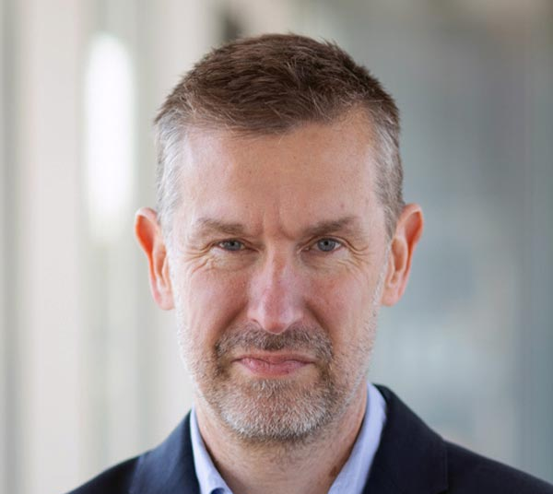

Leverage biobanks to identify rare disease risks particularly in founder populations
Dr. Mariko Isshiki (Segawa)
Dr. John Greally
Notes:
Large-Scale Biobanks as Discovery Engines
Heading: The Power of the All of Us Research Program
Content:
Diversity by Design: Unlike historical biobanks (90%+ European), All of Us prioritizes underrepresented communities.
Beyond Common Disease: While often used for polygenic scores (common disease), biobanks are powerful tools for identifying "private" rare variants in specific ancestries.
Insight: Large-scale

Slide 9
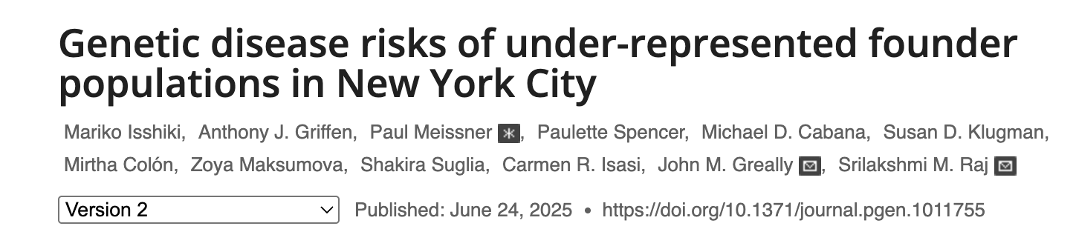
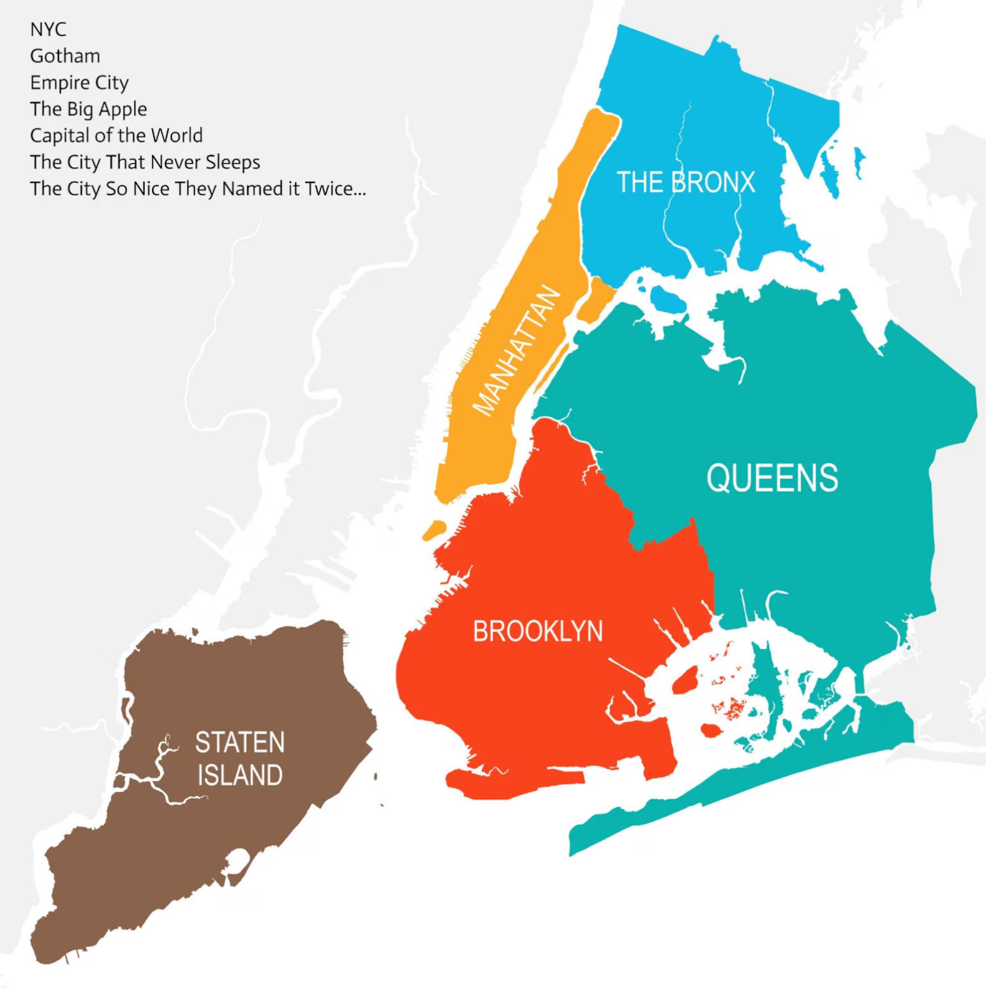
IBD across New York City
PMID: 40554605
Notes:
We published a paper last year focusing on founder groups in New York.
Large-Scale Biobanks as Discovery Engines
Heading: The Power of the All of Us Research Program
Content:
Diversity by Design: Unlike historical biobanks (90%+ European), All of Us prioritizes underrepresented communities.
Beyond Common Disease: While often used for polygenic scores (common disease), biobanks are powerful tools for identifying "private" rare variants in specific ancestries.
Insight: Large-scale

Slide 10
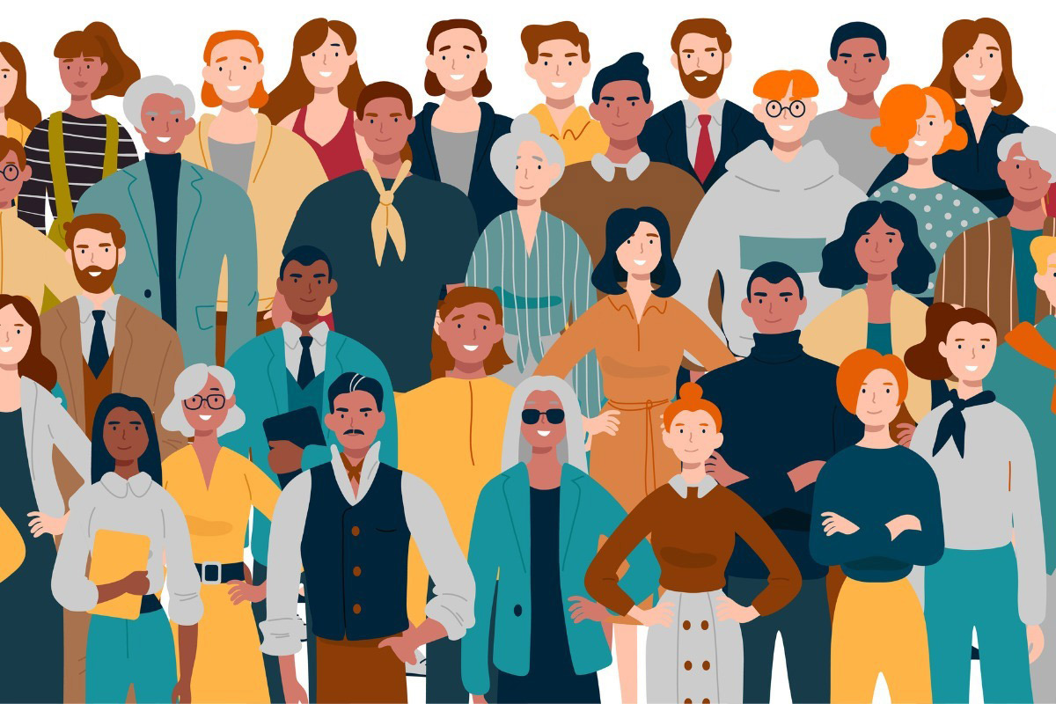
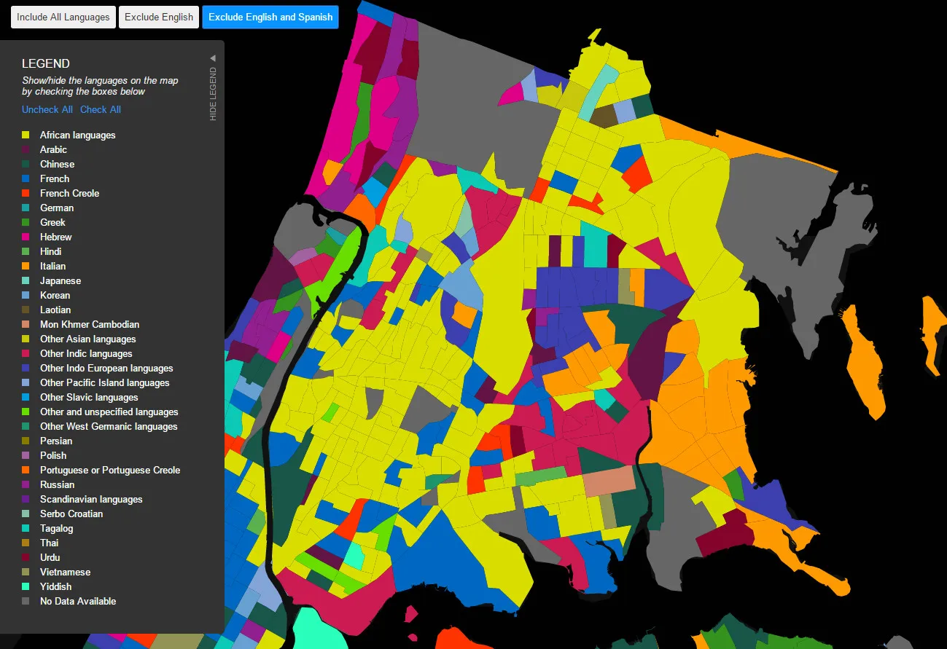
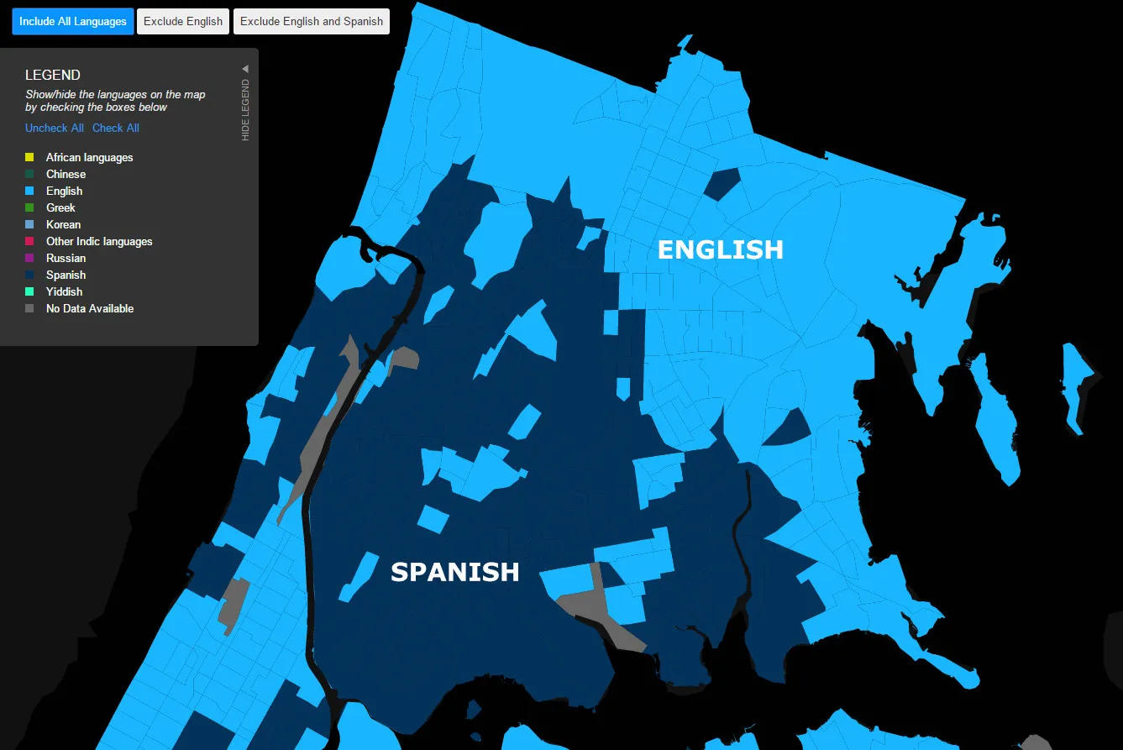
Why New York? New York City is immense and diverse
>800 languages spoken
8.6 million residents
Notes:
Why New York? Other than it being the catchment area of our health system, Montefiore-Einstein, serving 1.8 million patients across largely the Bronx borough of New York City, it is simply immensely diverse. Simply asking patients about their race does not begin to scratch the surface of this diversity, and can hinder rare disease diagnoses. So, we used our IBD technique to identify networks of individuals who share relatedness.
Now with that story in mind, let’s back up a bit. New York City is very diverse. It is said that over 800 languages are spoken here. In the Bronx, the two major languages spoken are English and Spanish, but when you look at the second most spoken languages in each neighborhood, a more complex picture emerges. Some of the populations that live in the Bronx may be founder groups like the Ashkenazi Jewish. Interestingly, our health system pioneered population-based screening in this group some 23 years earlier, notably leading to a dramatic reduction in Tay-Sachs disease.
https://www.nytimes.com/2003/02/18/science/using-genetic-tests-ashkenazi-jews-vanquish-a-disease.html

Slide 11
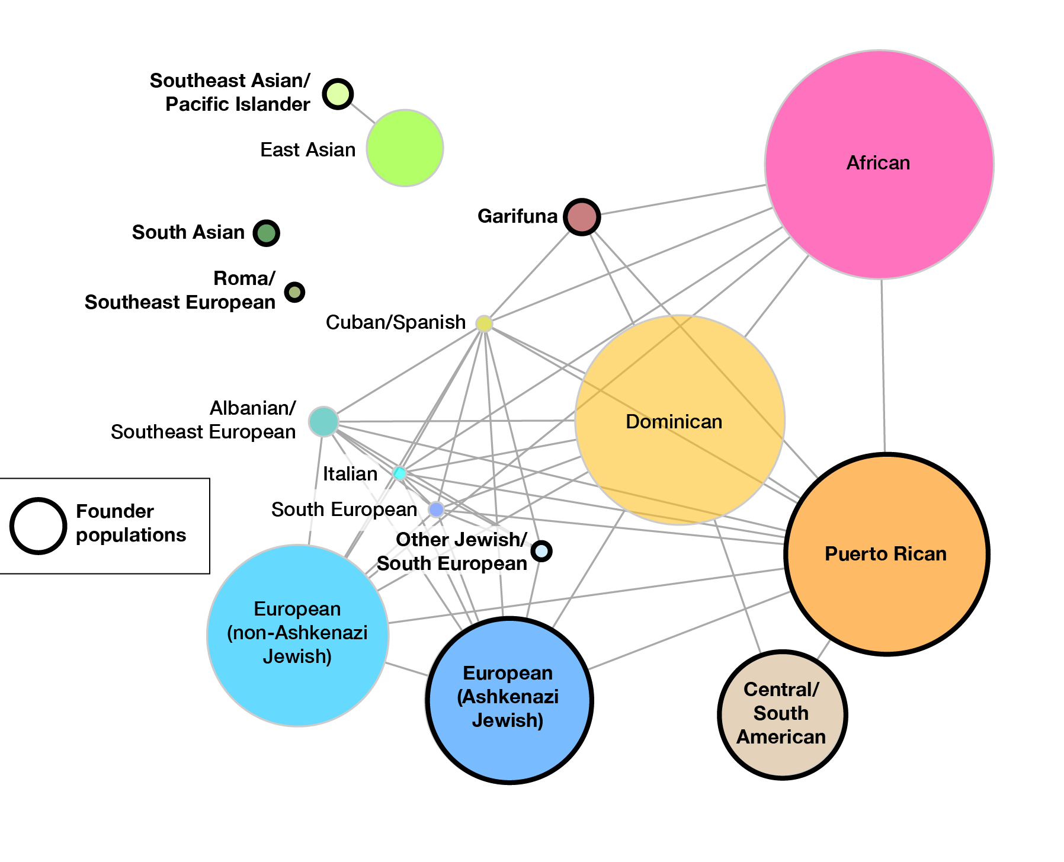
We identified 17 IBD groups in New York City
Notes:
….and this is what we found. We used IBD analyses to identify groups of individuals that share recent common ancestry, remember this extended pedigree of sorts that go back 20-50 generations. They correspond to many well-known populations and can identify them as distinct groups, like Dominicans vs Puerto Ricans versus Albanians, Jewish and non-Jewish Europeans. Many of these groups were annotated with the help of self-identified population labels from participants of the BioMe biobank at Mt. Sinai, also in NYC.
For example, we see from our data that we are able to distinguish Dominicans from Puerto Ricans, from Mexicans/central/south americans, Jewish and non-Jewish europeans, Albanians, a southern European group, and several asian communities as well. Our knowledge of who these groups correspond to is based on a comparison against DNA from other sources where people disclose their own ethnic background. In some cases we can be confident of the identify of the group, such as Puerto Ricans or Ashkenazi Jewish, but in some cases it is more difficult, like “south Asian” here where we couldn’t get more specific with the data we had.
Combining BioMe and AoU data together, we see that there are 17 groups, including 8 that are founder populations based on the score.
ADD NUMBER OF TOTAL PARTICIPANTS
Two questions come to mind - the first is,
Fst - explain that. Also, combining with BioMe data

Slide 12
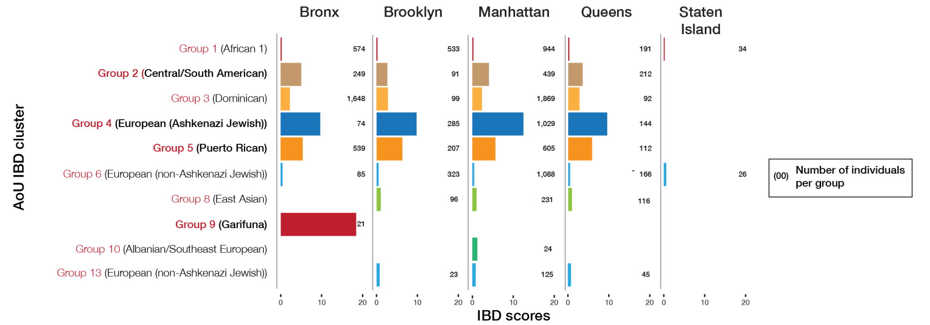
Identifying a strong founder effect in the Bronx
Notes:
When we separate out the IBD scores for the individuals who live in each borough, in the AoU dataset, we see that 4 of these founder populations we identified throughout New York City. We also see there’s a very strong signal in the Bronx from this Garifuna group.
have a strong presence in the Bronx, including Mexicans/central/south americans, ashkenazi jewish, puerto rican, and Garifuna. Garifuna in particular, you don’t see a signal except in the Bronx.

Slide 13
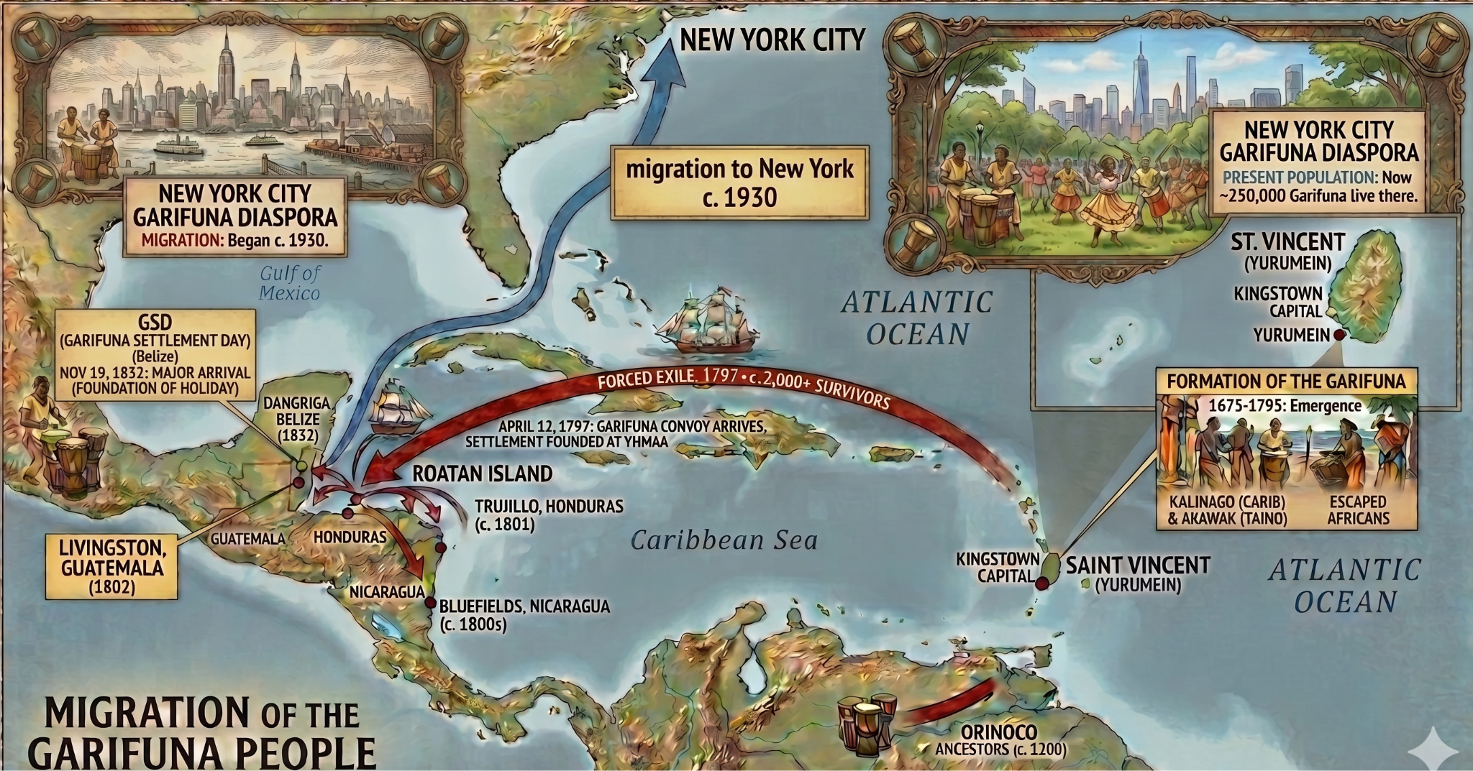
Who are the Garifuna?
Notes:
Who are the Garifuna? This image was AI generated, but factual. The Garifuna are the descendants of indigenous Arawak, Kalinago (Island Carib), and escaped Afro-Caribbean people who lived in the island of St. Vincent from 1630s onwards. In 1797, the British exiled them to coastal Honduras, Guatemala and Belize, where they reside today. During this process, an estimated 80% of this group were decimated, constraining the group to only 2000. Today, their largest diaspora outside coastal central America is New York where an estimated 250,000 Garifuna live, concentrated in the Bronx. They are the only group that continues to speak a native caribbean language, and are a largely understudied founder population.
The founding population of the Central American diaspora, estimated at 2,500 to 5,000 persons, were transplanted to the Central American coast from the Commonwealth Caribbean island of Saint Vincent from 1635. They are now mixed race “Black Caribs”. They were never re-enslaved, and that allowed them to maintain their distinct culture and language, even after they were exiled to coastal Central America, in Honduras, in the 18th century and then moved to Belize .
enslaved people from West Africa, married indigenous local Arawak and Kalinago (Island Carib) and then became the Garifuna group.

Slide 14
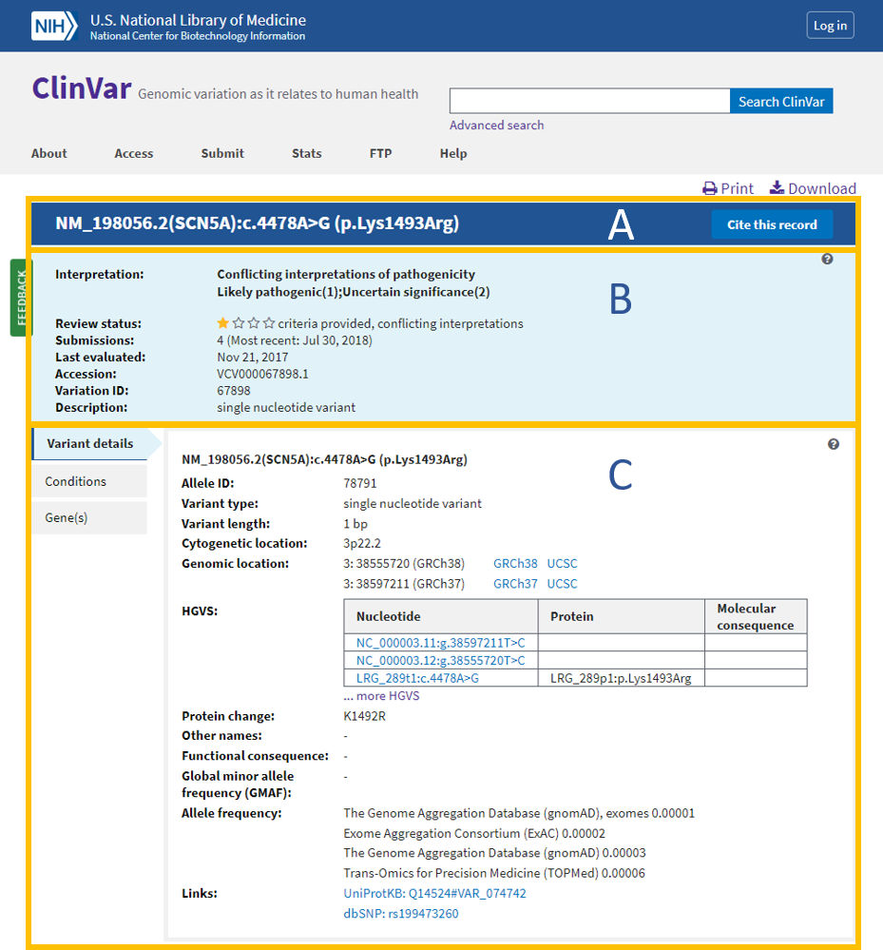
Defining rare disease risk - ClinVar P/LP variants
ClinVar - 3,616 Pathogenic/Likely Pathogenic (P/LP) variants
-genotype rate > 0.9
- appear > 1x in NYC dataset
Notes:
Here’s where rare disease comes into play. We took variants catalogued in the clinvar database, and looked at the frequencies of the pathogenic variants in our groups.
The ClinVar database is a freely accessible, public archive of the reports of relationships among human variations and phenotypes. Specifically, the NCBI archives and aggregates submitted interpretations of the clinical and/or functional significance of variants for specified conditions, with opportunities to provide the supporting evidence. We filtered a subset of the variants reported to be “Pathogenic or Likely Pathogenic” by clinical sequencing, so very likely to be truly damaging, that had a high genotype rate in our dataset and appeared more than once.

Slide 15
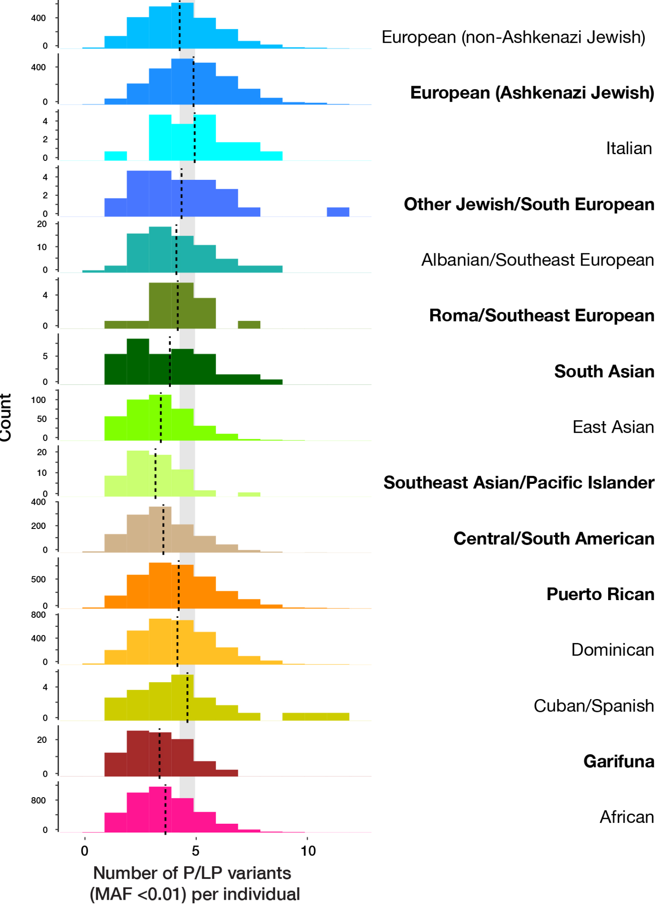
Uncovering founder effects for clinical pathogenic variants
Ashkenazi Jewish
Gene | Condition | Frequency in founder | Frequency in everyone else (~20k people)
F11 | Hereditary factor XI deficiency | 0.0248 | 0
KRT18 | Cryptogenic cirrhosis | 0.0098 | 0
CFTR | Cystic Fibrosis | 0.0094 | 0
Puerto Rican
Gene | Condition | Frequency in founder | Frequency in everyone else (~20k people) | Ancestral origin
HPS1 | Hermanski-Pudlak syndrome 1 | 0.0097 | 5.77E-05 | AFR
RSPH4A | Primary ciliary dyskinesia | 0.0096 | 2.89E-05 | EUR
COL27A1 | Steele syndrome | 0.0091 | 5.77E-05 | AMR
Notes:
We were reassured to find well known enrichment of pathogenic variants in our well-studied founder groups, Ashkenazi Jewish and Puerto Ricans. We also found a few new ones!
We looked for frequency differences in known pathogenic variants between our founder populations. For example, in the Ashkenazi Jewish population, we were able to identify most of the well-studied founder variants, like those underlying Cystic fibrosis disease, Factor 11 deficiency, BRCA1 mutations. Similarly, we identified known founder effects in Puerto Ricans, too, like variants underlying Hermanski-Pudlak, Steele syndromes. However, we also discovered new founder effects, like the KTF18 variant in Ashkenazi Jews for crypotgenic cirrhosis in Ashkenazi Jews, and the RSPH4A variant for primary ciliary dyskinesia in Puerto Ricans.
We also want to note that although we detected known variants, in total we found no major variation in the number of P/LP variants across populations. We therefore emphasize how pathogenic variants occur in everyone, regardless of demographic categorization or genetic ancestry

Slide 16
Discovering new founder effects
Garifuna
Gene | Condition | Frequency in founder | Frequency in everyone else (~20k people) | Ancestral origin
MYBPC3 | Hypertrophic Cardiomyopathy | 0.0245 | 2.38E-05 | AMR
DUOX2 | Thyroid dyshormonogenesis | 0.0098 | 0 | AFR
CNGB1 | Retinitis pigmentosa | 0.0147 | 2.38E-05 | AFR
Notes:
For groups that are under studied , everything we found was new.
Similarly, we identified previously unreported founder effects for the Garifuna, which are not a recognized founder group. There are 25 of these variants that exceeded the Tier 3 allele frequency threshold for inclusion into a prenatal screening panel. Garifuna, we known to be admixed, and similarly, their variants come from different ancestral backgrounds.
These include variants 25 new variants exceeded the Tier 3 allele frequency (1/200) threshold for inclusion into a prenatal screening panel., including ones in established founder groups (like AJ) but new founder groups that are not ACMG recognized - Garifuna, Bukhariam Jewish for example

Slide 17
Discovering new founder effects
Garifuna
Gene | Condition | Frequency in founder | Frequency in everyone else (~20k people) | Ancestral origin
MYBPC3 | Hypertrophic Cardiomyopathy | 0.0245 | 2.38E-05 | AMR
DUOX2 | Thyroid dyshormonogenesis | 0.0098 | 0 | AFR
CNGB1 | Retinitis pigmentosa | 0.0147 | 2.38E-05 | AFR
1 in 20 Garifuna have this variant
Closing the therapeutic loop - NYCRD colleagues involved in inherited hypertrophic cardiomyopathy treatment
Notes:
Hcm - autosomal dominant
now in Garifuna everything we found was new. I'd like to pay attention to this variant in particular, which is responsible for an autosomal dominant form of HCM, and is known to be highly penetrant. it is a rare disease, but in this group, nearly 1 in 20 carry it. Given 150-200k Garifuna live in the Bronx, we are looking at nearly 10,000 people in the Bronx alone who would be at risk. This is no longer just a rare disease. It is a rare disease that is now common within our health system. We're closing the therapeutic loop by involving NYCRD physicians to screen for and treat this disease.

Slide 18
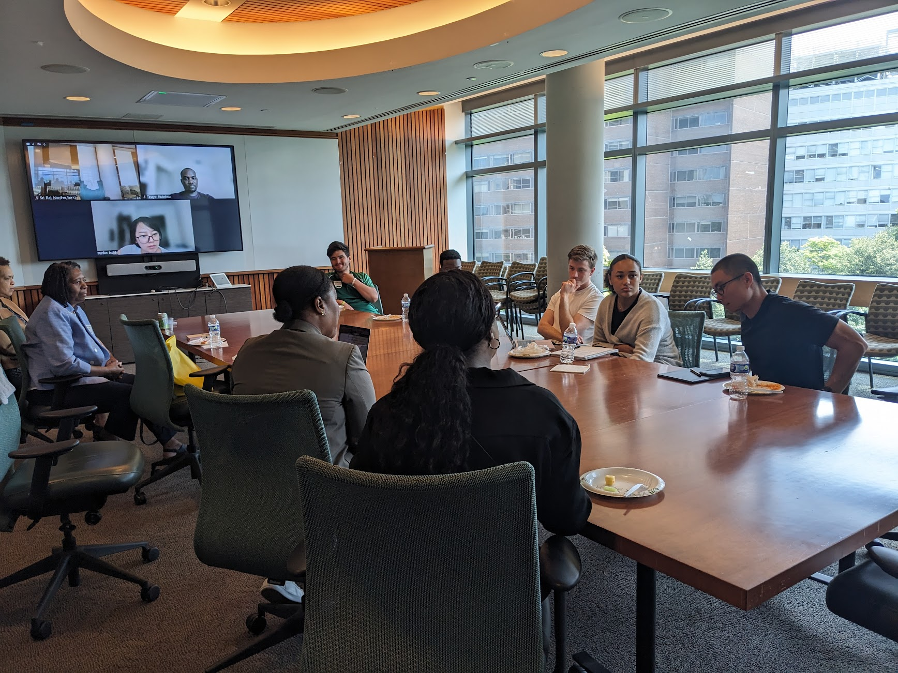
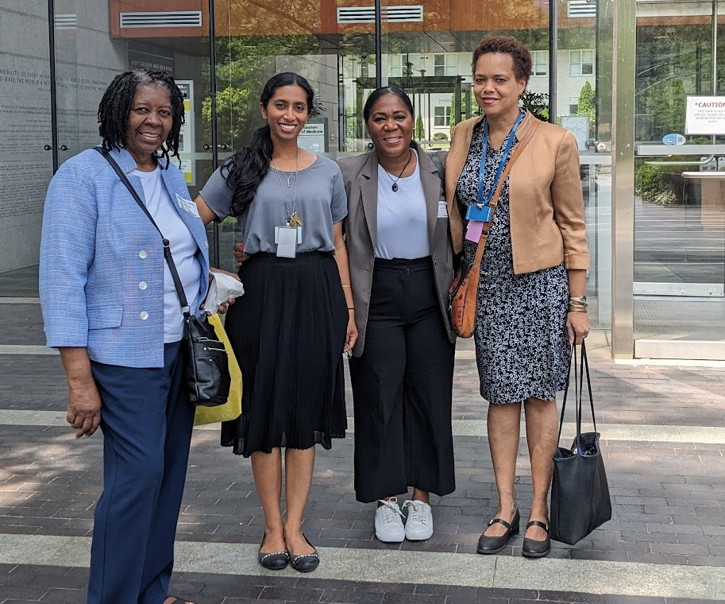
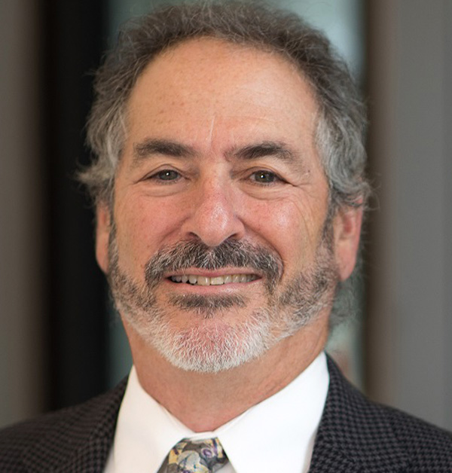
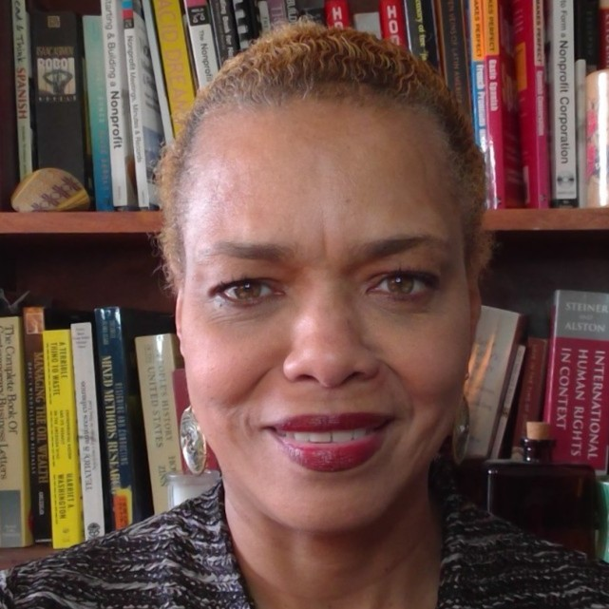
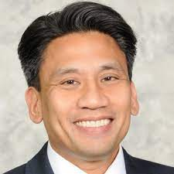
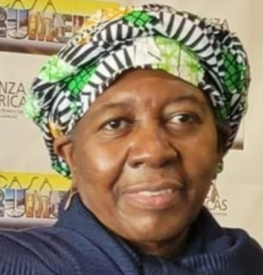
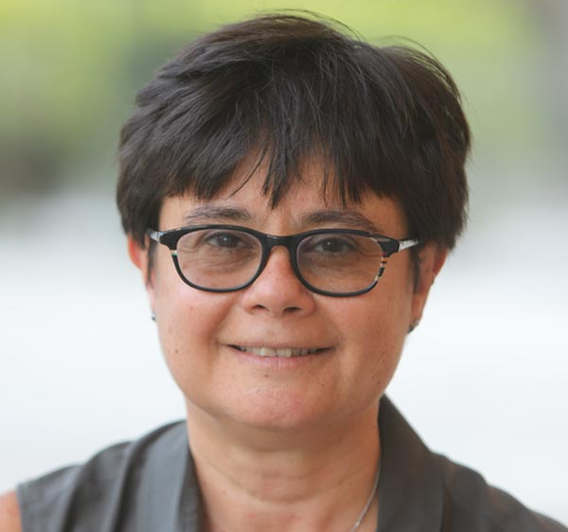
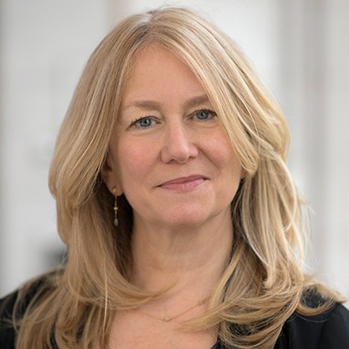
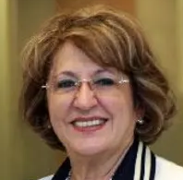
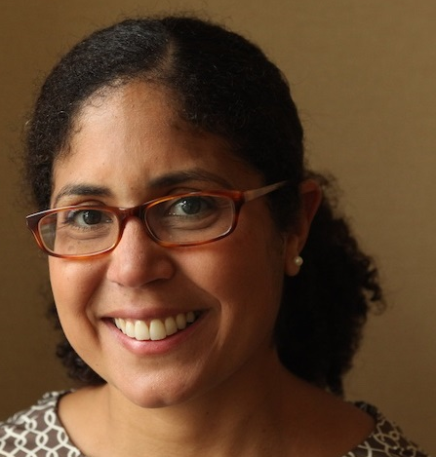
Collaborating with community leaders and researchers
Notes:
There is an incredibly strong community engagement component to this program as well, when we are working with understudied founder populations and discovering new enrichments of rare diseases that were previously unknown. Our publications are done in partnership with community leaders from each group, with co-authorship. They also play an active role in helping increase awareness of the conditions in their community, co-designing messages to increase trust-building between researchers, providers and the community.
We have to balance the value of identifying a genetic disease risk in a community with the risk of stigmatizing that group. The AoU Research Program notes this potential for biased interpretation promoting negative stereotypes. We collaborated with researchers and community leaders who are invested in healthcare outcomes in their communities to address the diverse concerns and needs of each community.

Slide 19
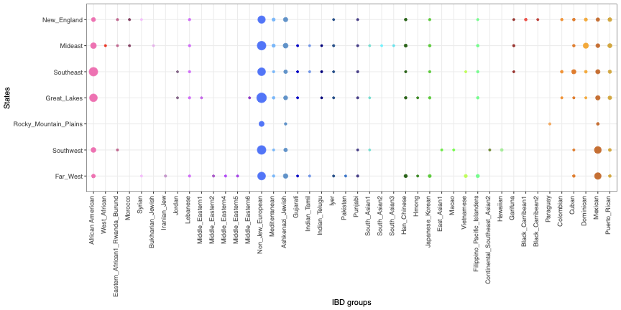
58 populations identified, who vary across the USA
Notes:
Just to give a bit of a teaser, we have now expanded this analysis to participants across the USA, identifying 58 populations, and enrichments of rare disease risks in these communities. Stay tuned!

Slide 20
Summary
Population-wide rare disease diagnostics: Biobanks allow expansion from family-based to population-based rare disease study
Community partnership is more important than ever to make genetic medicine accessible and reduce medical mistrust
Notes:
Just to summarize how biobanks have helped us in rare disease research. they have allowed us to expand from family-based to population-based rare disease risks, and also underscored the necessity of community partnerships

Slide 21
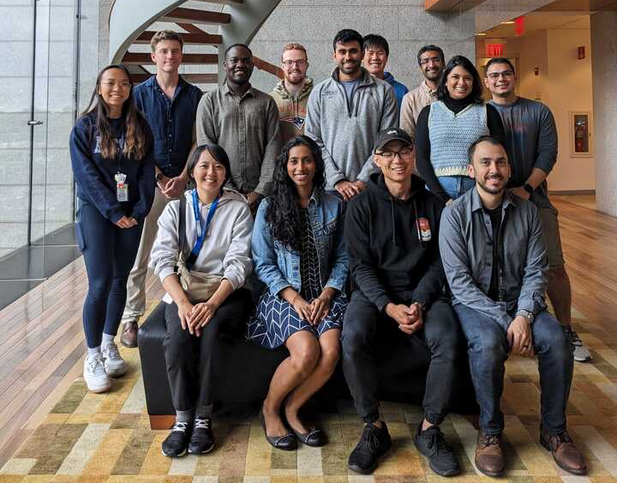
Einstein’s All of Us analysis team
MD-PhD students,
PhD students,
Bioinformaticians,
Postdocs,
Medical students

Slide 22
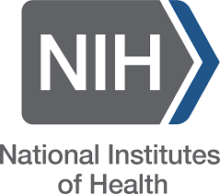





Acknowledgements
Dr. Mariko Isshiki (Segawa)
David Yang
Anthony Griffen
Dr. John Greally
Greally lab
Dr. Masako Suzuki
Suzuki lab
Paul Meissner
Paulette Spencer
Carmen Isasi
Susan Klugman
Michael Cabana
-NIH for funding
-Cancer Center and Department of Genetics for support
-all the participants of the All of Us program, BioMe, and other biobanks
Varun Gupta
Marina Konopleva
Paul Meissner
Parvathi Myer
Dr. Deepa Rastogi
Paulette Spencer
Yvonne Saenger
Ed Chu
Robert Kaplan
Tamar Sofer
Shakira Suglia
Gillian Belbin
Magda Matache
Mirtha Colon
Zoya Maksumova
Eimear Kenny
Alex Charney
Notes:
The research I presented here and elsewhere could not be done without my many collaborators some of whom are listed here, and others sprinkled throughout my talk, and I'd also like to thank my funding sources, mostly NIH

Slide 23
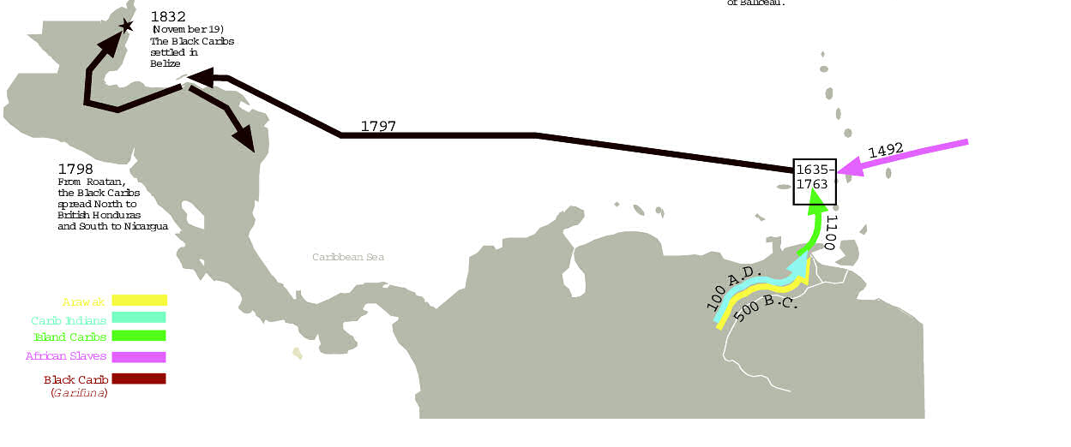
Who are the Garifuna?
West African enslaved people who shipwrecked on the Caribbean island of St. Vincent ~1635.
Garifuna - descendants of these enslaved people and indigenous island Carib and Arawak
https://carriacou.biz/caribs-garifuna/
Notes:
According to legend, in 1635 or 1675 a slave ship shipwrecked off the coast of the tiny island of St. Vincent. The survivors of that shipwreck, enslaved people from West Africa, married indigenous local Arawak and Kalinago (Island Carib) and then became the Garifuna group. They are now mixed race “Black Caribs”. They were never re-enslaved, and that allowed them to maintain their distinct culture and language, even after they were exiled to coastal Central America, in Honduras, in the 18th century and then moved to Belize. They are now settled throughout coastal central america.
https://carriacou.biz/caribs-garifuna/
The Garifuna are the descendants of indigenous Arawak, Kalinago (Island Carib), and Afro-Caribbean people. The founding population of the Central American diaspora, estimated at 2,500 to 5,000 persons, were transplanted to the Central American coast from the Commonwealth Caribbean island of Saint Vincent from 1635. They are now mixed race “Black Caribs”. They were never re-enslaved, and that allowed them to maintain their distinct culture and language, even after they were exiled to coastal Central America, in Honduras, in the 18th century and then moved to Belize .
Garifuna is an Arawakan language of Central America, spoken by more than 150,000 people in Honduras, Guatemala, Nicaragua and Belize. The Garifuna people are mixed-race (and frequently referred to as the Black Caribs)-- their community is said to have originated because Caribbean people attacking Spanish ships in the 1600's adopted the African slaves they freed. This alliance served both groups very well, as the Africans were never re-enslaved and the Garifuna are one of the few Carib peoples who have survived as a distinct culture and with their native language thriving.

Slide 24
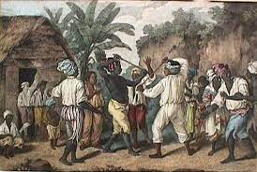
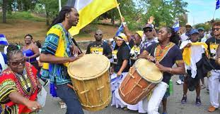
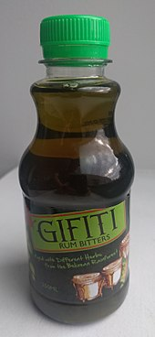
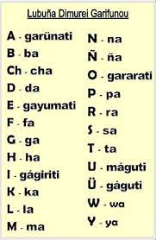
Garifuna have a strong presence in the Bronx
>200-300K in NYC, most in Crotona, South Bronx
Notes:
The bronx is home to the largest Garifuna community in the United States.
Maintain a distinct language that includes Arawak and Carib words. Distinct food, including this drink Gifiti, traditionally used as a herbal remedy, and their own language, including their own alphabet.
Garifuna word actually comes from the word “cassava”, and Garinagu, the plural of Garifuna, actually means “cassava people”
http://www.native-languages.org/garifuna.htm

Slide 25



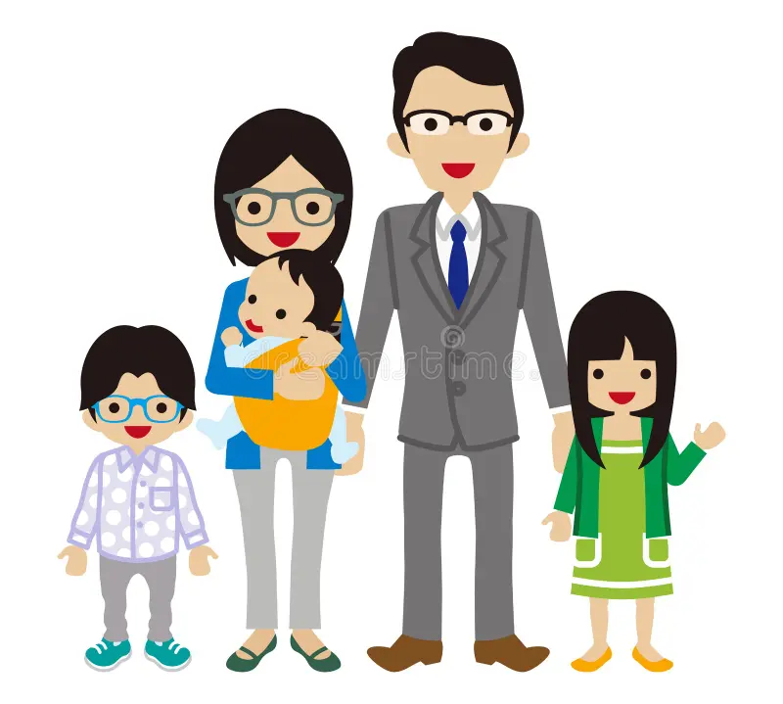
Challenges to the physician - what is a population?
Race vs ancestry: Self-defined race is helpful for social determinants of health, misleading and often wrong for biological determinants of health
-especially problematic for admixed individuals
American or Latino -
Cuban?
Mexican?
Puerto Rican?
Indigenous?
African?
African-American?
Afro-Caribbean?
Brazilian?
Creole?
Northern European white?
Ashkenazi Jewish?
Hutterite?
Amish?
Italian?
Chinese?
Japanese?
Hmong?
Filipino?
Vietnamese?
Notes:
Large-Scale Biobanks as Discovery Engines
Heading: The Power of the All of Us Research Program
Content:
Diversity by Design: Unlike historical biobanks (90%+ European), All of Us prioritizes underrepresented communities.
Beyond Common Disease: While often used for polygenic scores (common disease), biobanks are powerful tools for identifying "private" rare variants in specific ancestries.
Insight: Large-scale

Slide 26
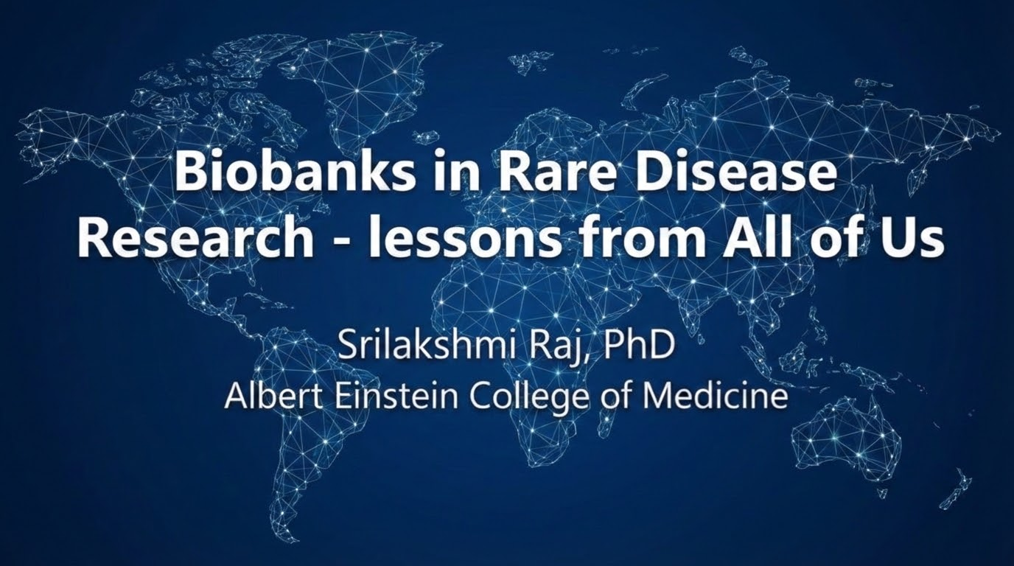

Slide 27
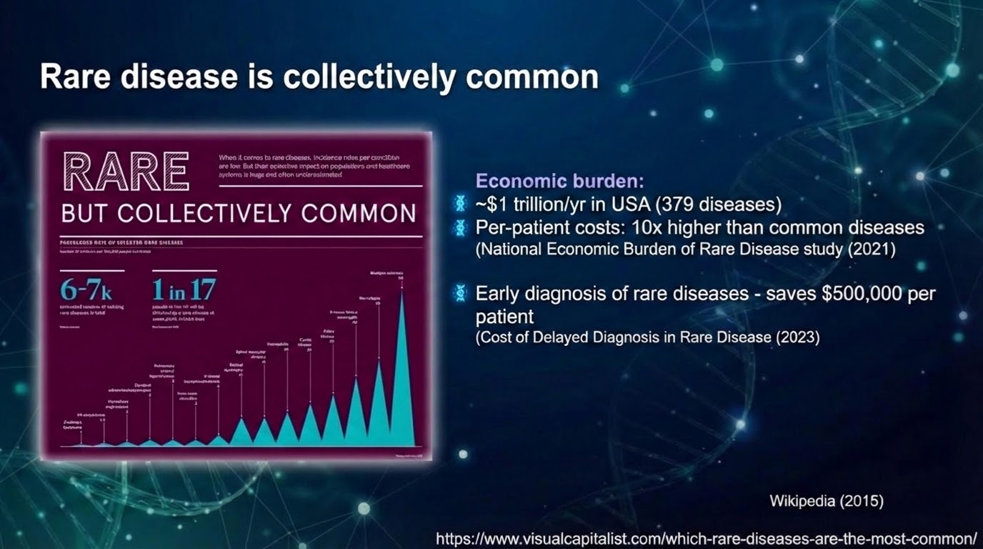

Slide 28
“If We Build It, They Will Come”
Amy Laster, PhD
Chief Scientific Officer

Slide 29
Retinal Degenerations
Rare: less common than 1:3,500 worldwide
Inherited: families may be concentrated in areas with limited access to specialist care
Extreme genetic heterogeneity: caused by genetic changes in over 300 genes, with variable and widely ranging clinical manifestations associated with each gene
Relentless: genetic changes cause progressive dysfunction and death of rod and cone photoreceptors
No effective treatments for most

Slide 30
Challenges to Developing Treatments
Uncommon: few patients available for study, limited information exists
Wide range of phenotypes requires evaluation using specialty testing and expert clinical evaluation
Limited standardized prospective natural history data on IRDs
Unclear what outcome measures will be most likely to demonstrate change over time, or safety and efficacy of treatments

Slide 31
Consortium Model
  Goal: Accelerate development of treatments for IRDs
  Investigators collaborate on ideas for hypotheses, study designs, and publications
  Consortium Natural History Studies (NHS):
        Provide prospective, standardized, longitudinal data on disease progression
        Identify sensitive structural and functional outcome measures for future clinical trials
  Data from completed studies will be archived in an open central repository to stimulate further hypothesis generation and innovation

Slide 32
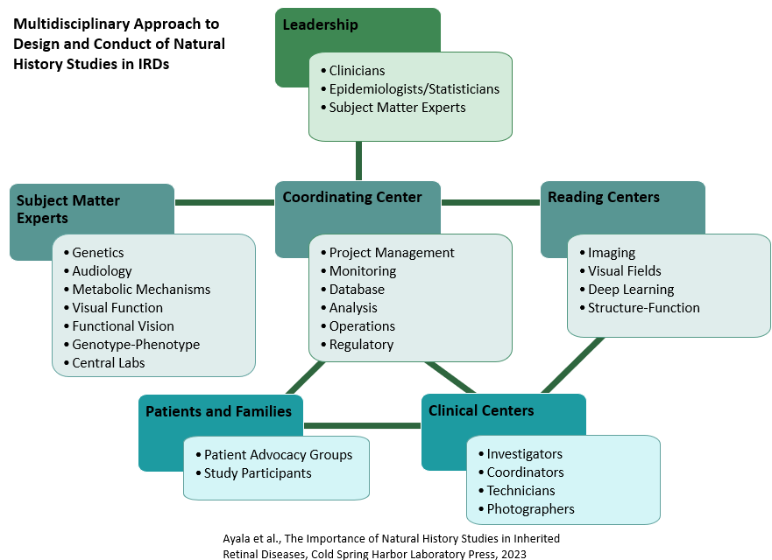
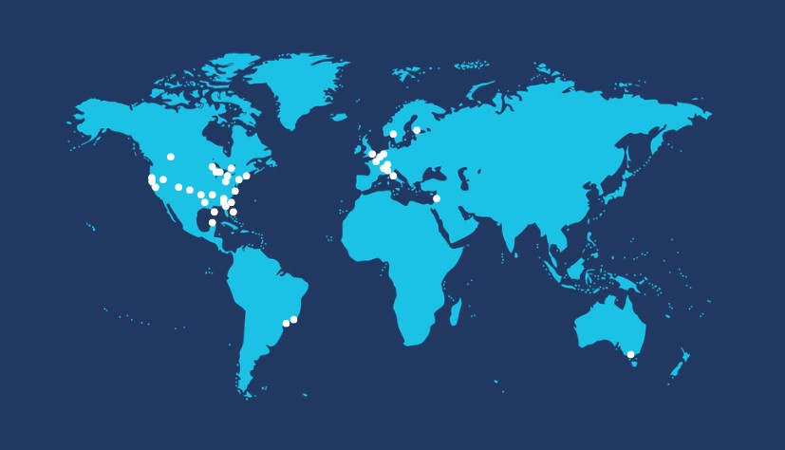
Consortium Overview
Consortium of clinical centers with expertise in inherited retinal degenerations (IRDs)
Goal: Accelerate development of treatments for IRDs
40 sites in 15 countries
Notes:
Alternative Single Slide Overview

Slide 33
Consortium Strengths
Feasible recruitment
  Due to large number of international sites
Data quality
  Enforced by standardized procedures
Efficiencies
  Gained from existing infrastructure
Collaboration
  Of ideas and expertise from multidisciplinary team
Sharing
  Of datasets further our mission to advance IRD research

Slide 34
Consortium Efficiencies
Master Agreements
IRB Reliance Agreements
Technician Certification
Standardized Data Collection Forms
Standardized Procedures
Downstream efficiencies – monitoring procedures, reports, checks, and statistical coding become standardized and based on templates

Slide 35
Objectives of our NHS
Estimate rates of progression
Investigate structure-function relationships
Explore properties of candidate endpoints (e.g., signal-to-noise, reproducibility, symmetry)
Identify factors related to progression
Define genotype-phenotype associations
Provide a source of historical control data
Inform the design and practical challenges of clinical trials

Slide 36
Outcome Measures in our NHS
Structural
  Spectral-domain optical coherence tomography (SD-OCT) volume and V/H, fundus autofluorescence (FAF), color photos
Functional
  Static perimetry (SP), microperimetry (MP), full-field stimulus threshold (FST), electroretinography (ERG), best corrected visual acuity (BCVA), low luminance visual acuity (LLVA), contrast sensitivity, color vision
Patient Reported Outcomes (PROs)
  Visual function questionnaires (MRDQ, ViSIO)
  Quality-of-life questionnaires (PROMIS-29)
Performance Based Tests (PBTs)
  MObility STandardized Task in Virtual Reality (MOST-VR)

Slide 37
Studies

Slide 38

Startup
Certification Launch
Recruitment
Follow Up
Study Closeout
Consortium Natural History Studies
Established in 2016
2019
2020
2021
2022
2023
2024
2025
2026
2027
2028
2029
2030
2031
RUSH2A
Pro-EYS
RUSH1F
Uni-Rare | Registry → |  |  |  |  | Registry →
 | RDH12 → |  | NHS launch genes → | NHS launch genes → |  | 1st NHS genes →
 | MYO7A→
 | Bluerock Multigene Cohort→
 | CLRN1-N48K →
 | CLRN1-Wide → | FDA OOPD Grant Genes → |  |  | FDA OOPD Grant Genes --→
 | KIZ→
GYROS

Slide 39
Universal Rare Gene Study (Uni-Rare)
Study Chair: José-Alain Sahel
Registry Component
  Prospective, standardized, cross-sectional clinical data collection
  Open to >300 rare IRD genes
  N=1500
Natural History Study (NHS) Component
  Prospective, standardized, longitudinal (4 years) clinical data collection
  A platform to move participants from the registry as each gene opens
  N=100 cap per gene
Genotype Characterization
Cross-Sectional Phenotype Characterization
Natural History using Functional, Structural, PRO Measures
Structure-Function Relationship
Risk Factors for Progression
Co-funded: Co-funded by Foundation Fighting Blindness, AAVantgarde, Allen B. Cutting Foundation, Anonymous Donors, Atsena Therapeutics, BlueRock Therapeutics, Cove Therapeutics, Eli Lilly and Company, Jackie and David Marlin, Maryrose Sylvester, Max and Minnie Tomerlin Voelcker Fund, Octant Inc., Opus Genetics, Sarah de Coizart Trust, Save Sight Now, Usher III Initiative
Status: Registry recruitment goal December 2026
  NCT05589714

Slide 40
Uni-Rare Impact
Part 1 – Cross-sectional registry
The registry will establish genetically and clinically well-characterized cohorts of patients across hundreds of genetic variants associated with retinal dystrophy. Characterization of these patients will:
Provide cross-sectional data on phenotype-genotype associations
Contribute to our knowledge of pathogenicity of these rare disease-causing variants
Accelerate eligibility screening for subsequent natural history studies
Part 2 – Prospective, natural history
The natural history study will accelerate the identification of sensitive, reliable outcome measures for clinical trials, which will facilitate development of treatments for retinal dystrophies due to disease-causing genetic variants. The expected impact of the natural history study is to:
Describe the natural history of retinal degeneration in patients with rare disease-causing genetic variants
Define sensitive structural and functional outcome measures for future multicenter clinical trials of rare inherited retinal degeneration
Identify well-defined subpopulations for future clinical trials of treatments for rare inherited retinal degeneration
Notes:
We expect Uni-Rare will have an impact on IRD research in several ways:
First - The Registry’s cross-sectional data collection will allow us to genetically and clinically characterize patients across hundreds of IRD genes. This is a prospective, standardized data collection, so the data we obtain will be high quality and will also allow us to clinically evaluate correlation of structural and functional measures and how these measures are associated with things like duration of disease, and age of onset of first symptoms.
The Registry also serves as a screening visit for the natural history study (NHS), so patients will enroll into the NHS directly from the Registry once their gene is opened into the NHS.
The NHS component then serves as an existing infrastructure to efficiently roll out each gene as funding is available. It will eliminate repetitive processes like certification, training, regulatory approval, contract agreements, and ultimately reduce costs and accelerate timelines for the natural history studies.
The impact of each gene’s NHS is the same as our other standalone natural history studies – which is to define the WHO, WHAT, and WHEN for future trial designs. But this platform will get us there more efficiently.
The Consortium envisions Uni-Rare will result in mutually beneficial partnerships between IRD researchers and companies, including early access to study datasets and joint development of outcome measures.

Slide 41
Thank you
Amy Laster, PhD
alaster@FightingBlindness.org

Slide 42
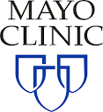
Supplementing Patient Registries with
Electronic Health Record (EHR) Dataset: Challenges and Opportunities
Mayowa Osundiji, MBBS, PhD, FACMG, FADLM, HCLD (ABB)
Clinical Geneticist
Department of Clinical Genomics

Slide 43
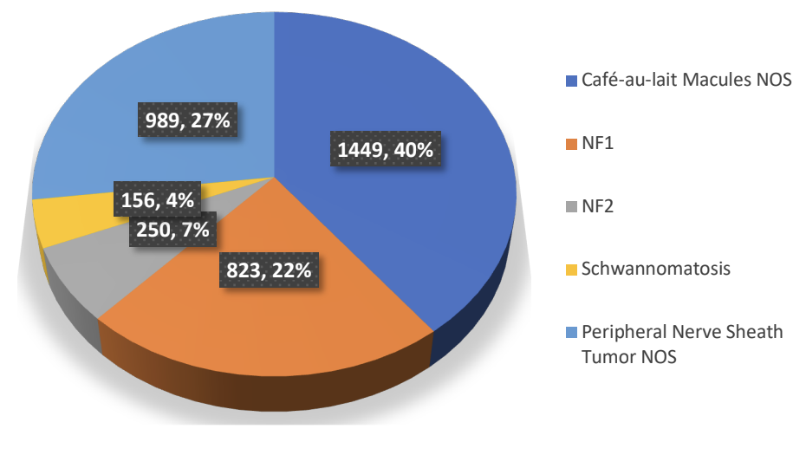
Supplementing Patient Registries with
Electronic Health Record (EHR) Dataset: Exemplified by Neurofibromatosis (NF) and Schwannomatosis (SCHWN)
Proportion (number and percentage) of patients with neurofibromatosis (NF) type 1 and 2 as well as schwannomatosis across Mayo Clinic. Also included are patients who are being followed for suspected NF1, NF2 or schwannomatosis in the context of a history of peripheral nerve sheath tumor or multiple café-au-lait macules. NOS means not otherwise specified. Total n=3,667.

Slide 44
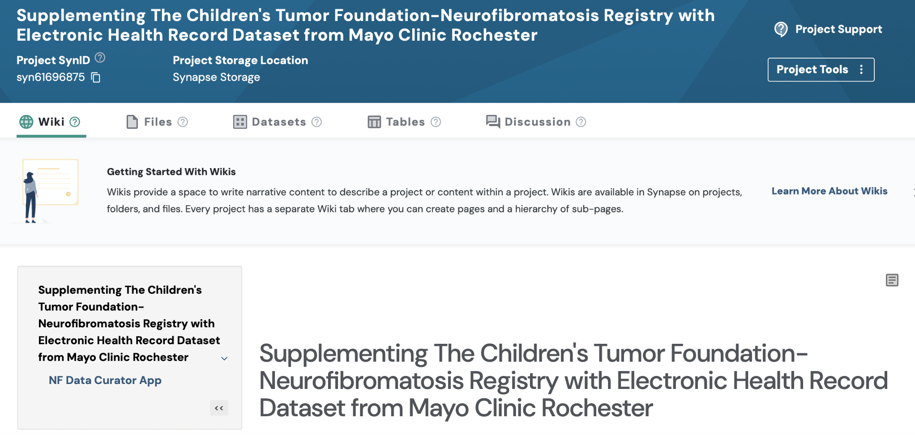
EHR Driven NF and SCHWN Registry

Slide 45
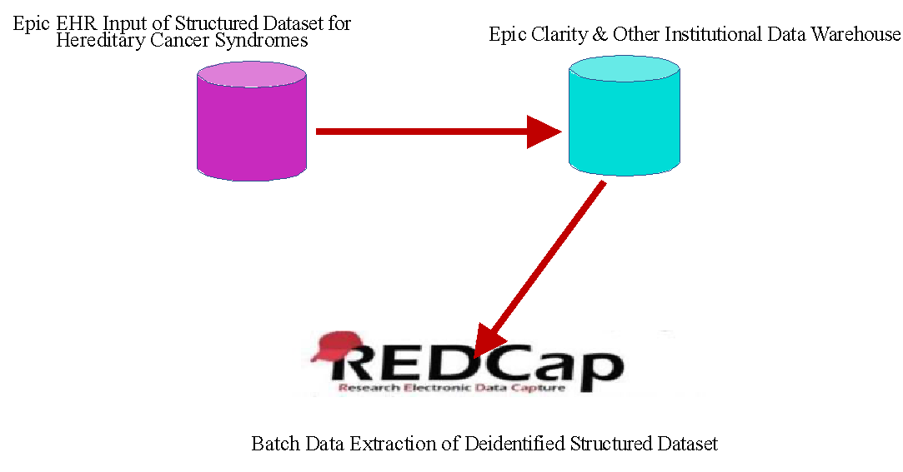
EHR Driven NF and SCHWN Registry

Slide 46
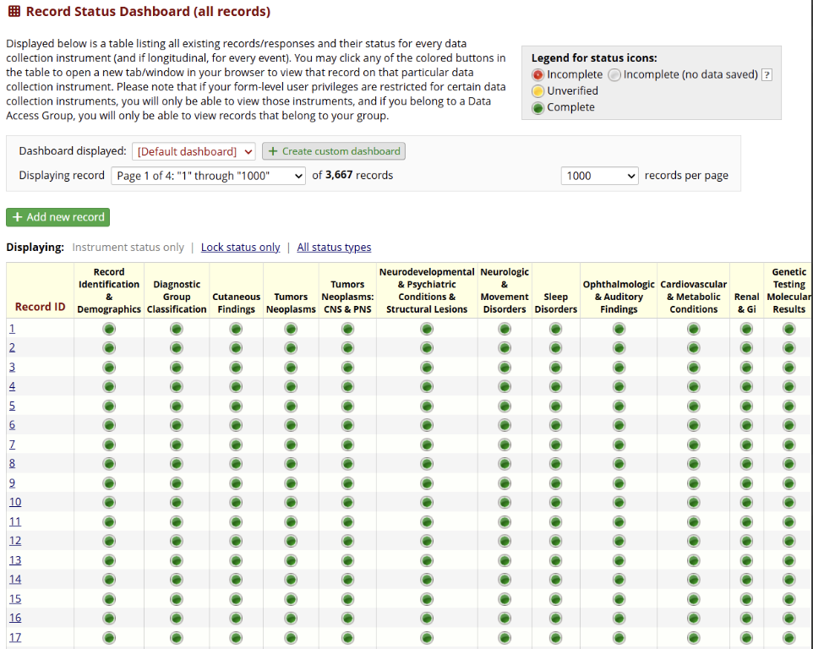
REDCap NF and SCHWN Registry

Slide 47
REDCap NF and SCHWN Registry
Improved understanding of clinical manifestations, disease characteristics and progression, can help guide surveillance
﻿﻿2. Genotype-phenotype associations and management outcomes
﻿﻿3. Improved molecular diagnostic processes via resolution of variants of
uncertain significance

Slide 48

Questions

Slide 49
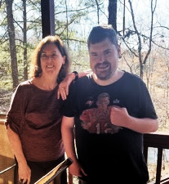


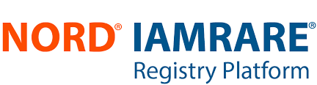
Registries and Real-World Data to Support Therapeutic Development: Empowering Patient Advocacy Groups
Theresa Strong, PhD
Director of Research Programs
Foundation for Prader-Willi Research
Daniel’s mom

Slide 50

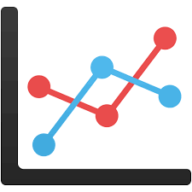
PAGs are uniquely suited to:
Collaboratively develop tools to support efficient, meaningful clinical trials
Build knowledge to inform clinical development for pharmaceutical companies, regulatory agencies
Bring quantitative data to support anecdotal evidence - documenting the unmet medical needs of our patient community

Slide 51




Prader-Willi Syndrome
Complex neurodevelopmental disorder that occurs in ~1/15,000 births; affects males/females, all races and ethnicities
Loss of paternally expressed, imprinted set of genes on chromosome 15q11-13
Major features:
  Hypotonia, FTT → hyperphagia, obesity
  Clinical problems: endocrine deficiencies, orthopedic problems (scoliosis), sleep disturbances, respiratory issues, GI problems, incr. risk of mortality across lifespan
  Challenging behavioral profile: anxiousness, temper outbursts, OCD behaviors, cognitive rigidity; highly susceptibility to mental illness
  Mild to moderate intellectual disability

Slide 52

Impact of PWS on the Family
Hyperphagia and behaviors limit the person’s ability to achieve independence, reach life goals and engage in the community
Caregiver burden as measured by the Zarit Burden Interview (ZBI) is very high, even compared to other challenging disorders: sleep, family relationships, and ability to work impacted
ZBI score is higher for those families experiencing more severe hyperphagia
ZBI scores stable over time in the absence of effective treatment
Increasing burden →
Increasing hyperphagia →
https://doi.org/10.1371/journal.pone.0248739.g002

Slide 53



What do families want to see treatments for? What level of risk are they willing to accept?
Families are willing to accept risk for a modest improvement in hyperphagia
Journal of Medical Economics, DOI: 10.1080/13696998.2018.1528980

Slide 54





Measuring the PWS-specific features that matter to families:
Characterizing new clinical outcome assessments
400-640 participants for each study
Longitudinal data over 4+ years

Slide 55

Evaluation of Validated Measures in PWS
PROMIS Parent Proxy Global Health
PROMIS Parent Proxy Life Satisfaction
Glasgow Depression Scale – Carer Supplement
Useful for assessing quality of life in the PWS population

Slide 56


Natural History Studies to Inform Clinical Trial Design
What % of the PWS population has >5% change in weight over 6 mo?
What % of the population are taking psychotropic medication?
n=644
Change in weekly weight over 6 mo, collected via HIPPA-compliant text messaging

Slide 57

Natural History Studies to Support Drug Approvals
Compared to participants in PATH for PWS Natl Hx Study who were not receiving the drug, matched participants treated with VykatXR for 6 months or 1 year showed:
    Highly significant improvements in hyperphagia (p <0.001)
    Significantly greater improvements in PWS associated behaviors - aggression, anxiety, compulsivity, rigidity/irritability, depression and disordered thinking
March 2025 approval

Slide 58


Challenges
PAG’s are increasingly sophisticated in using registries and real-world data to support therapeutic development
Ideally situated to collaborate / lead these studies:
understand disease-specific issues / landscape
highly motivated to generate and share data
long-term commitment
Are we collecting data from a representative population?
How can we better integrate multiple data sources (e.g., clinician reported data with patient reported data)?
How can we ensure that PAGs have a meaningful seat at the table?

