Slide 1
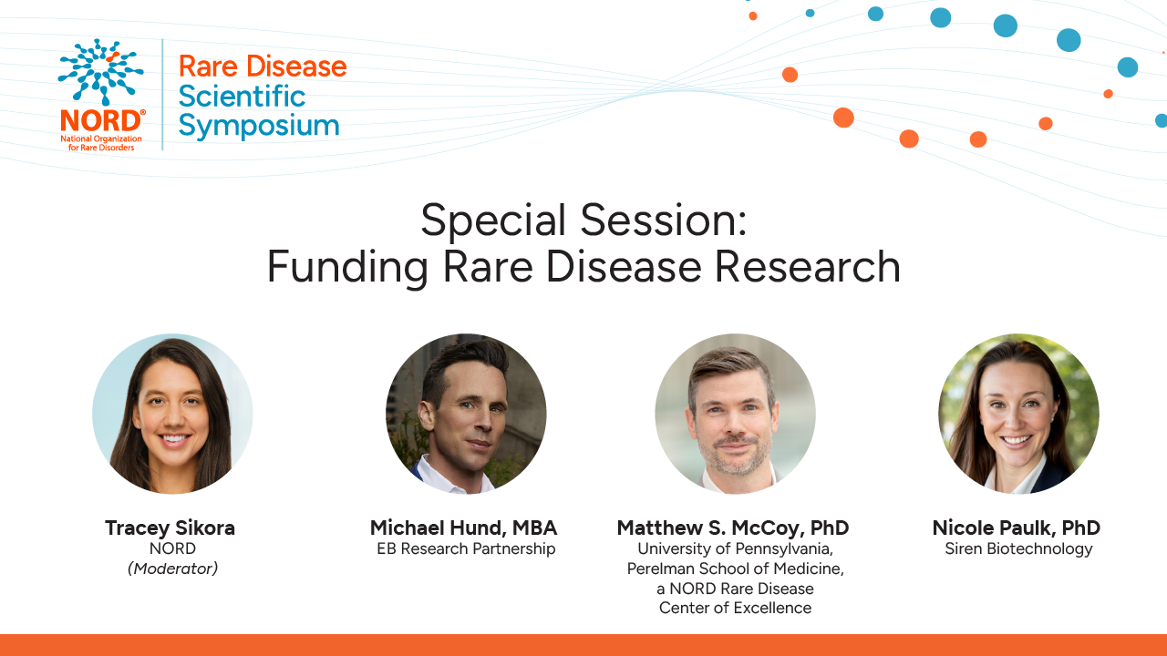

Slide 2
Funding Rare Disease Research
Michael Hund, MBA
CEO, EB Research Partnership

Slide 3
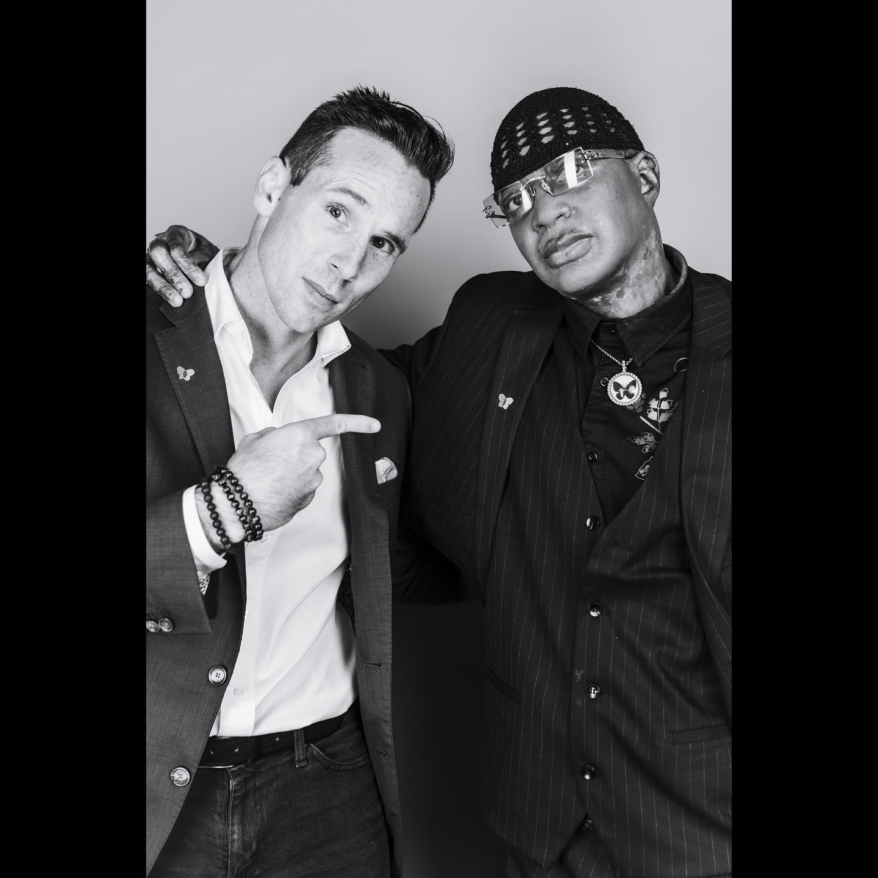
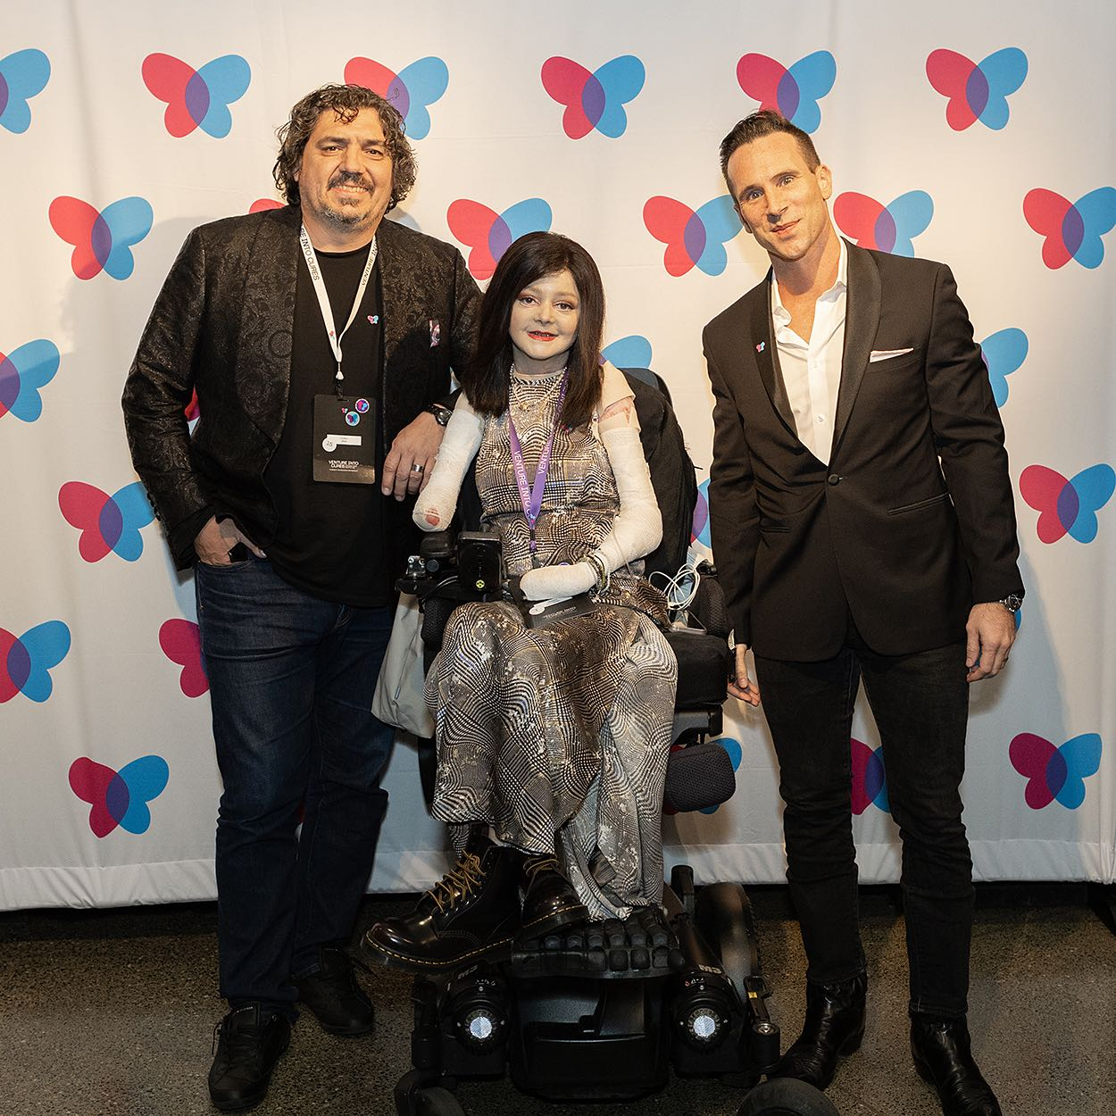
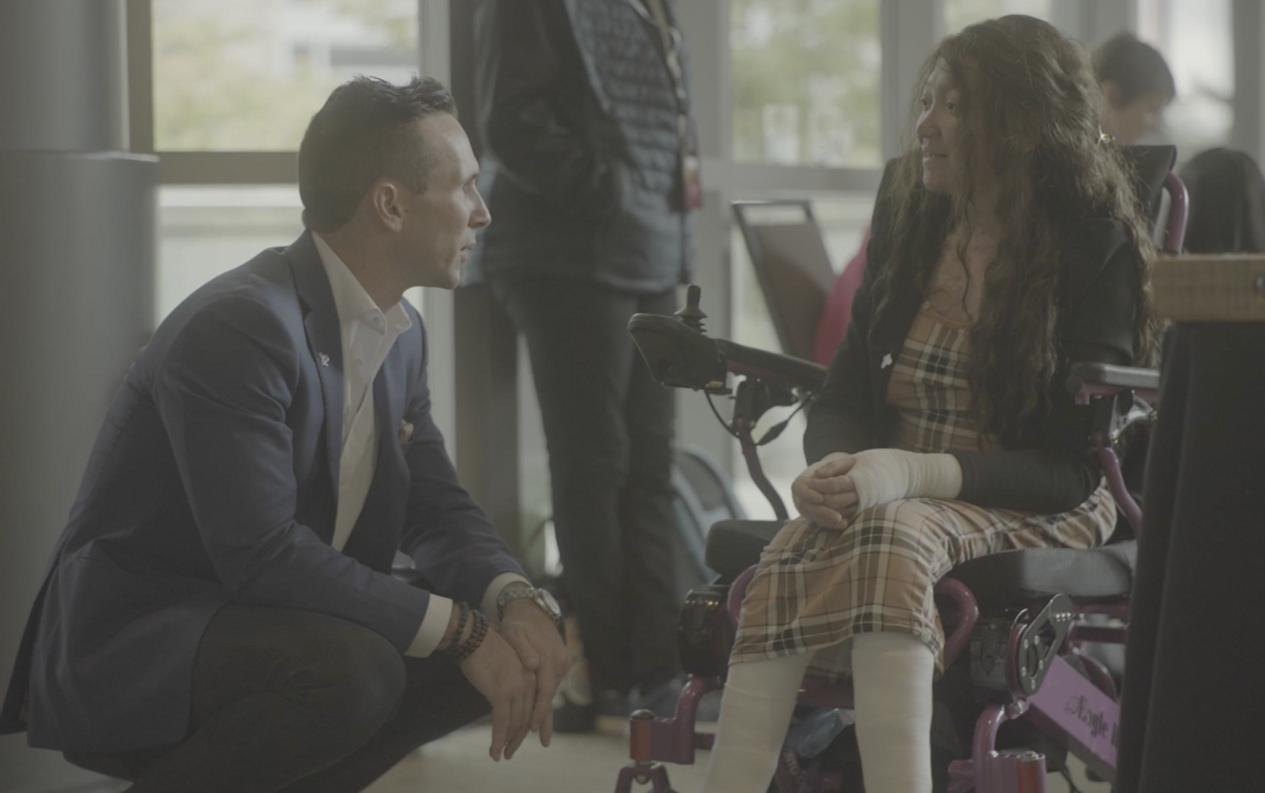


Michael Hund, MBA
Chief Executive Officer
EB Research Partnership
NORD SCIENTIFIC SYMPOSIUM

Slide 5


Slide 6

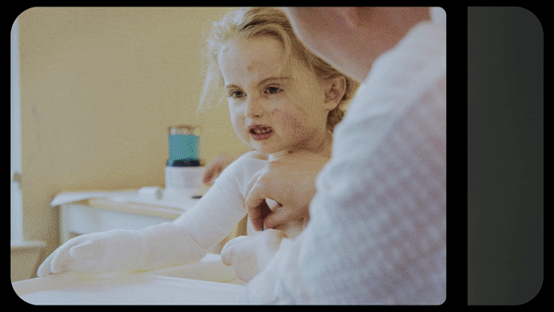




2030
At EB Research Partnership,
our goal is to cure EB by
And we’re pioneering a
path for all rare disease
in the process.

Slide 7
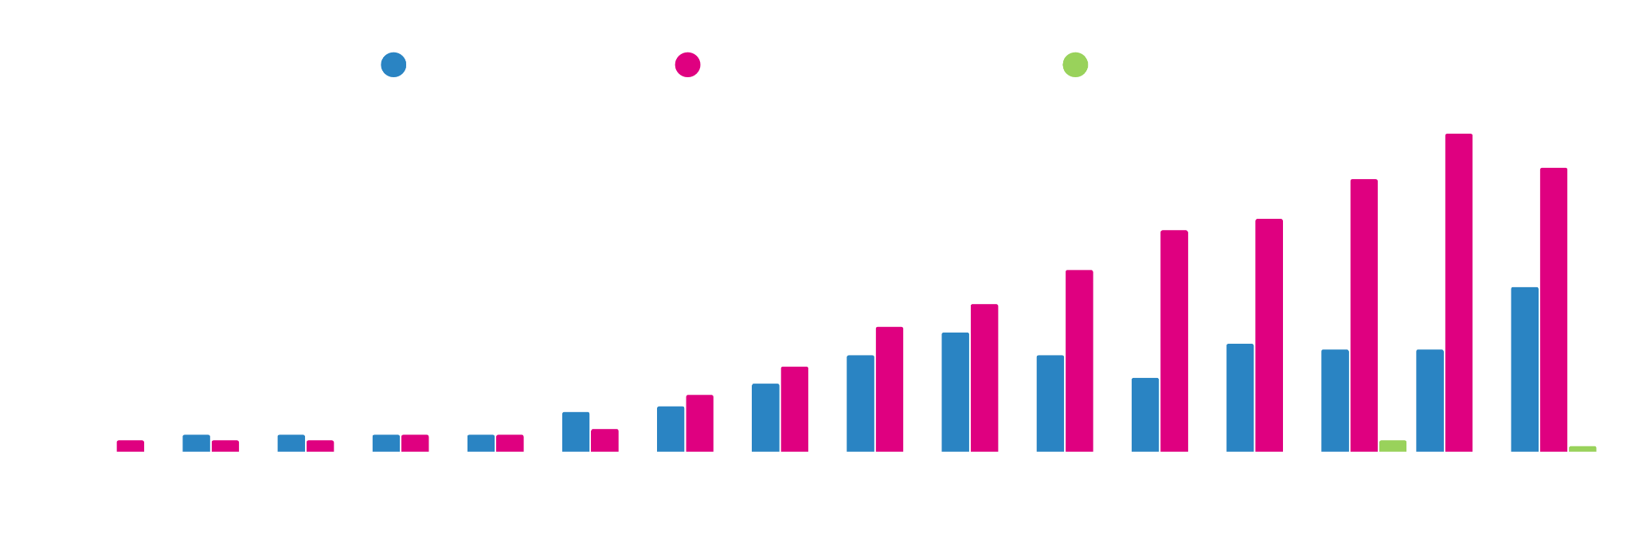
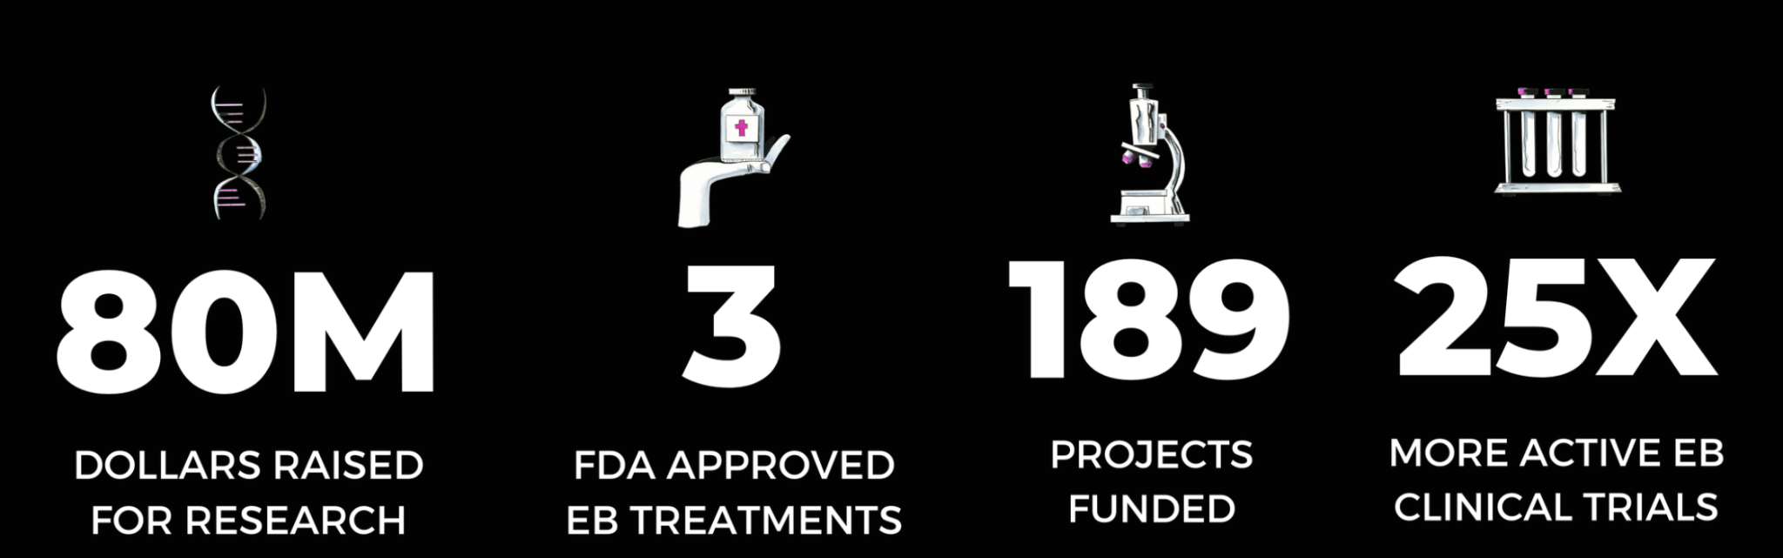
Our Impact

Slide 8



Our Venture Into Cures Model
Data
Platforms
Medical
Infrastructure
Venture
Philanthropy

Slide 9

Venture Philanthropy Model

Slide 10
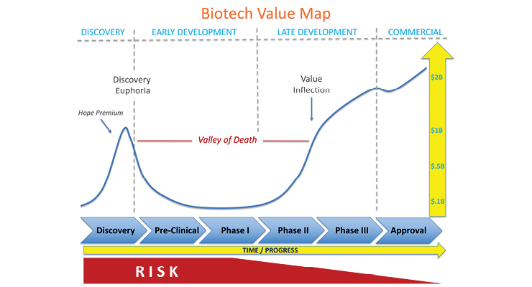
Source: MPO-Mag

Slide 13
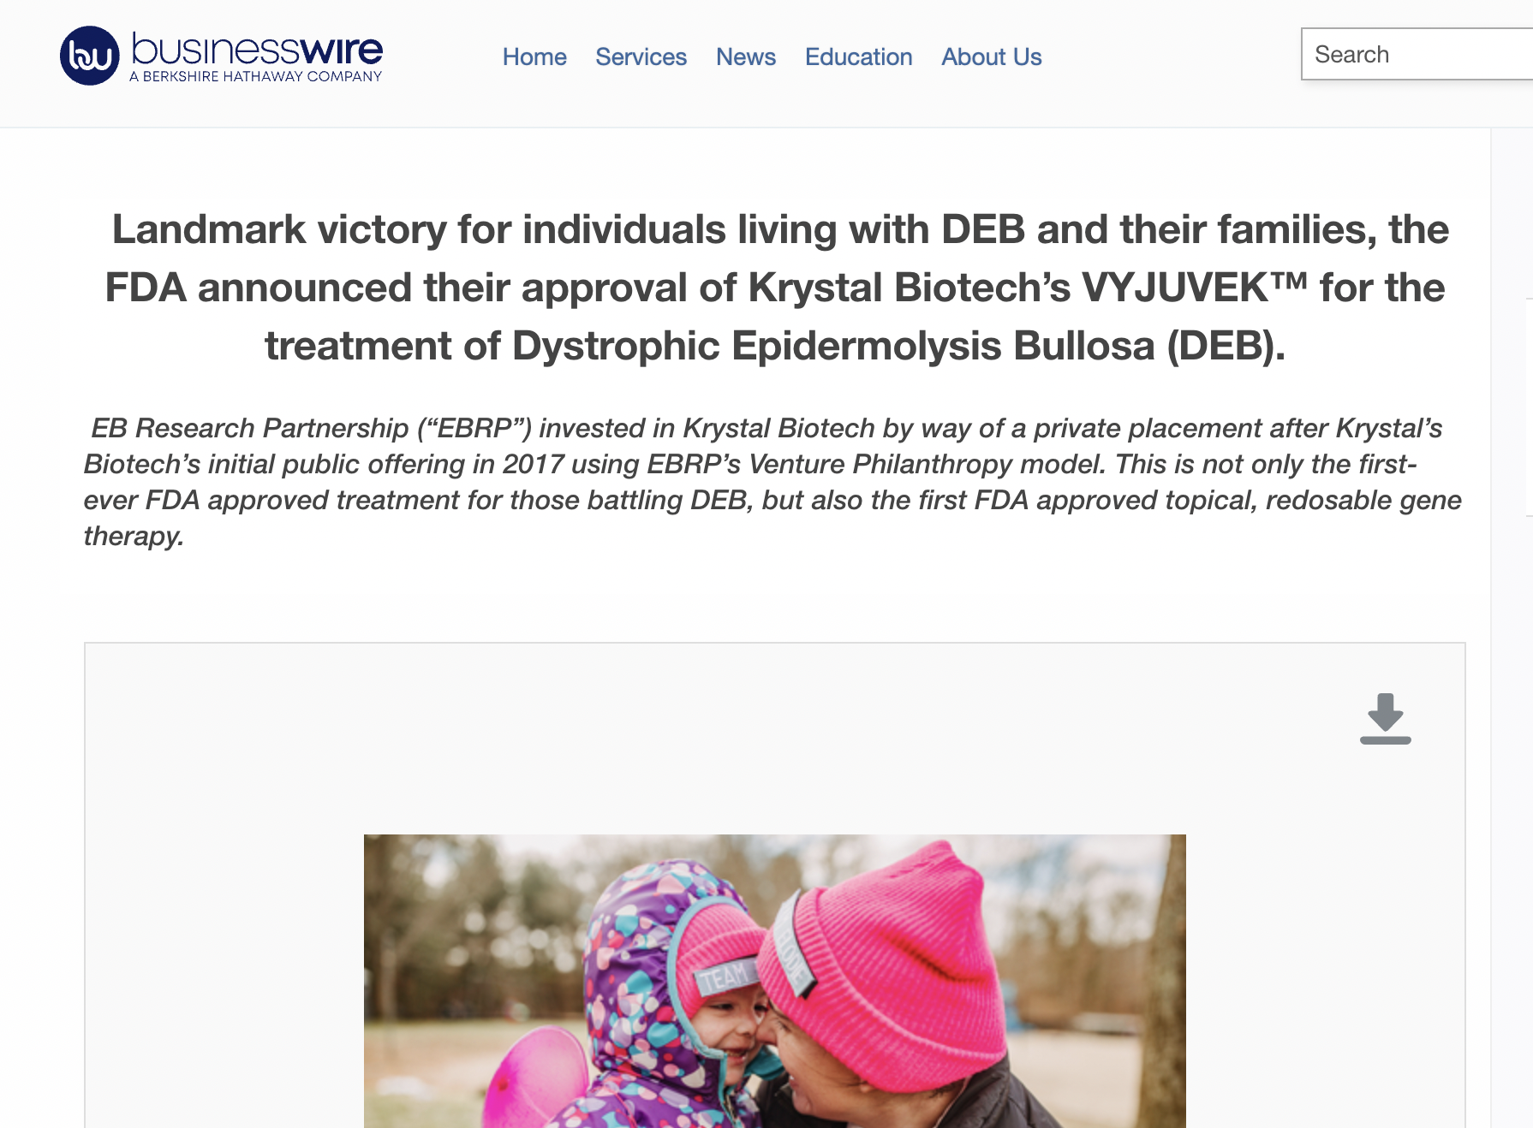

Slide 14
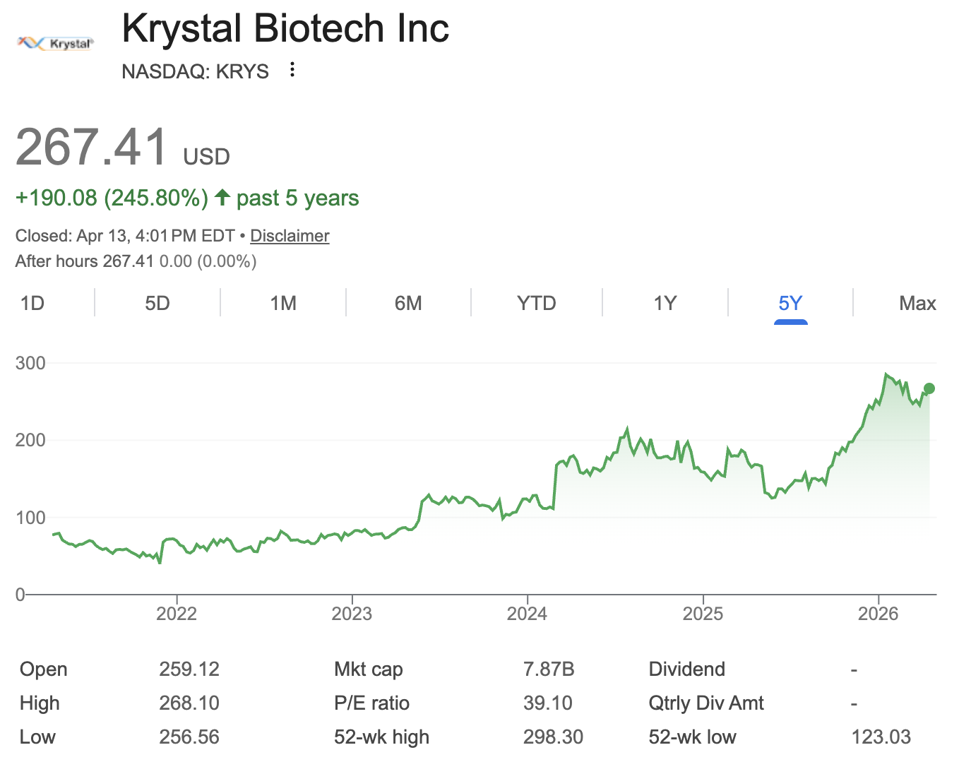

Slide 15
Case Study: 6x Return on Investment
$3M
$500K
1
2
3
4
We fund a university to develop a treatment for severe EB that corrects gene mutations in skin cells under (1) Venture Philanthropy agreement.
A public biotech company uses that intellectual property to make a treatment, (2) we received stock in the company.
That (3) stock grew to be worth multiples beyond our original investment.
We sell our shares and direct that (4) revenue right back into research projects.

Slide 16
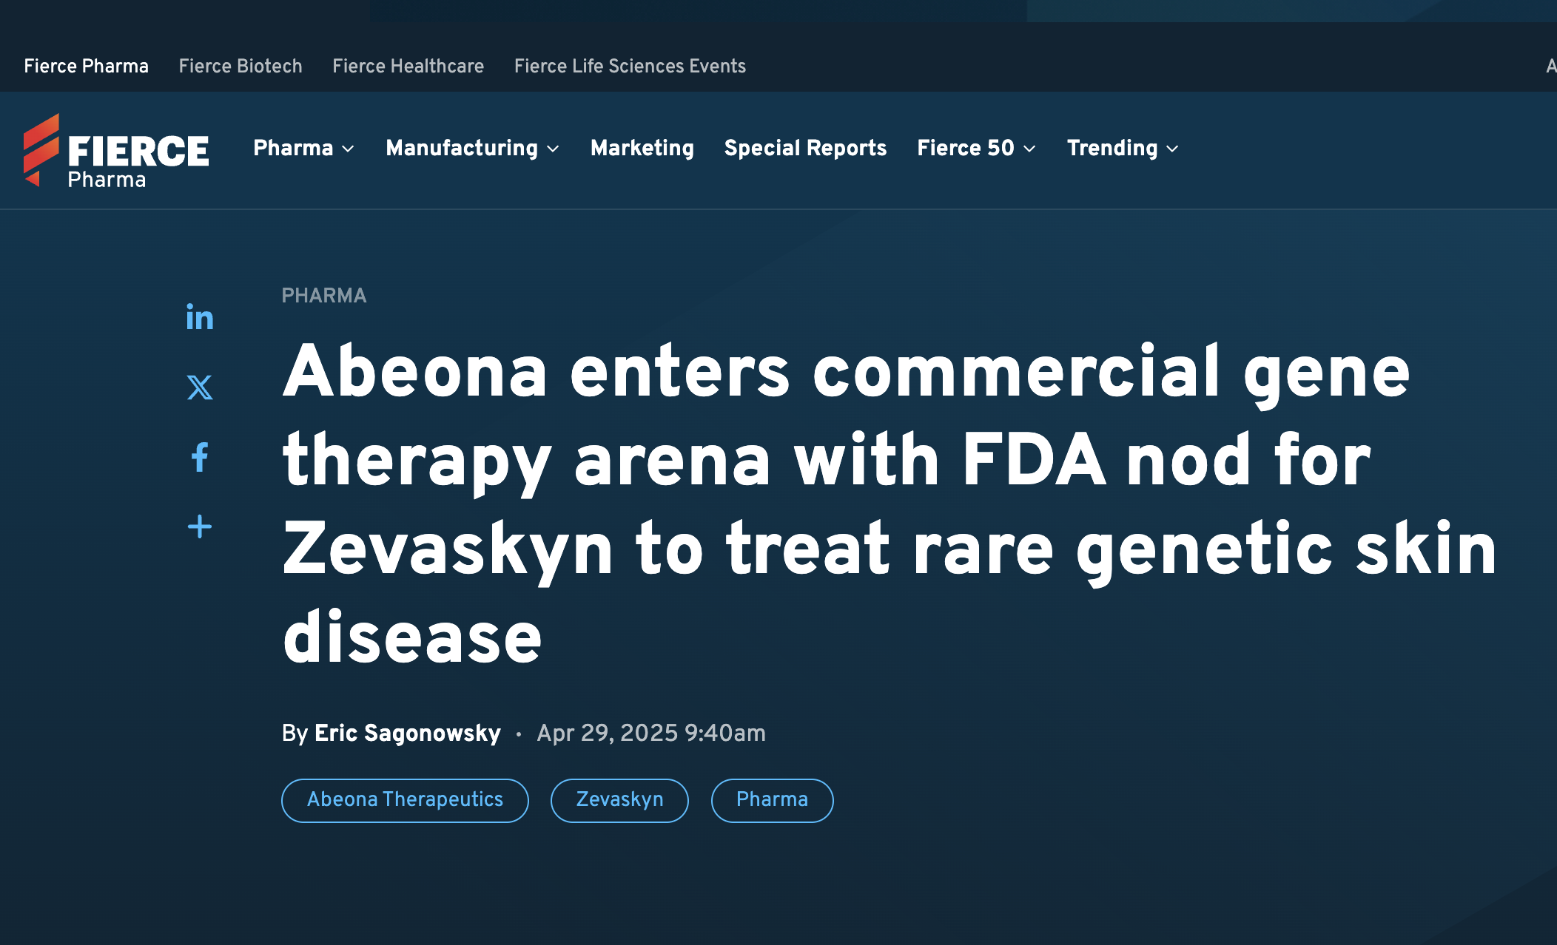
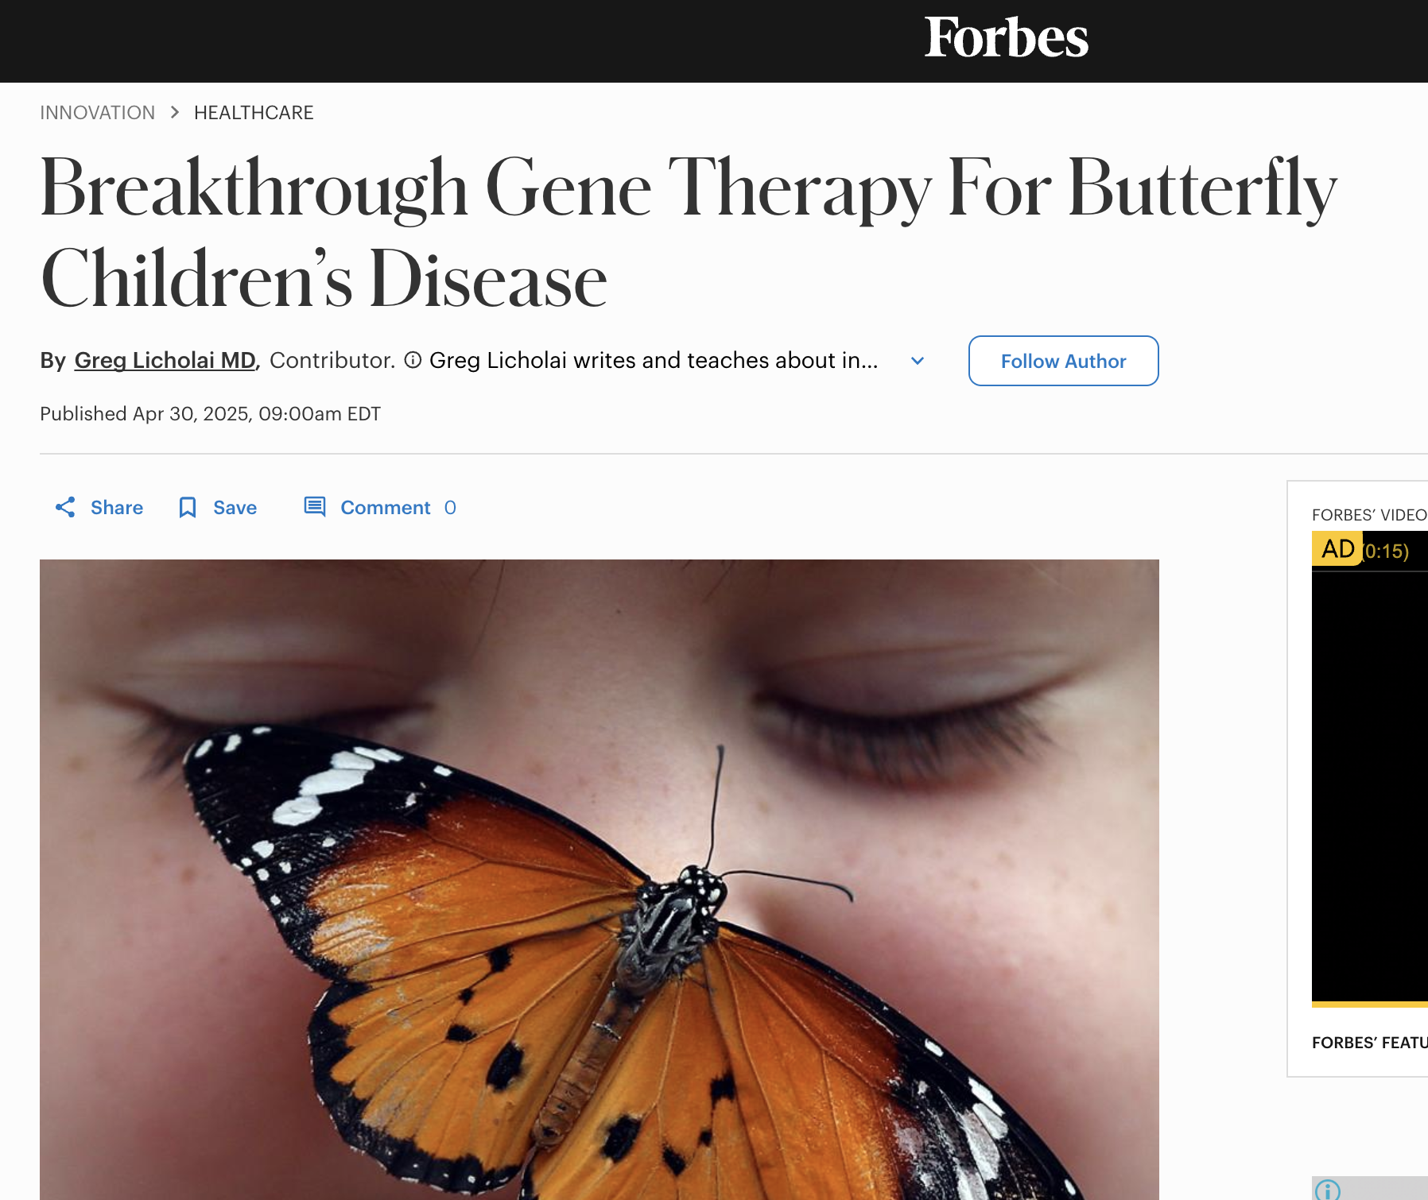
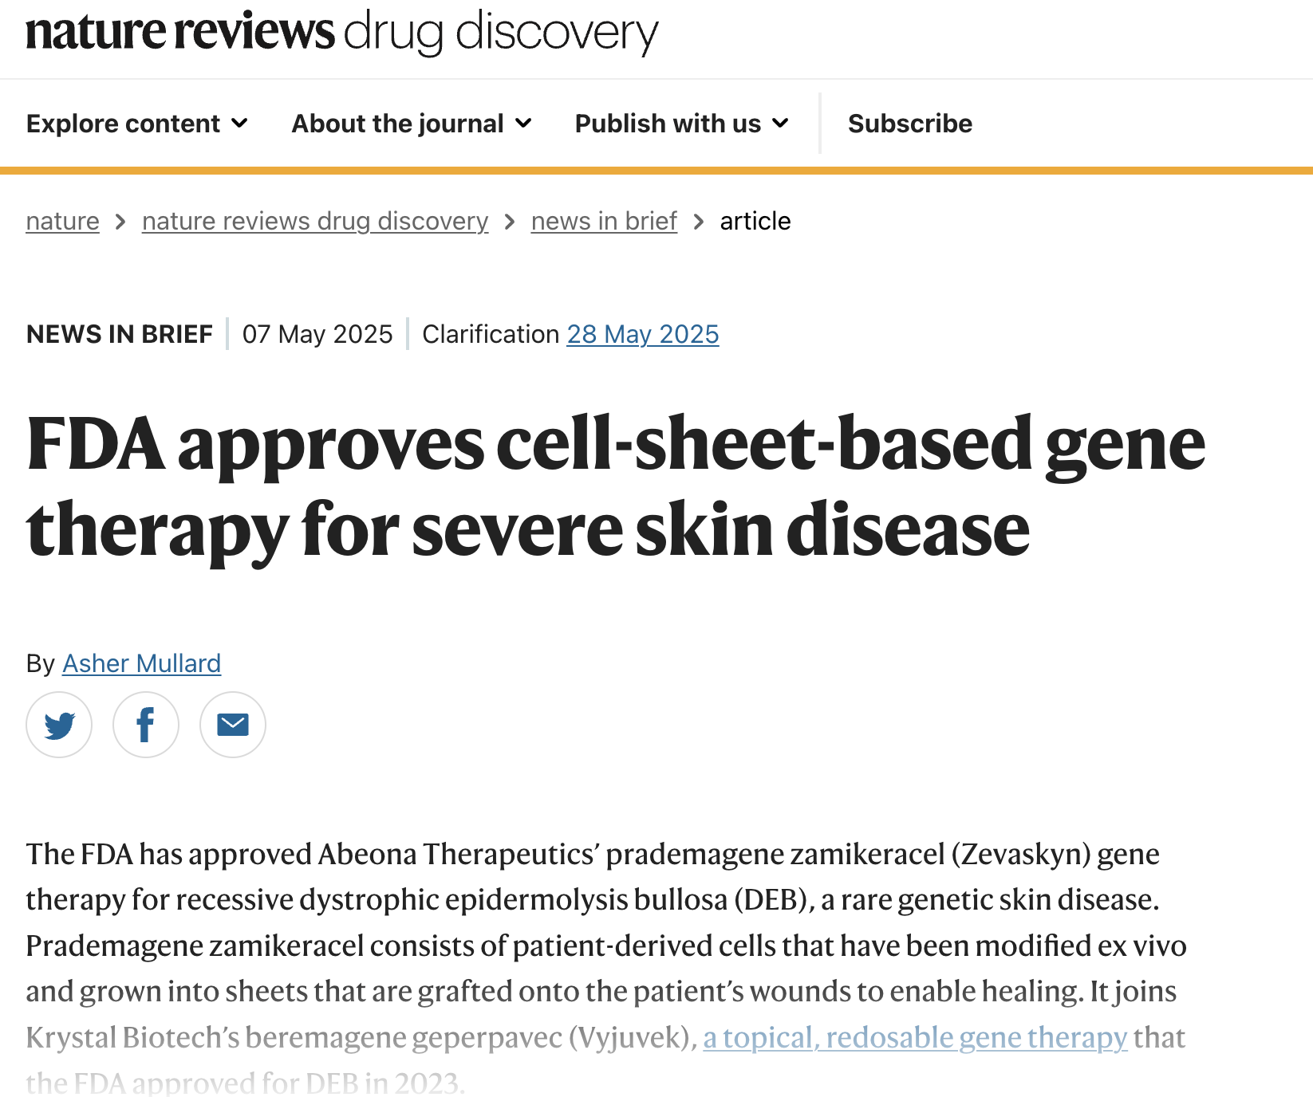

Slide 17
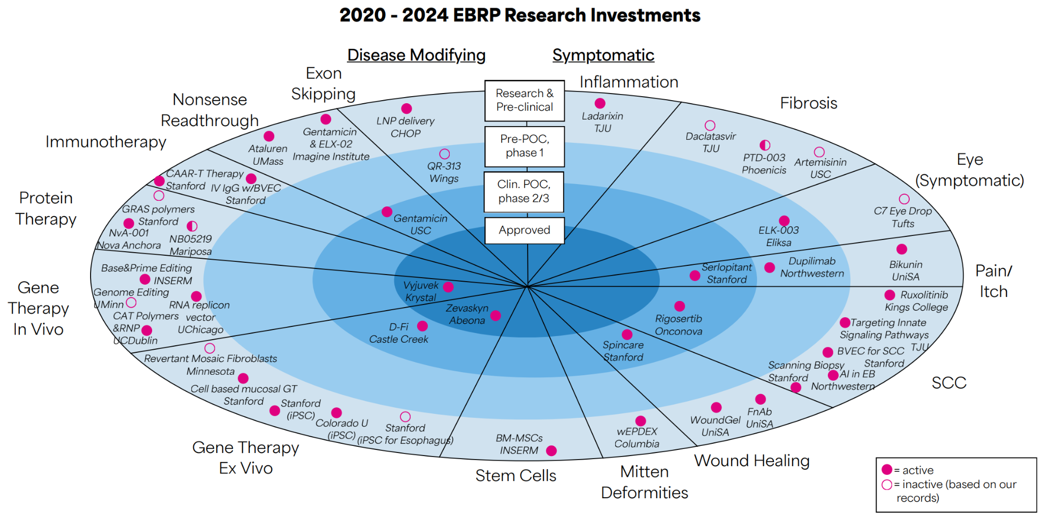
Diversified Investment Portfolio

Slide 18
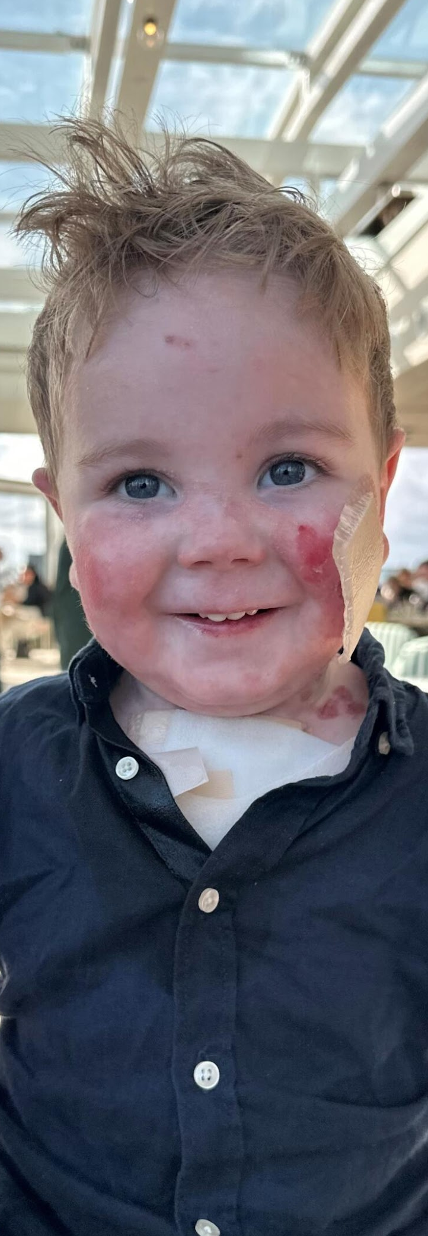
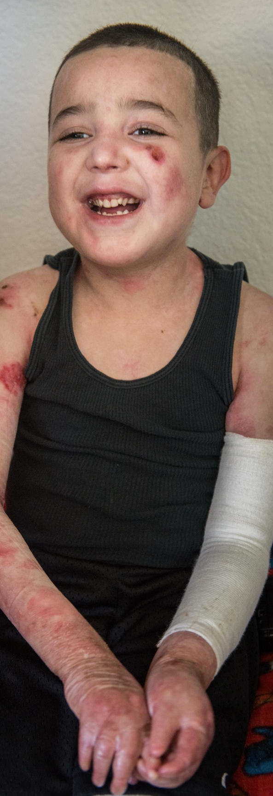
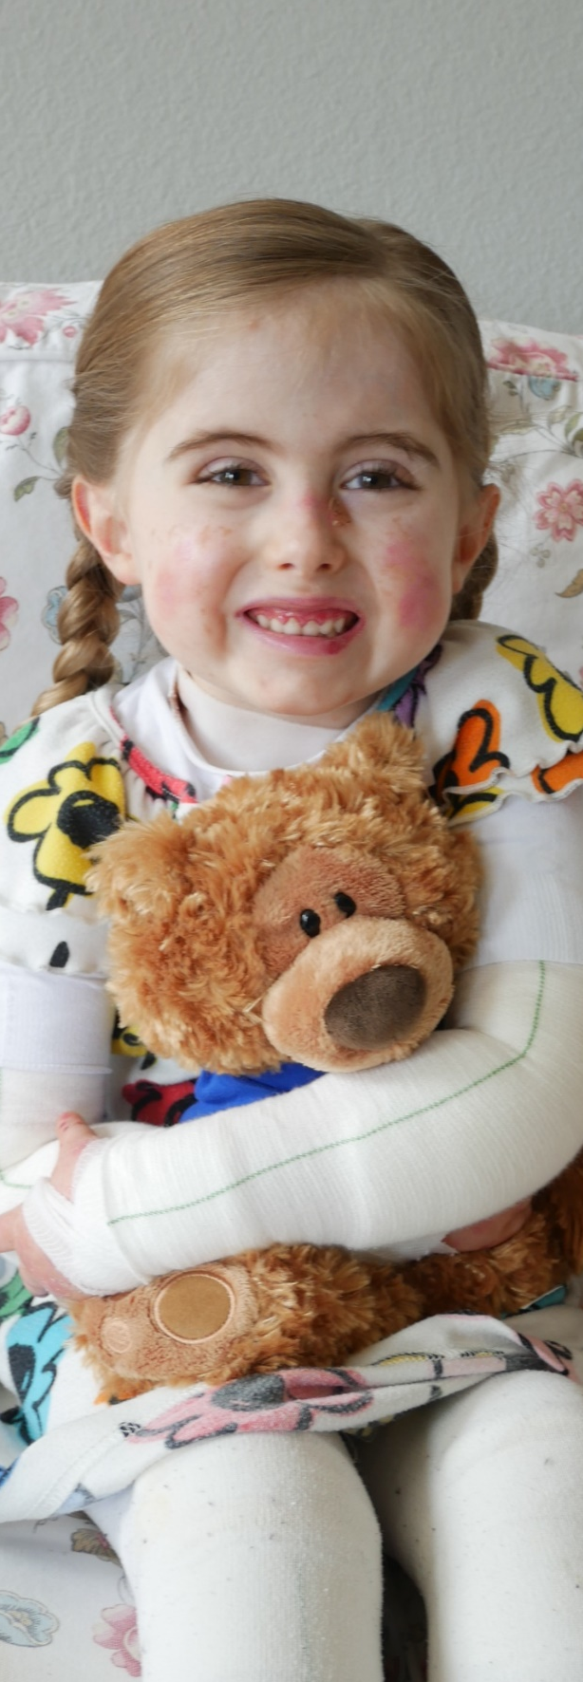



Slide 19


THANK YOU
MICHAEL HUND,MBA
ebresearch.org
@ebresearch

Slide 20
Thank You

Slide 21
Funding Rare Disease Research
Michael Hund, MBA
CEO, EB Research Partnership

Slide 22
Michael Hund, MBA
Chief Executive Officer
EB Research Partnership
NORD SCIENTIFIC SYMPOSIUM

Slide 25
2030
At EB Research Partnership,
our goal is to cure EB by
And we’re pioneering a
path for all rare disease
in the process.

Slide 26
Our Impact

Slide 27
Our Venture Into Cures Model
Data
Platforms
Medical
Infrastructure
Venture
Philanthropy

Slide 28
Venture Philanthropy Model

Slide 29
Source: MPO-Mag

Slide 34
Case Study: 6x Return on Investment
$3M
$500K
1
2
3
4
We fund a university to develop a treatment for severe EB that corrects gene mutations in skin cells under (1) Venture Philanthropy agreement.
A public biotech company uses that intellectual property to make a treatment, (2) we received stock in the company.
That (3) stock grew to be worth multiples beyond our original investment.
We sell our shares and direct that (4) revenue right back into research projects.

Slide 36
Diversified Investment Portfolio

Slide 38
THANK YOU
MICHAEL HUND,MBA
ebresearch.org
@ebresearch

Slide 39
Thank You

Slide 40
Funding Rare Disease Research
Matthew McCoy, PhD
University of Pennsylvania

Slide 41
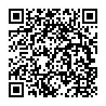


Ethics of Engagement in Patient-Focused Drug Development for Rare Diseases
(5R01HG014059-02 )
100+ interviews with stakeholders involved in developing therapies for rare diseases:
PAG leaders
Academic Investigators and Administrators
Professionals in the biotech and pharmaceutical industries
Public officials engaged in funding or regulating related research

Slide 42
“My families can't even afford basic necessities.”
For us to spend $150,000…what could that have been doing for patients’ care today, or for the patients that were born this year where we could have set them up. Where formula isn’t covered. For metabolic disorder, it’s constantly not covered…You think about these things, and, like, that was a waste of time and money.
– PAG leader

Slide 43
When we were fully focused on research, we got an open letter from members of the patient community who felt like we weren’t doing enough on patient services…[and] I think what we’ve come to realize is that patient services can’t be viewed as distinct from research.
– PAG leader
If you can end the disease, then you don’t need any of those other services. Stop the suffering, you know? Put ourselves out of business.
– PAG leader

Slide 44
Because of the handful of successes, the super low-hanging fruit…It feels like people think that gene therapy is easy now. We just need to raise the money to do it. That’s not the case. You know, I [work with] one foundation where they think they just need to raise a little bit more money to get a better mouse model, and they’ll have the gene therapy. That’s not the case. I mean, that’s like the 1% step that you need to take first.
– Academic investigator
“It’s still full of risk”

Slide 45
Just because something in an academic lab seems really promising doesn’t mean that someone’s going to pick it up. Doesn’t mean that a company’s willing to jump on board and invest in it.
– PAG leader
“It’s still full of risk”

Slide 46
If you lose control of that last leg of drug development, then I think we are constantly in the cycle of unaffordable drugs that’s only going to become more and more expensive, especially for rare diseases and fatal diseases. And even if you have a wonder drug, it’s not going to be accessible by most people, and that is a problem.
– Academic investigator
“No one can afford this”

Slide 47
We were assured that the pricing would be responsible and ethical. [But] the company was sold to the next company. All of those guarantees went out the window, and the drug became unobtainable, and insurance would not cover it. And so now we have an ethical dilemma. You have overpriced the product. Private insurance will not pay for it, and so families who were in the trial, helped get the drug FDA approved, now they’re priced out.
– PAG leader
“No one can afford this”

Slide 48
Thank You
mmcco@pennmedicine.upenn.edu
Study Interest Form

